Slide 1
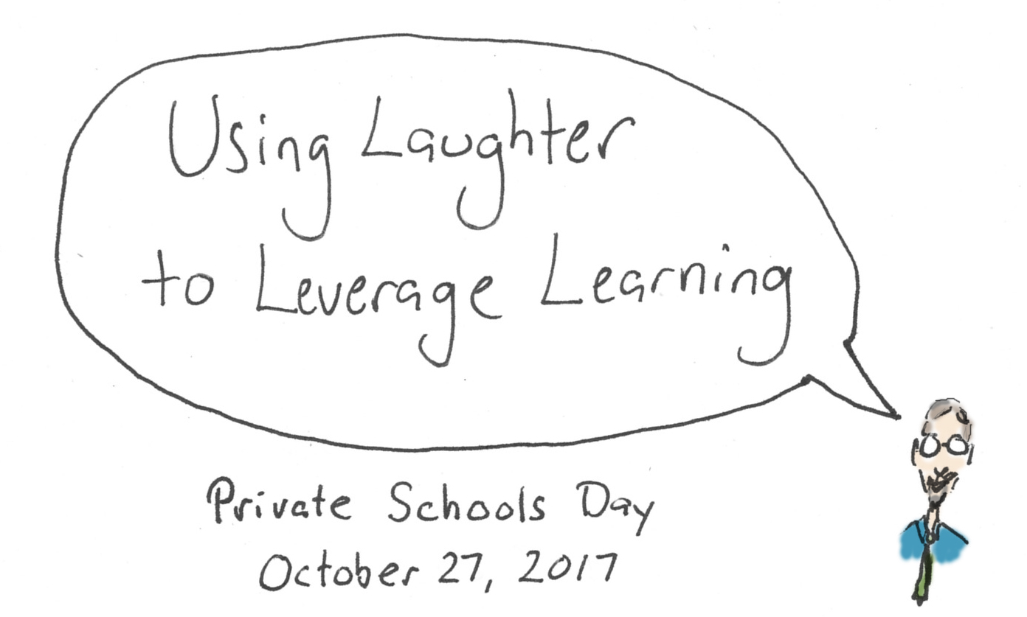

Slide 7
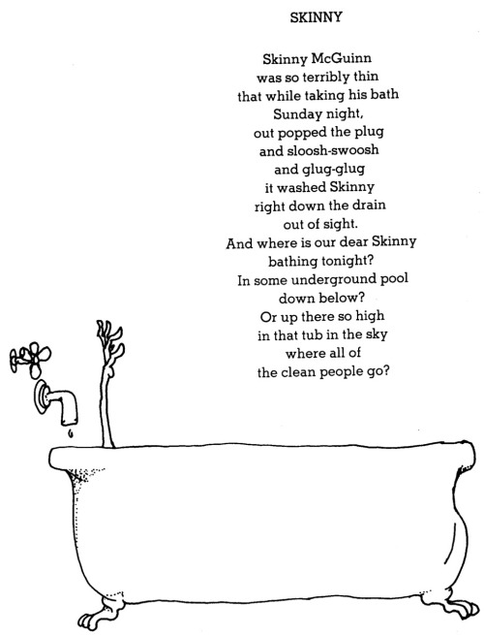

Slide 8
Notes:
http://www.quickmeme.com/p/3vz4me

Slide 9
Notes:
http://www.quickmeme.com/p/3vz4me

Slide 10
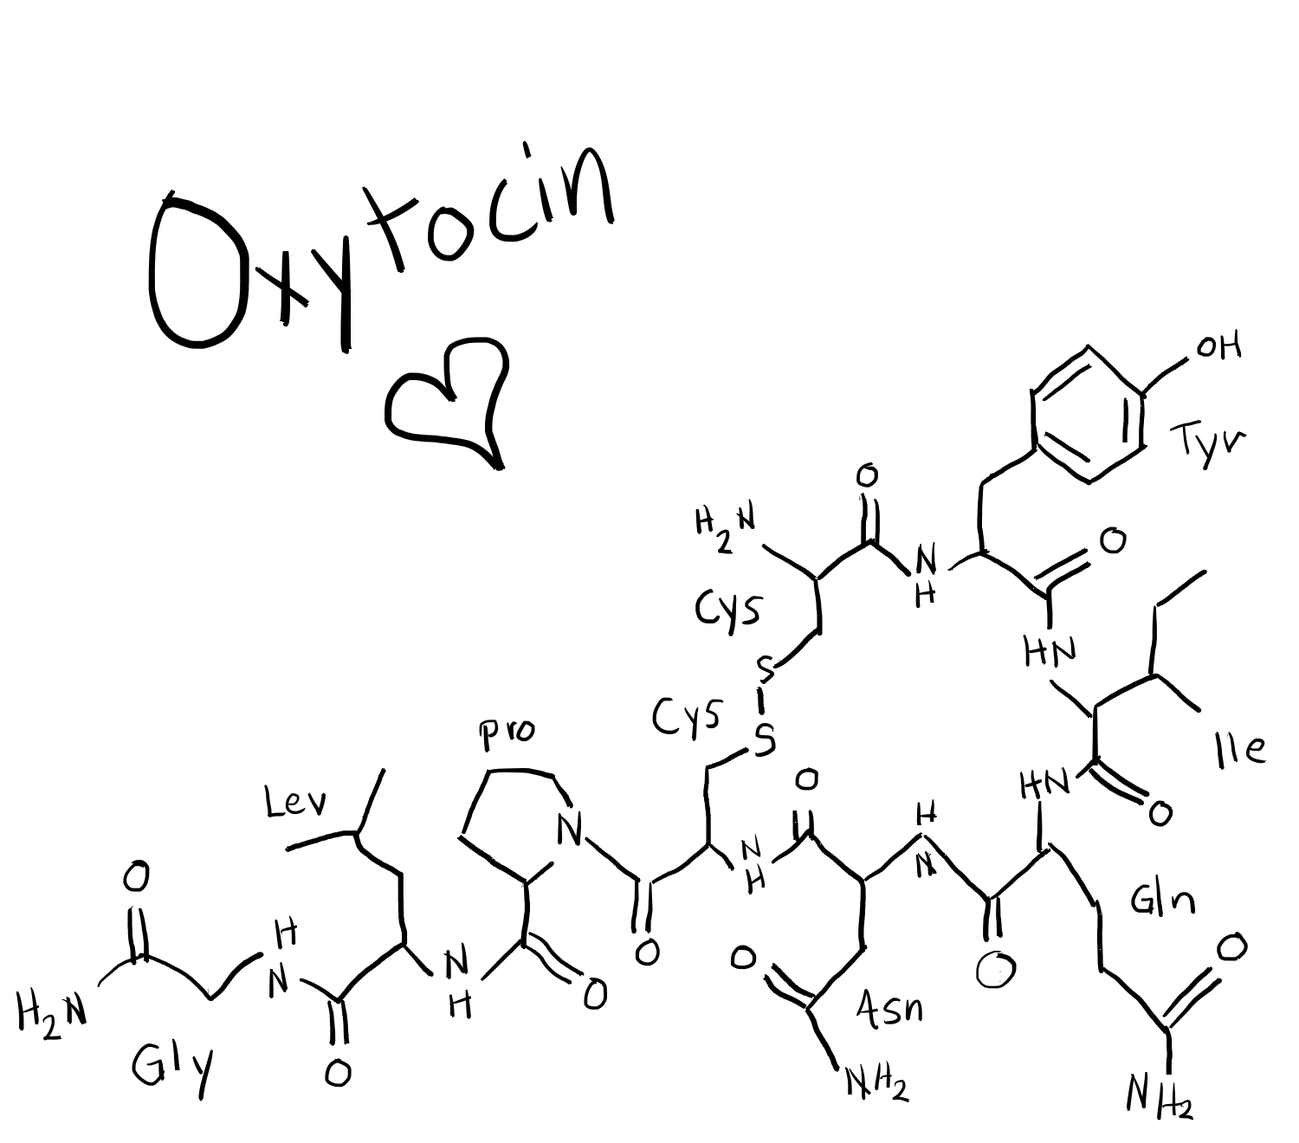

Slide 12
Notes:
http://www.quickmeme.com/meme/3t46wp

Slide 15
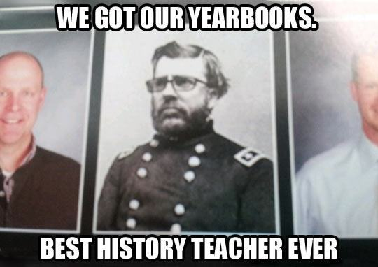

Slide 18
Notes:
Message: I know this is hard stuff, and I am not heartless about it.

Slide 25
Notes:
Image: http://www.sharpeslawn.com/our-products-toro-bobcat-stihl-mowers-trimmers-blowers/stihl/stihl-rescue-chain-saw/ms-460-rescue-chain-saw-with-depth-limiter/
https://www.fastcompany.com/3016628/leatherface-from-chainsaw-massacre-takes-us-back-to-that-sweltering-smelly-house-of-horror

Slide 30
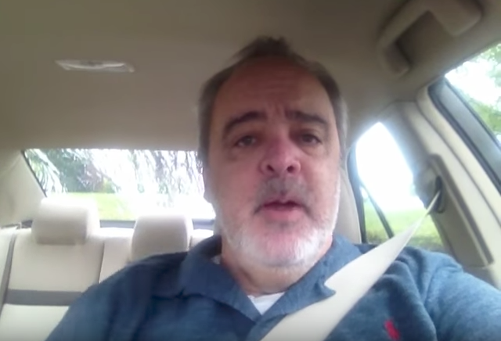
Notes:
https://www.youtube.com/watch?v=IglhSNNk7Qk

Slide 31
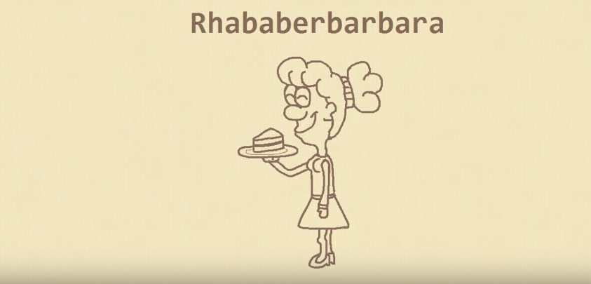

Slide 32
Resources
Funny teacher images - http://www.cleverpedia.com/teachers-meet-new-levels-awesome/
Make your own memes - https://bighugelabs.com/ , https://memegenerator.net
Rhubarb Barbara video - https://www.youtube.com/watch?v=gG62zay3kck
John Cleese Brain Video - https://www.youtube.com/watch?v=ByF6Vg-KoGw
Presentation file and other resources – www.mcquinnable.com

