Slide 1
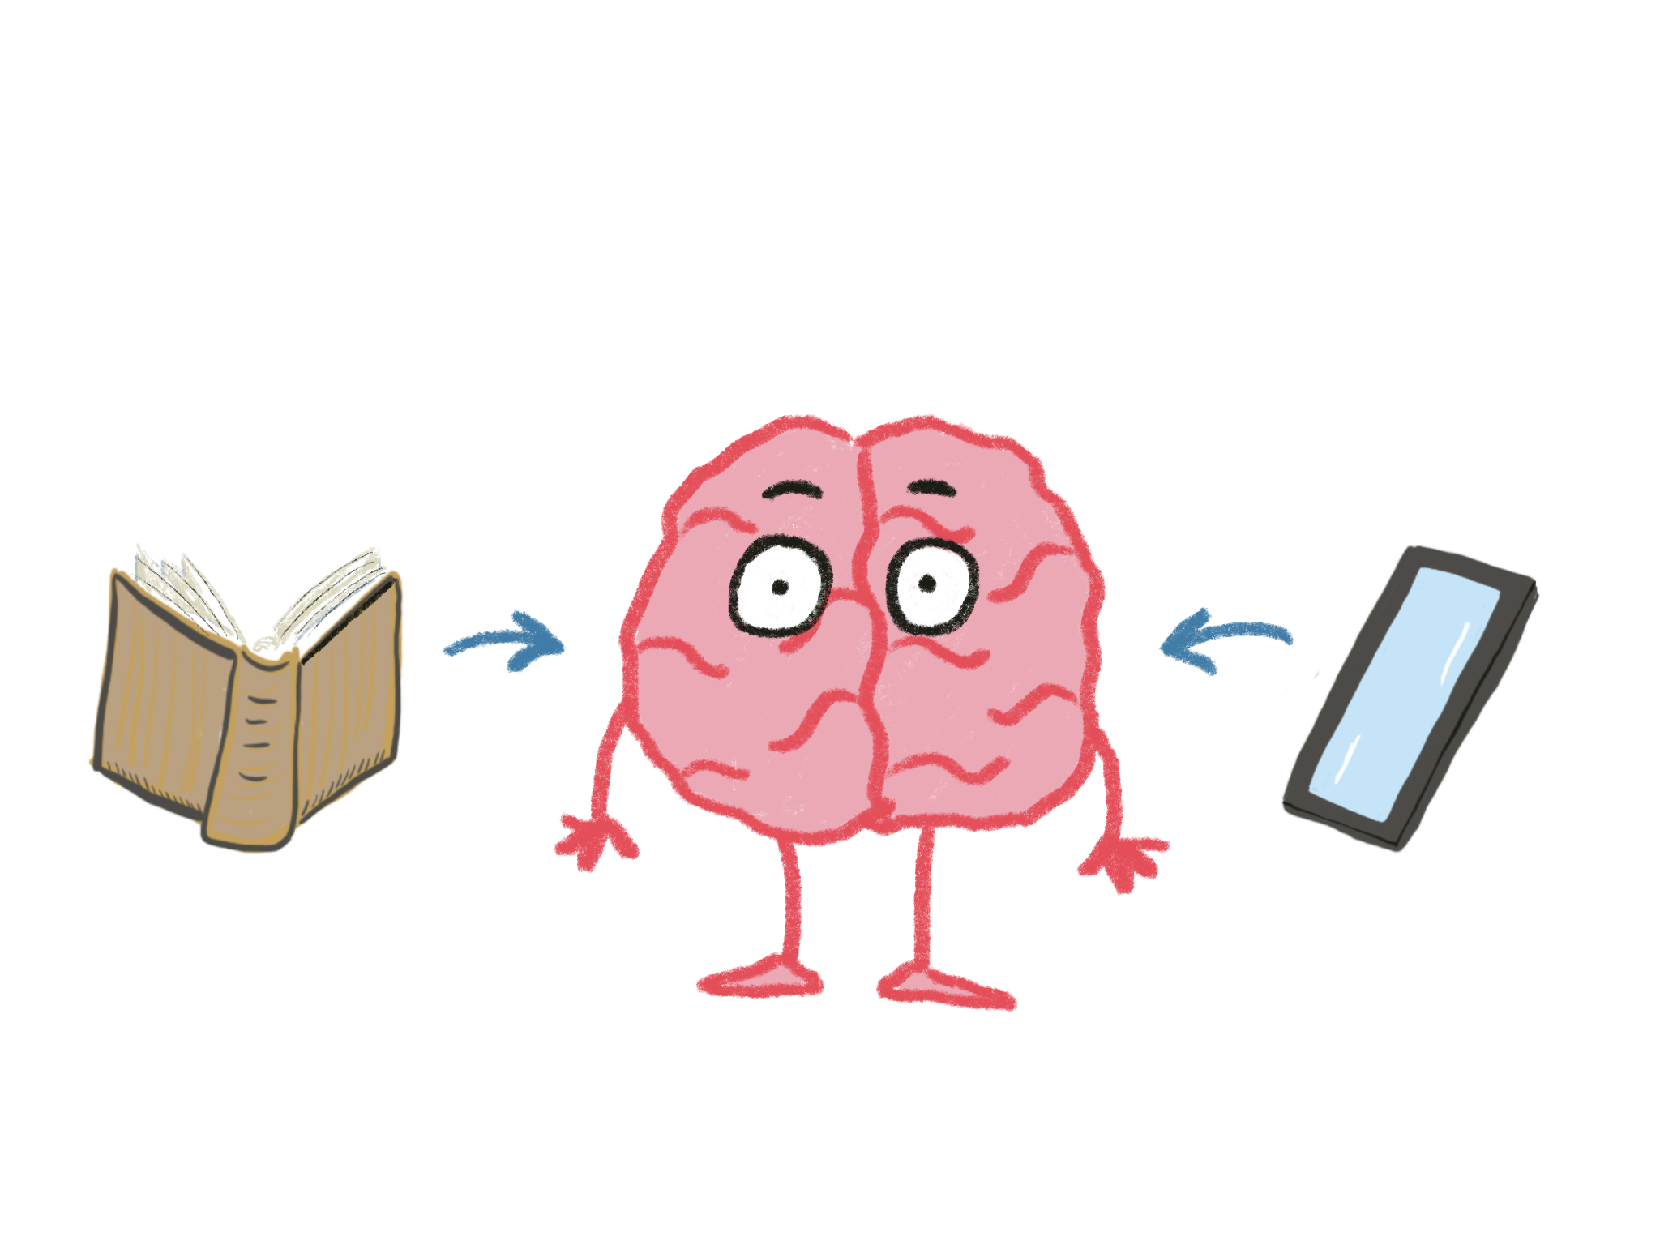
Mind Melds
How Stories and Technology
Change Our Brains
Conn McQuinn – NCCE 2023

Slide 2
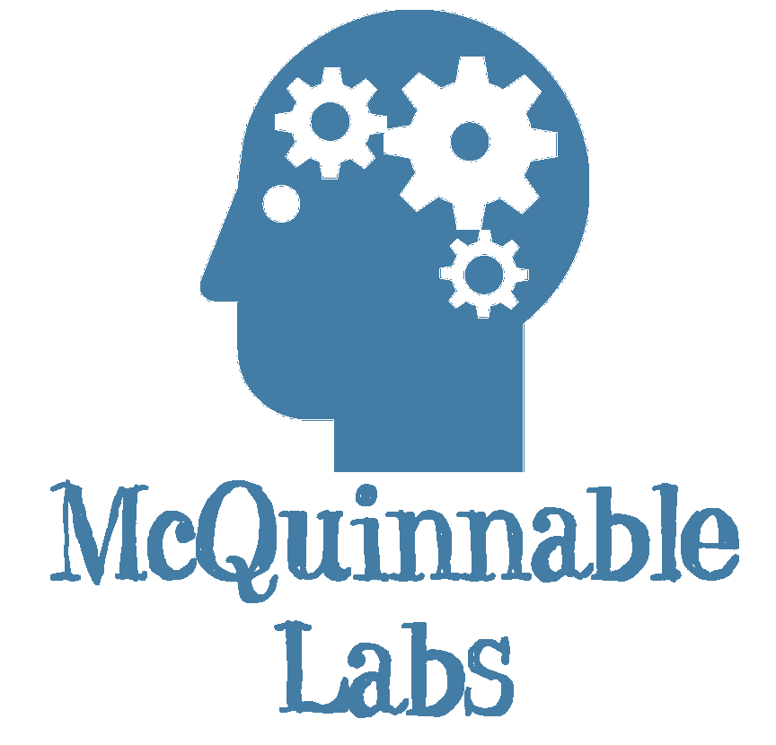
Introduction

Slide 3
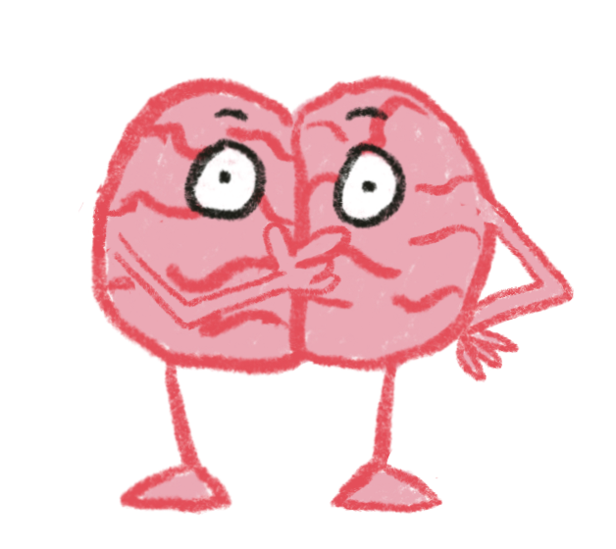
Write down what you already know about stories and their impact on our brains, and what you hope to learn.

Slide 4
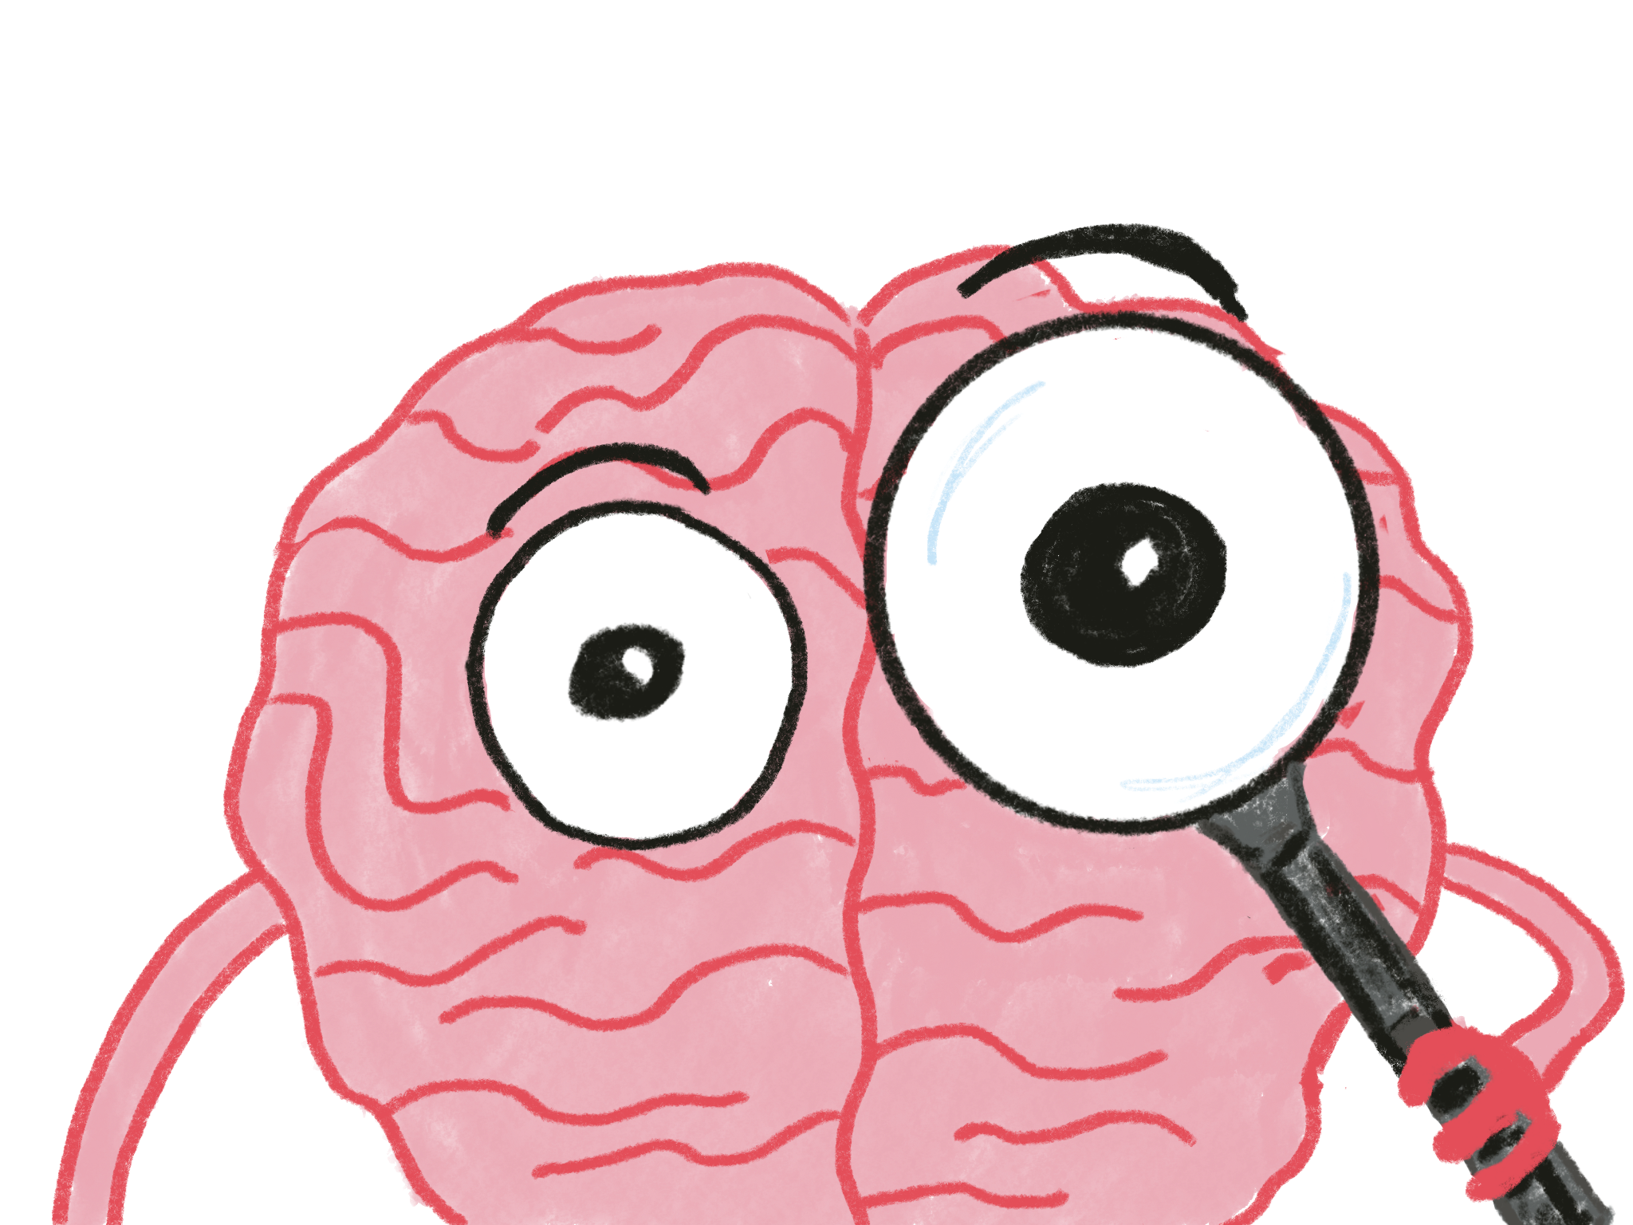
Notes:
My goal for this presentation is to give you a lens that will help provide some additional insight into your learning environment, and help provide a different way of thinking about the role of technology in it.

Slide 5
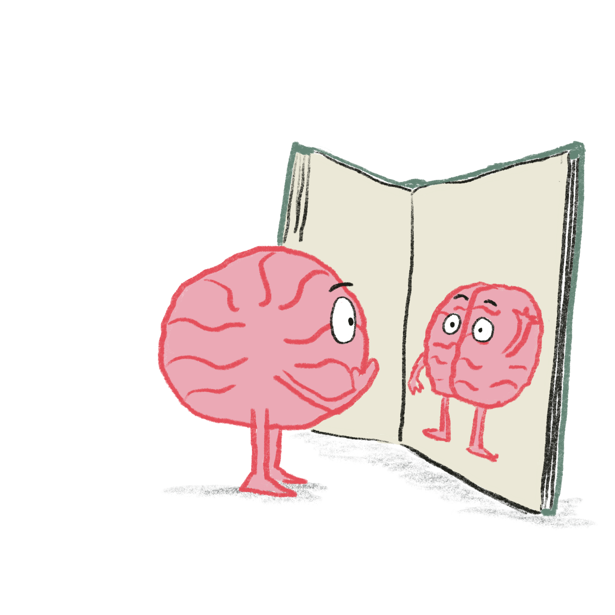
Stories are both a reflection of how our brains work and a powerful influence on how we think
Enduring Understanding 1

Slide 6
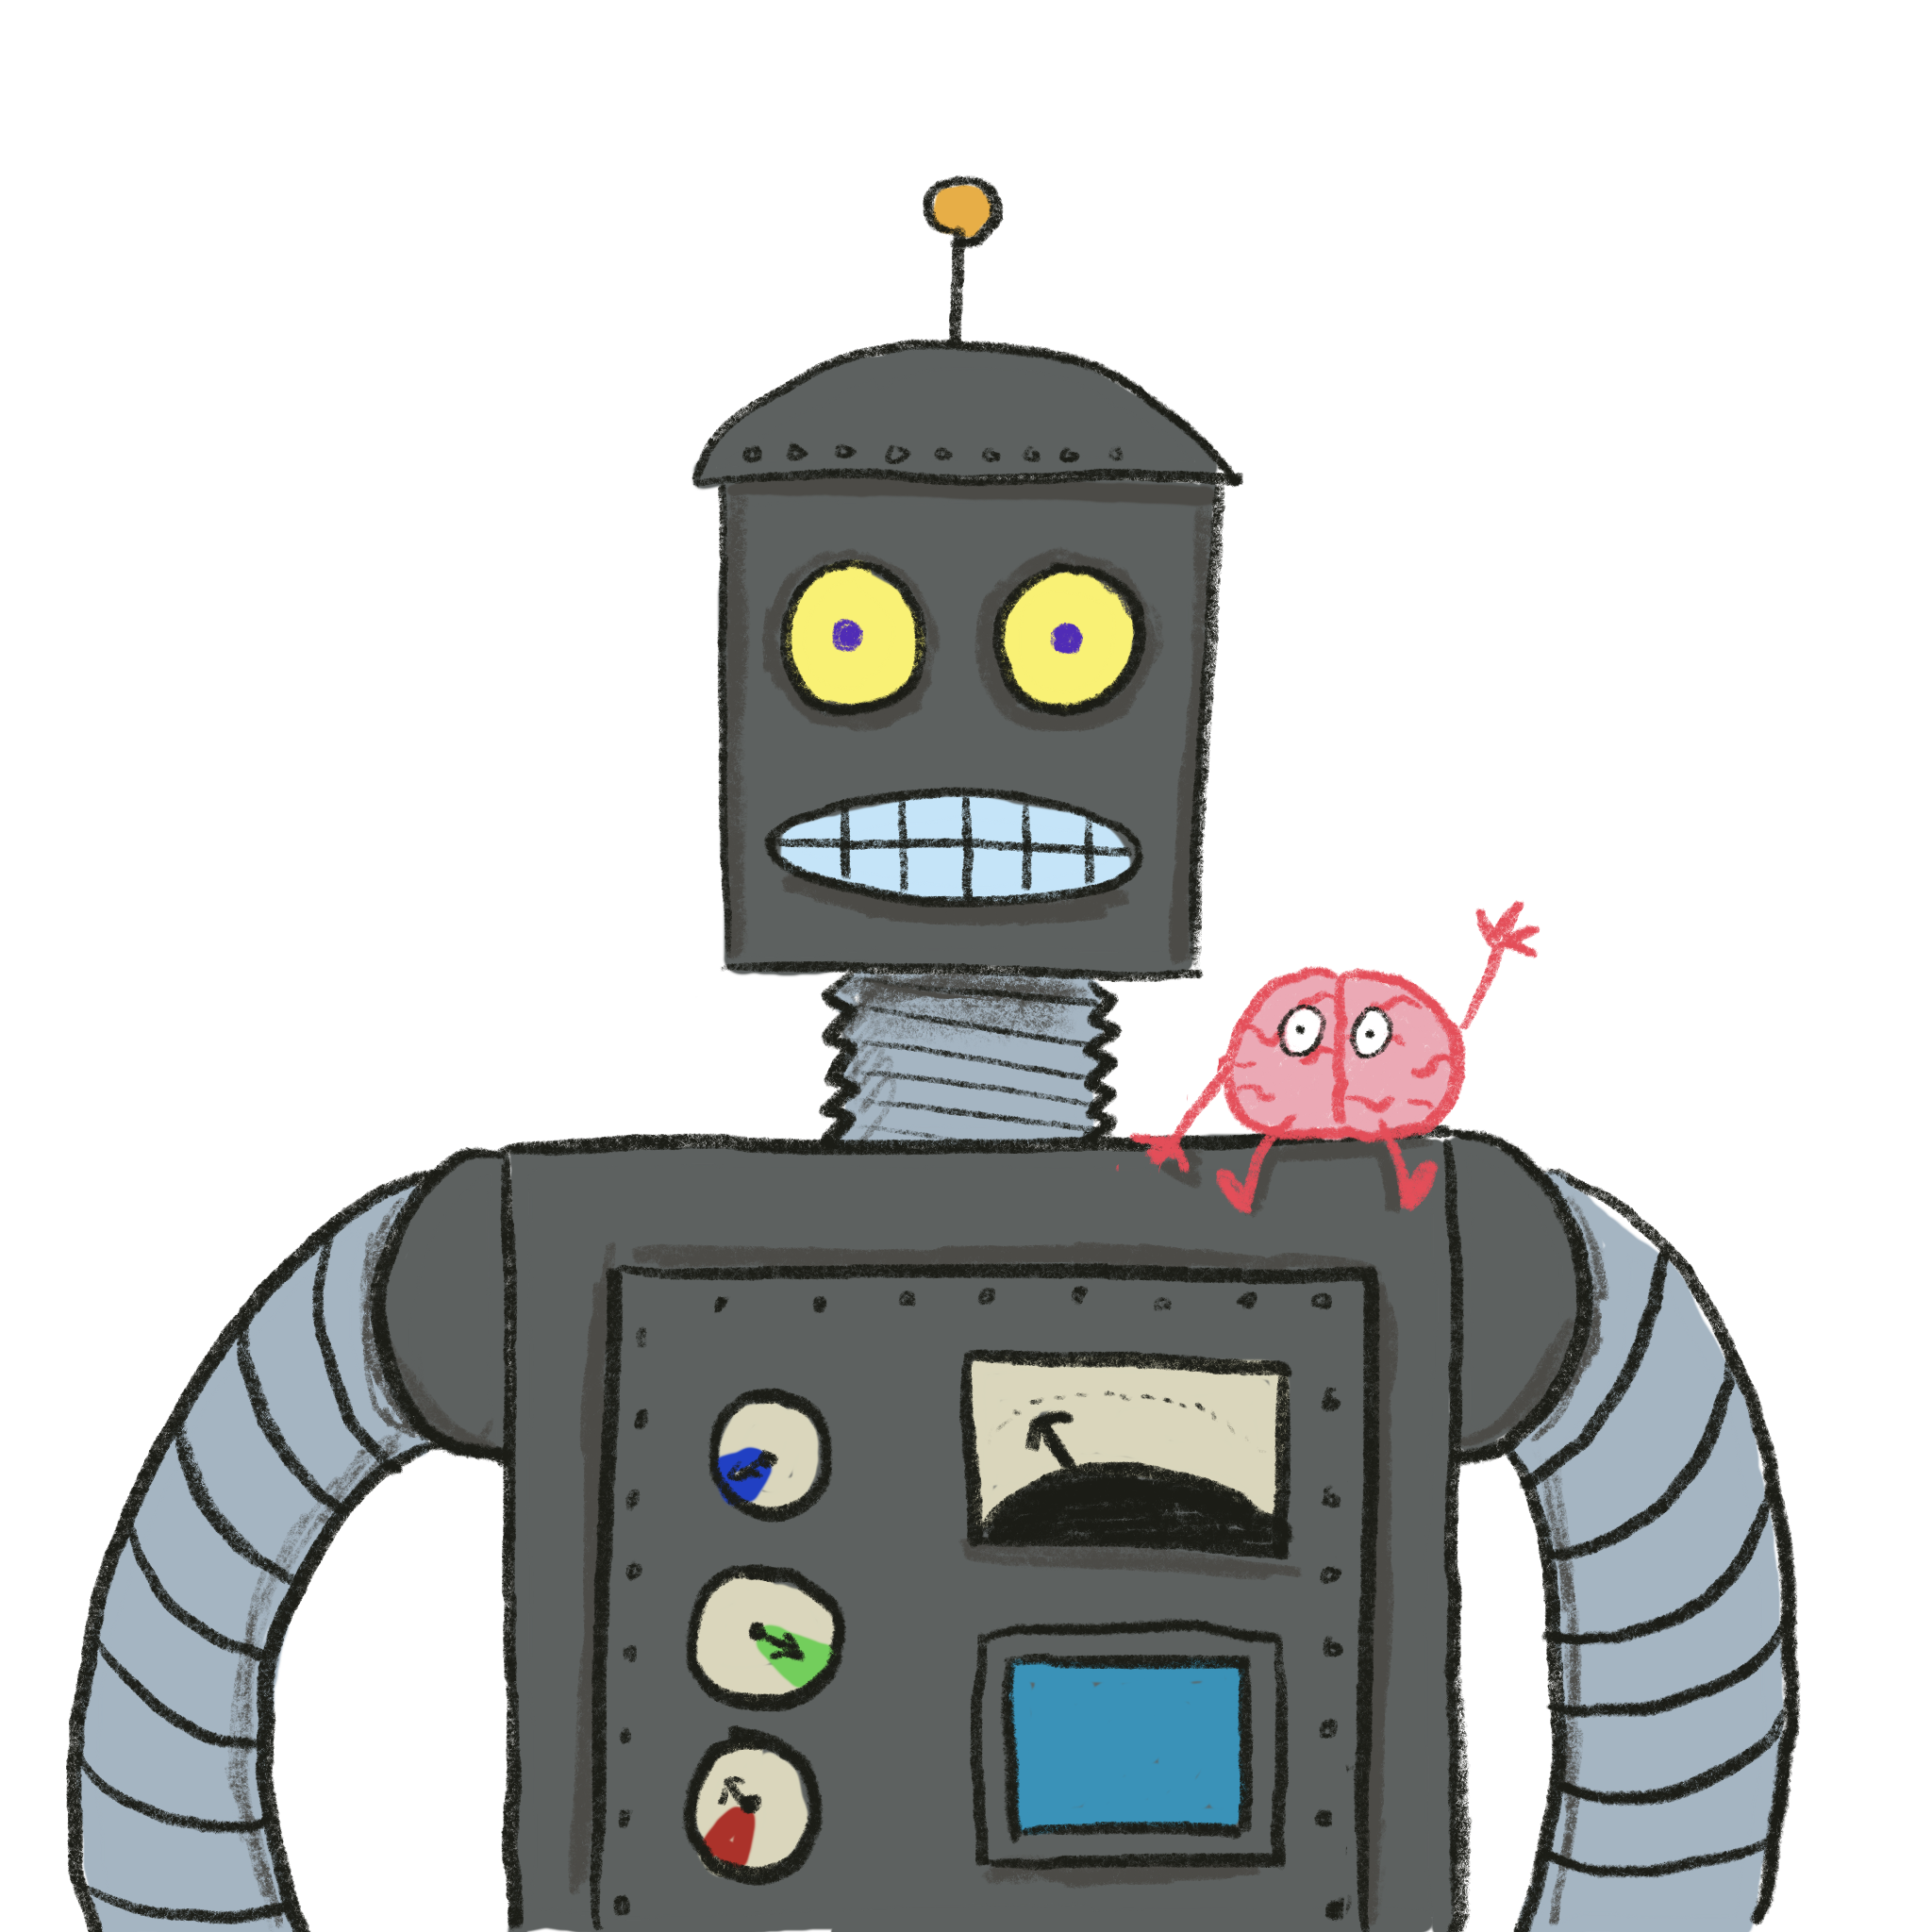
Enduring Understanding 2
Technology has a powerful impact on our stories

Slide 7
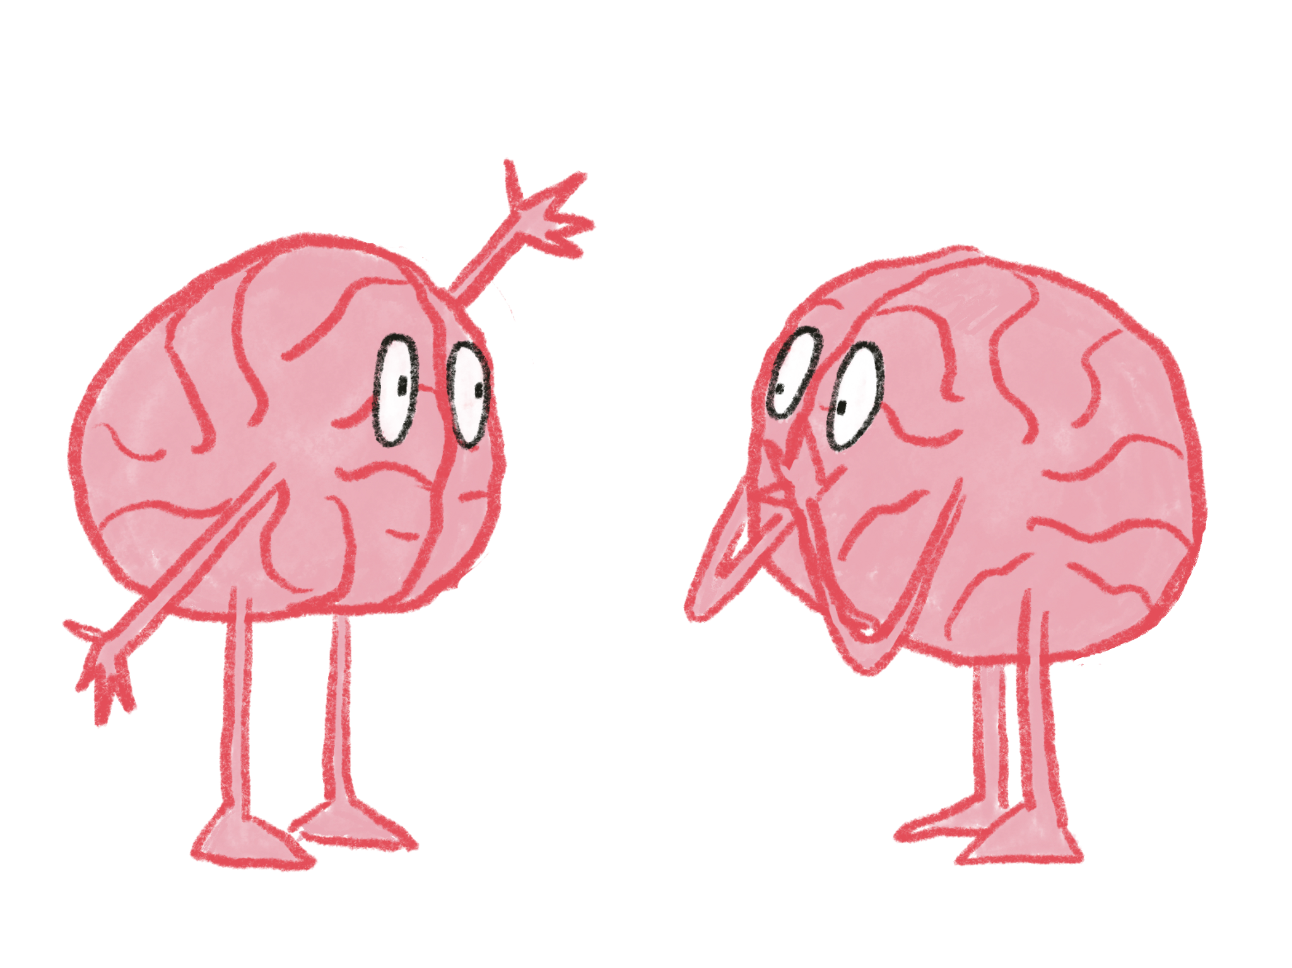
Notes:
Stories are central to human existence. What do we do when we visit friends and family? Tell stories. What do we do when we mail, email, text, or talk on the phone? Exchange stories. We discuss our favorite TV shows, books, and movies – which are stories.

Slide 8
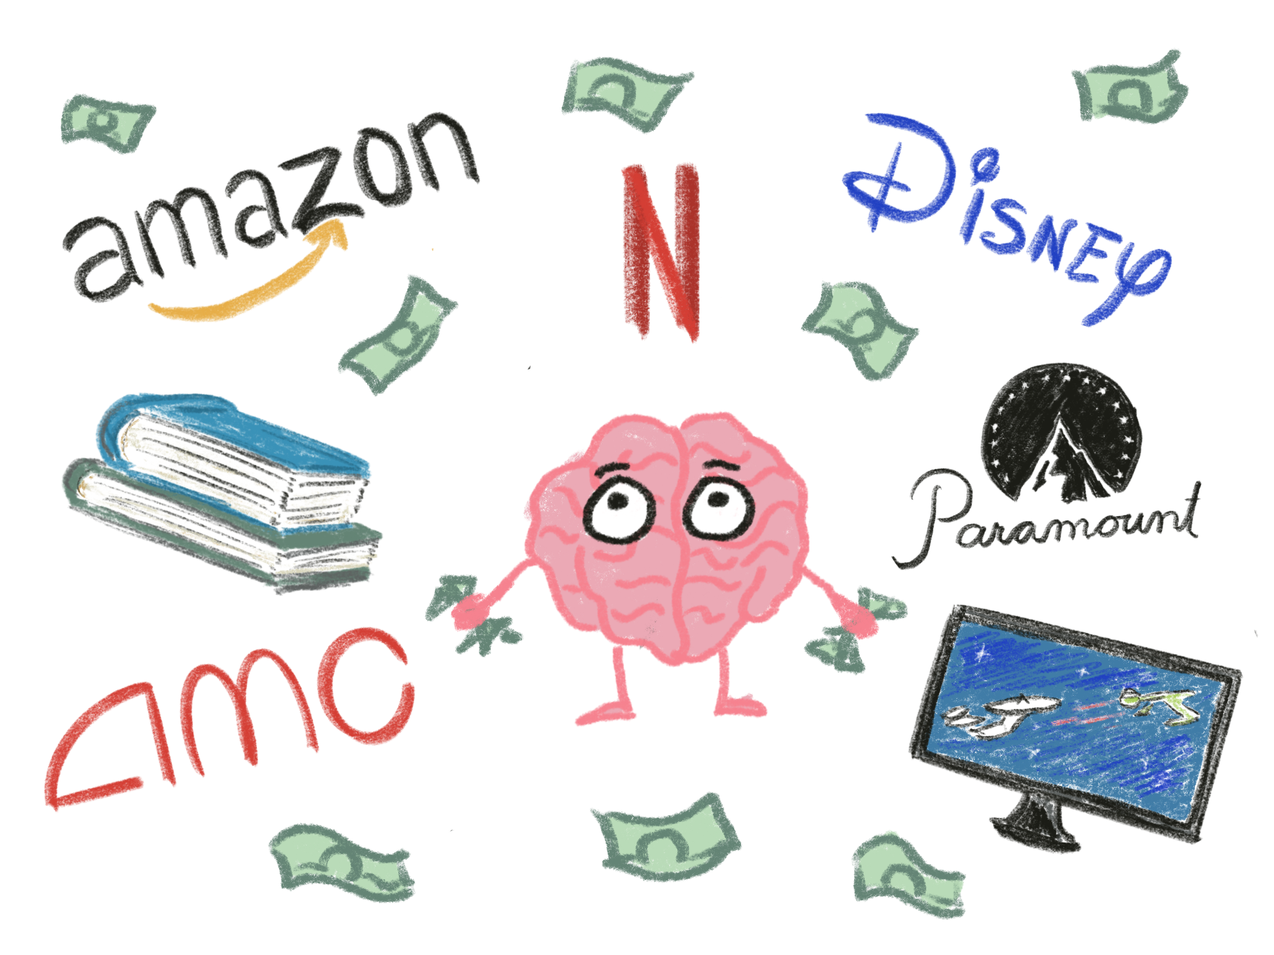
Notes:
We are immersed in stories. Many of the largest, most profitable industries in the world are about stories – movies, television, books, podcasts, plays. We read stories online. When we get together with family and friends, we exchange stories, sometimes about other stories – our favorite books, movies, and television shows.
Throughout history many of the most respected and honored individuals were storytellers What we know about any other historical figures is because of storytellers!
We are all driven to seek, consume, and create stories. It’s because we are wired for them.

Slide 9
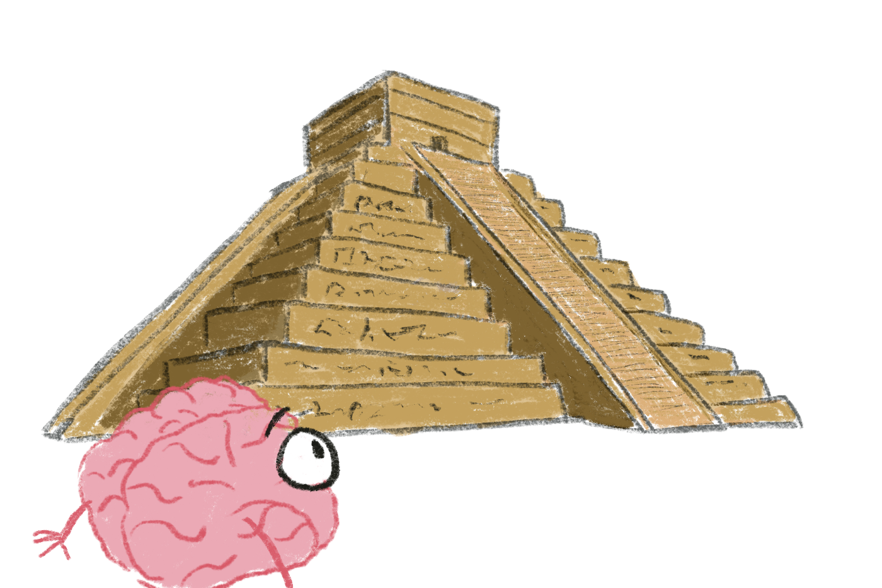
There have been great societies that did not use the wheel.
There have been no societies that did not tell stories.
Ursula K. Le Guin
Notes:
This quote from Ursula K. Le Guin captures how deeply universal stories and storytelling is. It’s also a big blinking neon sign to a neuroscientist – it indicates that the drive to create and consume stories is integral to brain function. For a long time we looked at tool use as the defining characteristic of being human, but more and more researchers are realizing that storytelling is what sets us apart from all other creatures..

Slide 10
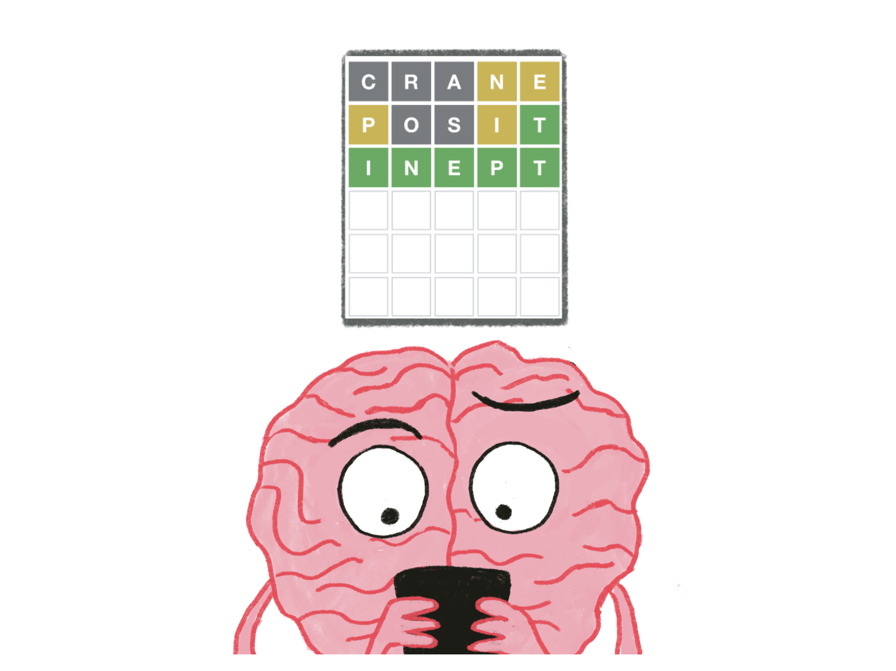
Notes:
Stories are an extension of the brain’s focus on identifying patterns. Our brains our pattern-seeking missiles. It’s why we love puzzles and mysteries Wordle. Recognizing patterns gives us tools to plan, tackle challenges, and in general just survive.
Stories are sophisticated patterns that have emotional meaning. They are patterns that help us understand our own identities, how we relate to others, and how to make sense of our lives.

Slide 11
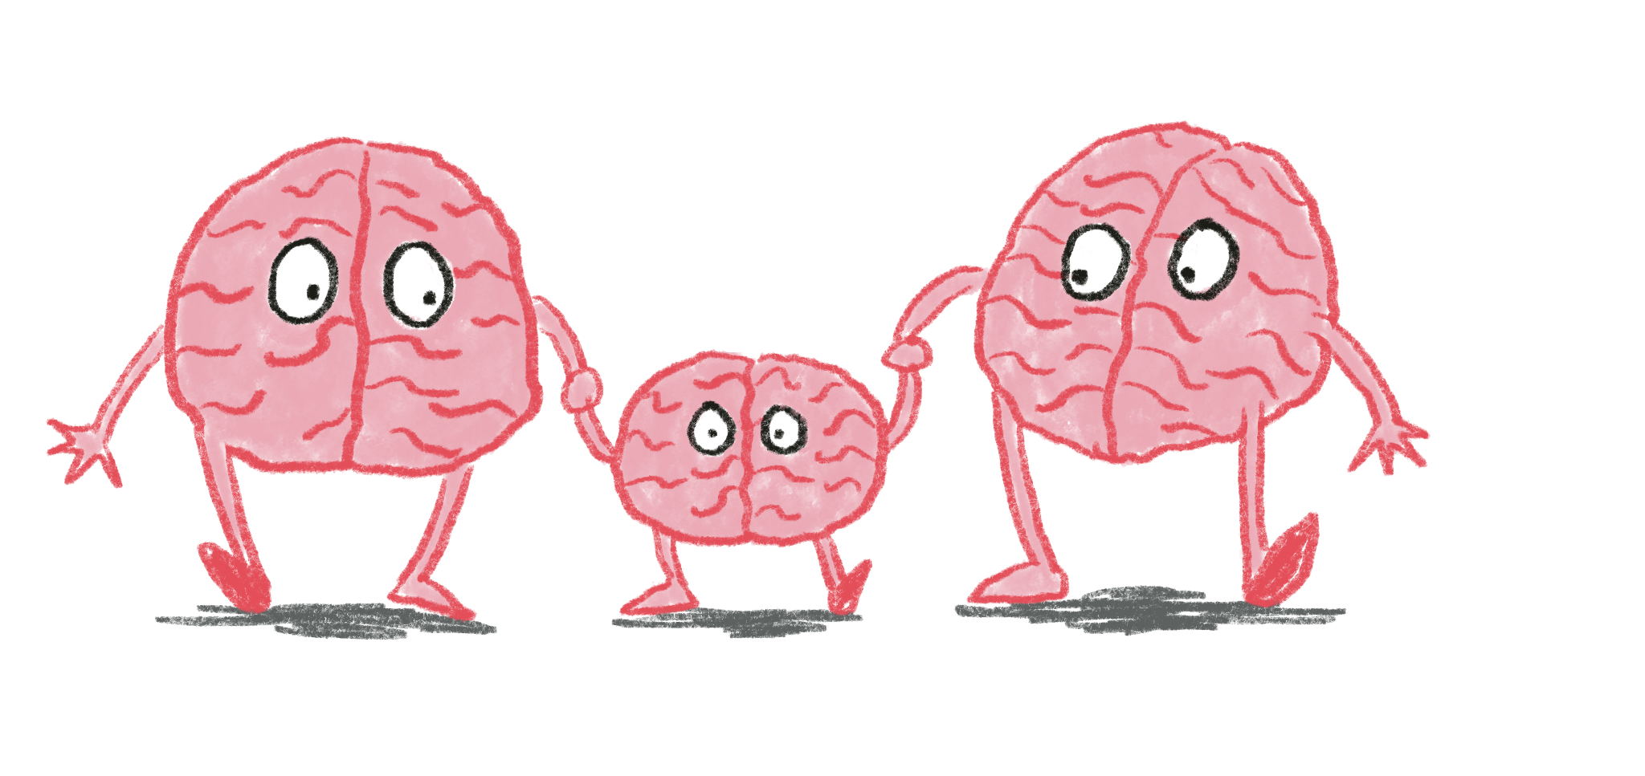
Notes:
At the beginning of our life, we build up a library of experiences and interactions with other people that form out first stories. Very early on, however, we also begin to be told stories by others – listening to family stories, having books read to us, television, and so many others. The drive for consuming stories is something every caregiver is familiar with – “Read me a story!” or “Tell me the story of when you did that embarrassing thing!” or the ever-present “Why?” That’s not a request for a specific piece of information, it’s a request for a story that makes sense.

Slide 12
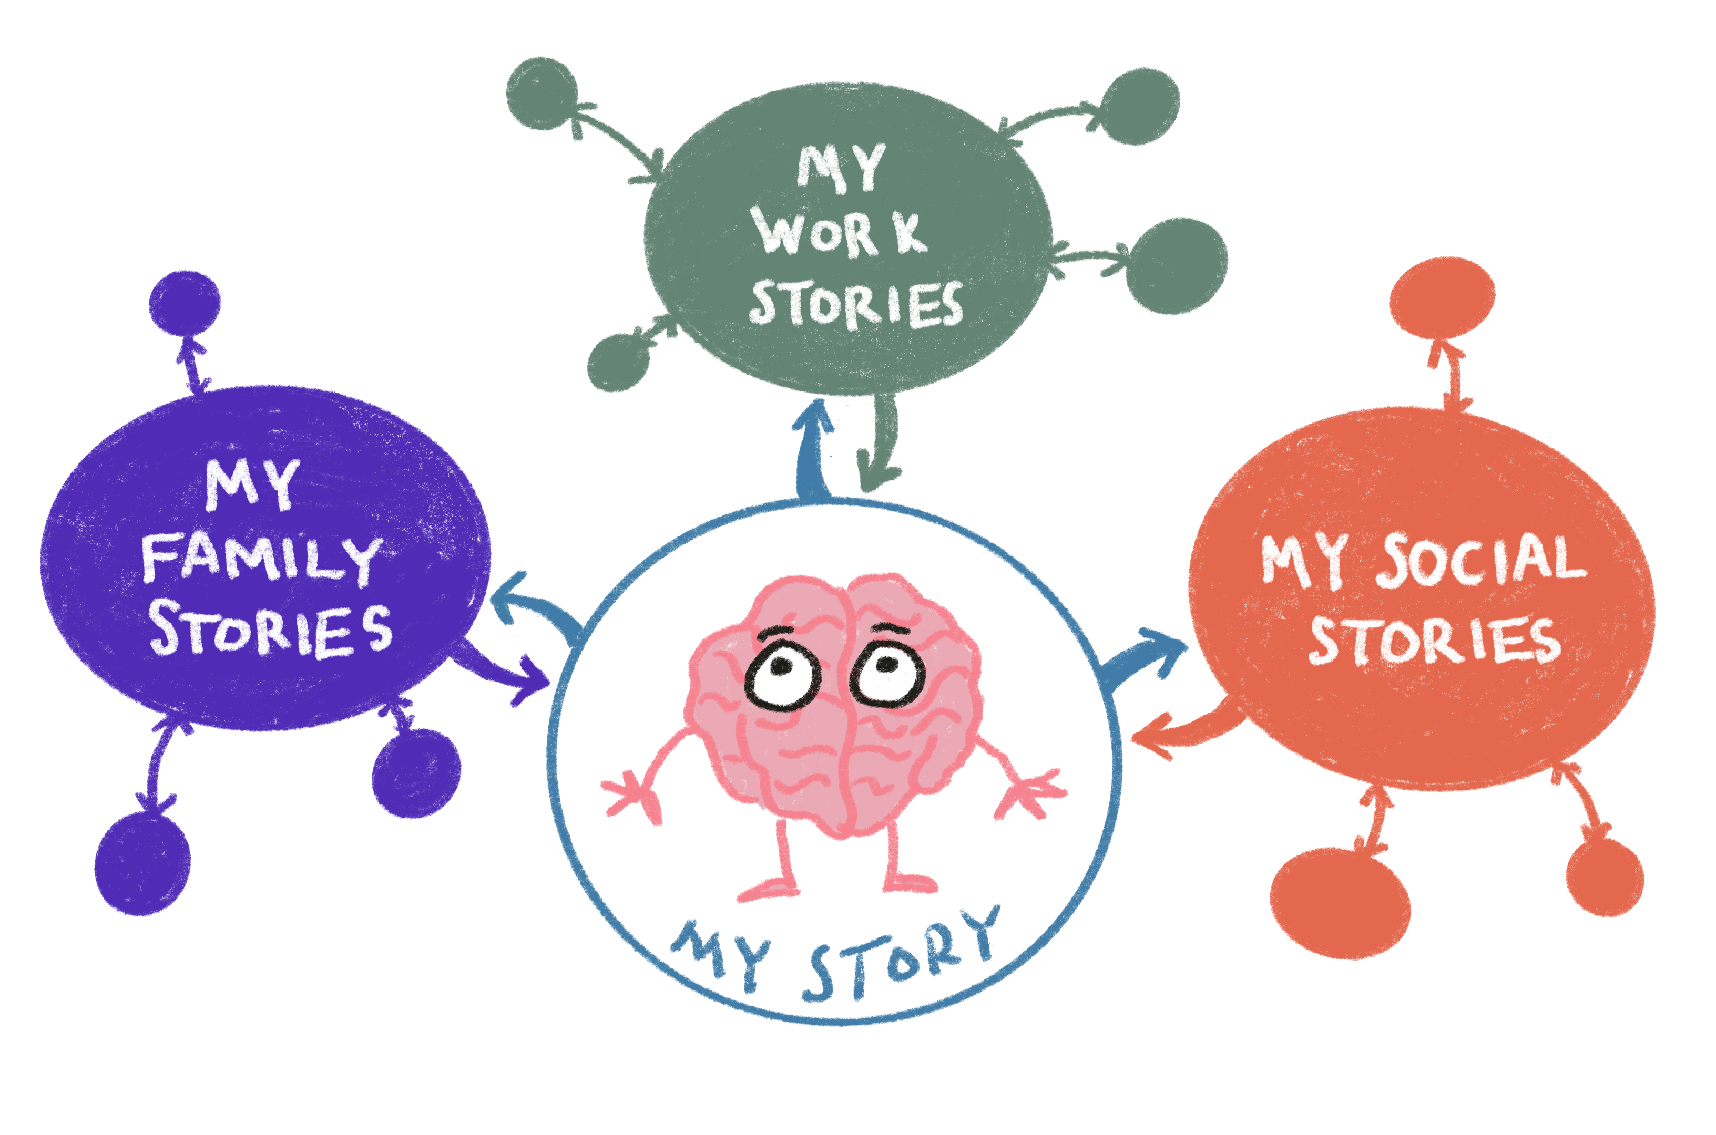
Notes:
And actually, the proper term is stories. We are made up of many interconnected stories. Every new setting or context we enter, we start generating new stories that reflect what we see, hear, and experience in that setting. These stories interact very powerfully, but they can also be different from each other. Your “family” story may define who you are in a very different way than your “work” story might. Your students’ “School” story may be very different than their “Home” story or their social identity.
The most important thing to remember is that we work really hard to make the stories coherent. It’s really important to us.
A

Slide 13
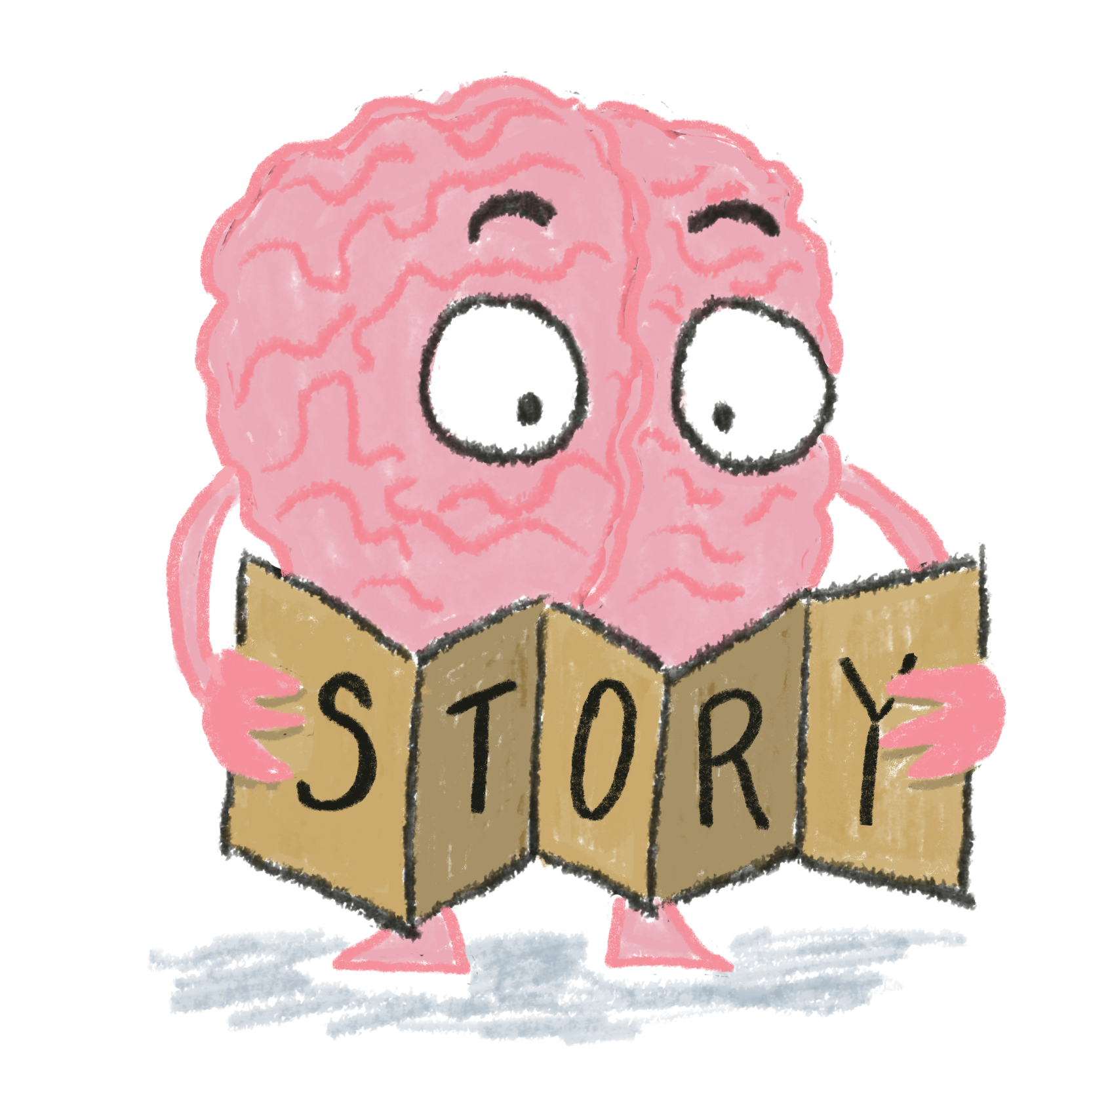
Notes:
The story in our mind guides us. It’s like a map that helps us make sense of the past, understand how to act in the present, and how to prepare for the future.
And like any story, it reflects values and beliefs. It tells us what is important, how to behave in a situation, and how to interact with others.

Slide 14
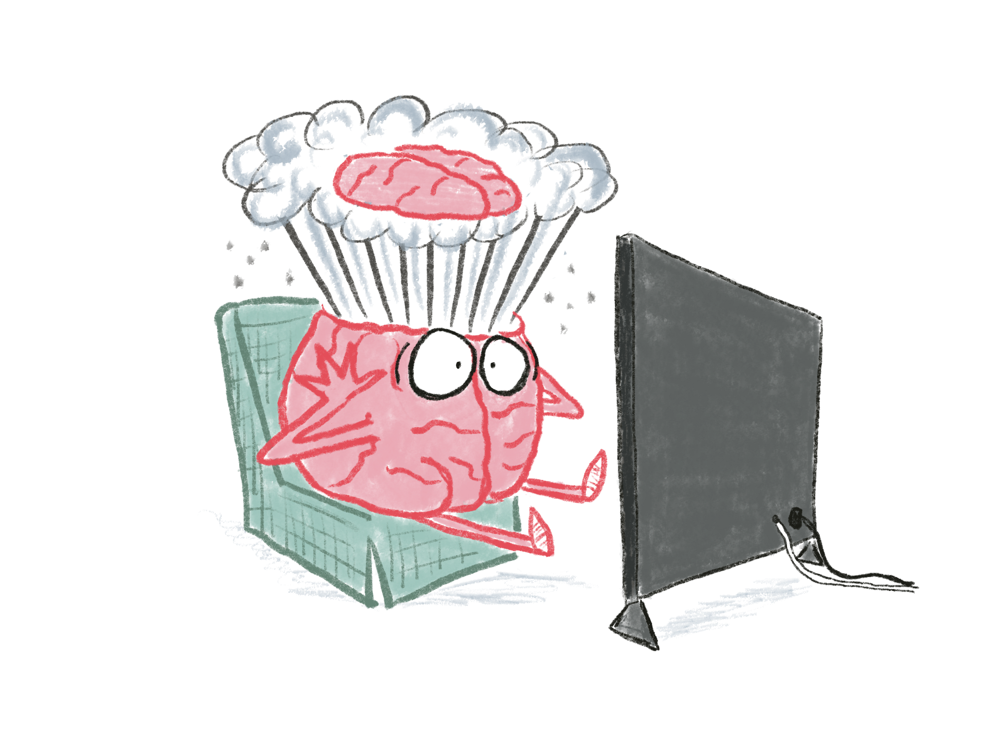
February 1, 2015
“Intercepted at the goal line by Malcom Butler!”
Notes:
Another strong indication of how important our stories are to us is the strong reaction we have when things don’t happen the way our internal stories tell us they should. Who recognizes the date of February 1, 2015, for the shared Seattle emotional scar that it is?
Yes, it’s the day that the Seahawks lost to the Patriots in the Super Bowl. That’s not the way the stories in our collective minds anticipated it ending. We believed without doubt at that moment at the goal line that the Seahawks were going to pull off an amazing victory. It was absolutely stunning when that interception was thrown.
And not just for us. In a recent article in the Seattle Times, Richard Sherman and Marshawn Lynch were interviewed about the game, and both said the decision to throw the ball rather than running it broke the team. Not because of how it turned out, but because to them it violated their idea of who the Seahawks were, a straight-through-the-middle smash-mouth team. They felt that Carroll had violated their shared narrative, and he never acknowledged that.
Whether it’s true or not, the point remains – things did not turn out as our internal story expected, and it was terribly upsetting.

Slide 15
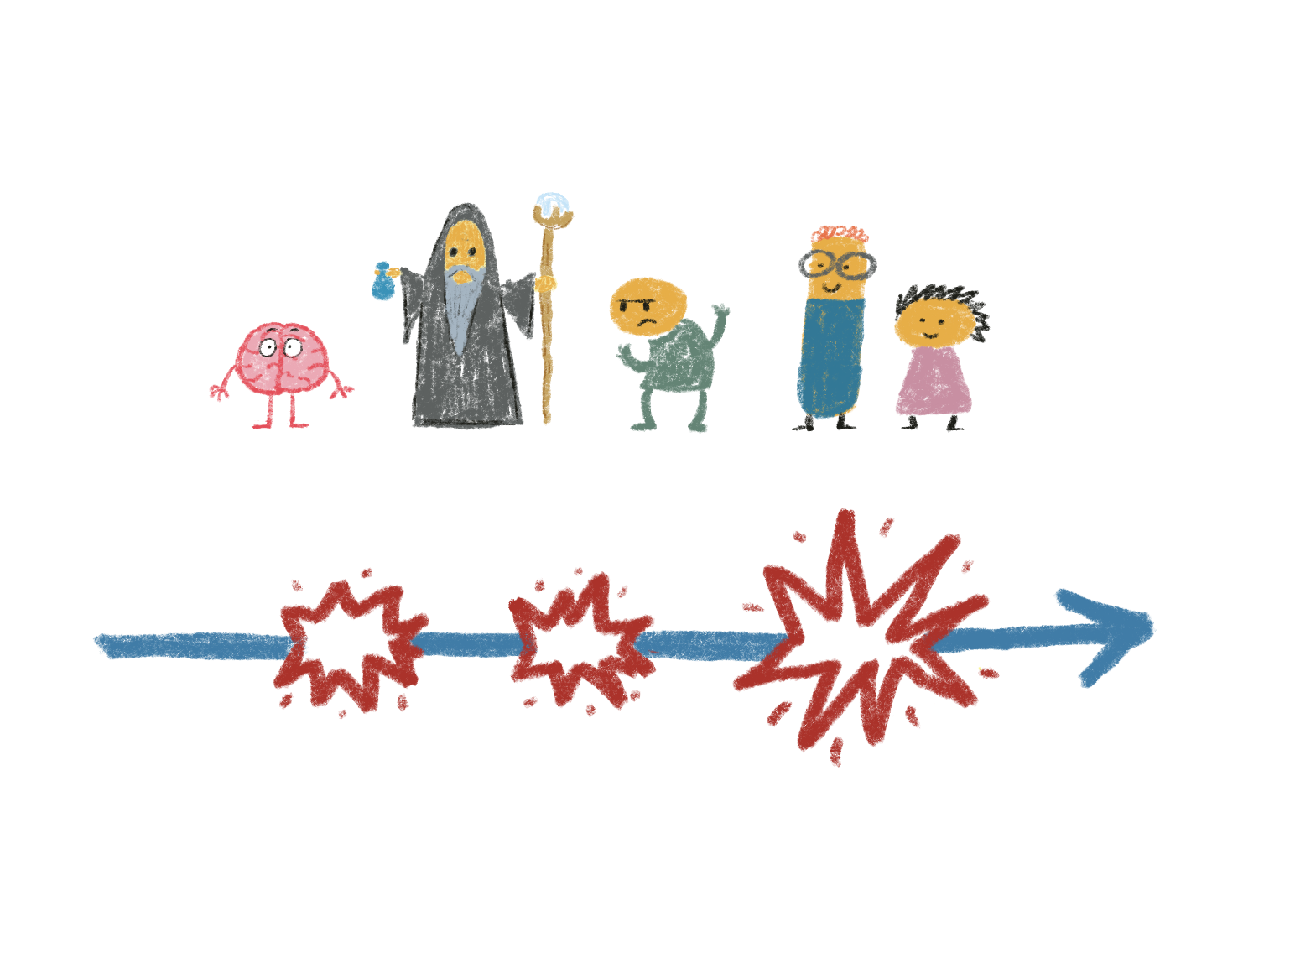
Magic item
Hero
Mentor
Antagonist
Allies
Ultimate Trial
Trial
Trial
Goal
The Journey
Notes:
But “story” is still kind of a vague term. Let’s put some structure to it.
Joseph Campbell was a researcher who noticed that there was a structure to our stories that was common across many cultures and societies. This is a simplified version of it. In most stories we have a hero (that’s you in your own stories), mentors, antagonists, and allies. The hero goes on a journey that involves a series of trials that lead up to an ultimate challenge. Her or she takes on those trials and challenges with the assistance of the Mentor and Allies, opposed by the Antagonist.
The central aspects of this story structure are about the characteristics of the hero (us), the nature of our relationships and how they either aid us or hinder us as we pursue our goals, and the skills and resources we need to meet those challenges.
We’re going to circle back to this structure during the rest of the presentation. It’s a framework that’s set in our brains!

Slide 16
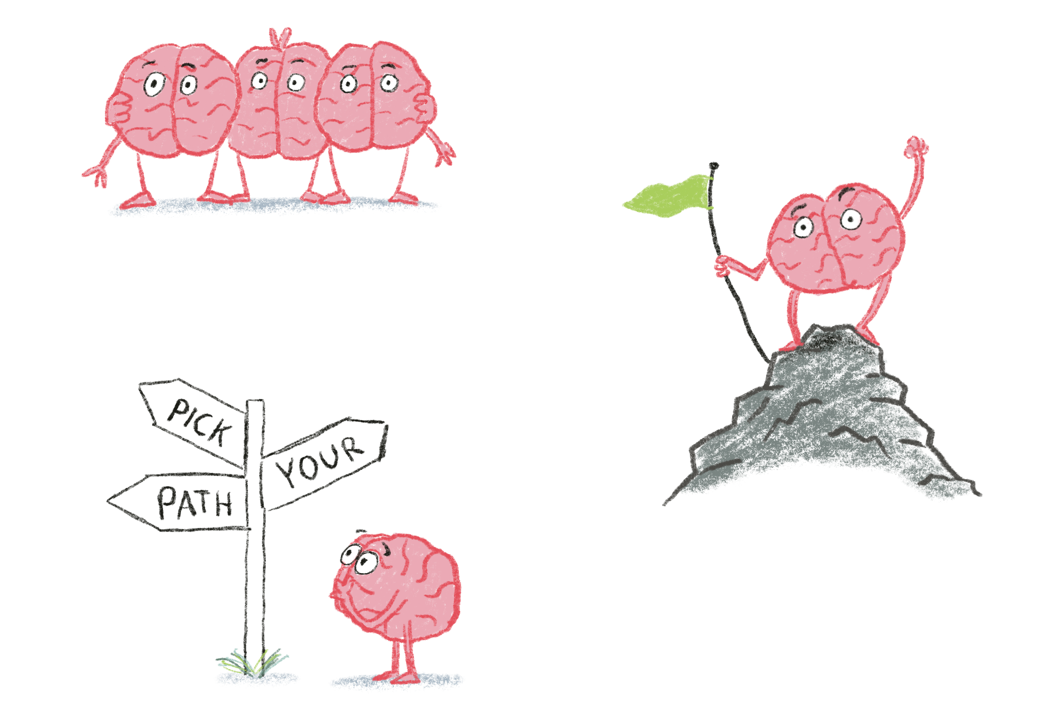
To belong
To feel competent
To have autonomy
Notes:
If you look at how almost all stories unfold, you’ll find that there are three basic needs the Hero is trying to meet. They seek to find a sense of belonging, to feel competent, and to have a sense of autonomy.
The universality of these needs is again a reflection of how our brains work. Forget Maslow’s Hierarchy – neuroscience research has made it quite clear that these three needs form the foundation of any pyramid.

Slide 17
Reflection
What was surprising?
What did you already know, but now see in a new way?
What new questions do you have?
Notes:
Personal reflection

Slide 18
Notes:
https://upload.wikimedia.org/wikipedia/commons/9/9a/Default_mode_network-WRNMMC.jpg
How is all of this reflected in the structure of the brain? The brain is focused on survival. That’s job #1. And since we are social animals and our safety depends on our personal community, nothing is more important to our survival and our sense of safety than the strength of our social connections.
And in fact, that is what the brain spends most of its time working on. There is a set of structures in the brain called the Default Network, and it’s called that because whenever your brain isn’t doing something specific, this network is active. When you are daydreaming, that’s your DM at work. It spends most of its time processing things you have done or things that may happen in the future, and often in a context of your relationships with others. It is, for all intents and purposes, your own personal Story Processor.
When kids (or we) are upset, it’s often because we are processing a story that is an unhappy or unsettling one. Reliving the embarrassing thing you did yesterday, worrying about sounding stupid when I do my presentation tomorrow.
This is another function of the Domain Network – we are always trying to read the minds of the people around us and interpret their motivations. Scientists call it “Theory of Mind,” and we are constantly working it. We are wired to assign motives and attributes to those with whom we interact. It’s such a powerful drive that we assign evil motivations to inanimate objects when they fail us. “The computer hates me today!” or “I’m going to smash that toaster!”
Who are possible adversaries?
Who are possible allies?
What are they thinking?
What is their motivation?
Critically, something else that activiates the DN is when we are listening to a story. It’s absorbing and processing what happens in the story as if you had experienced it yourself.

Slide 19
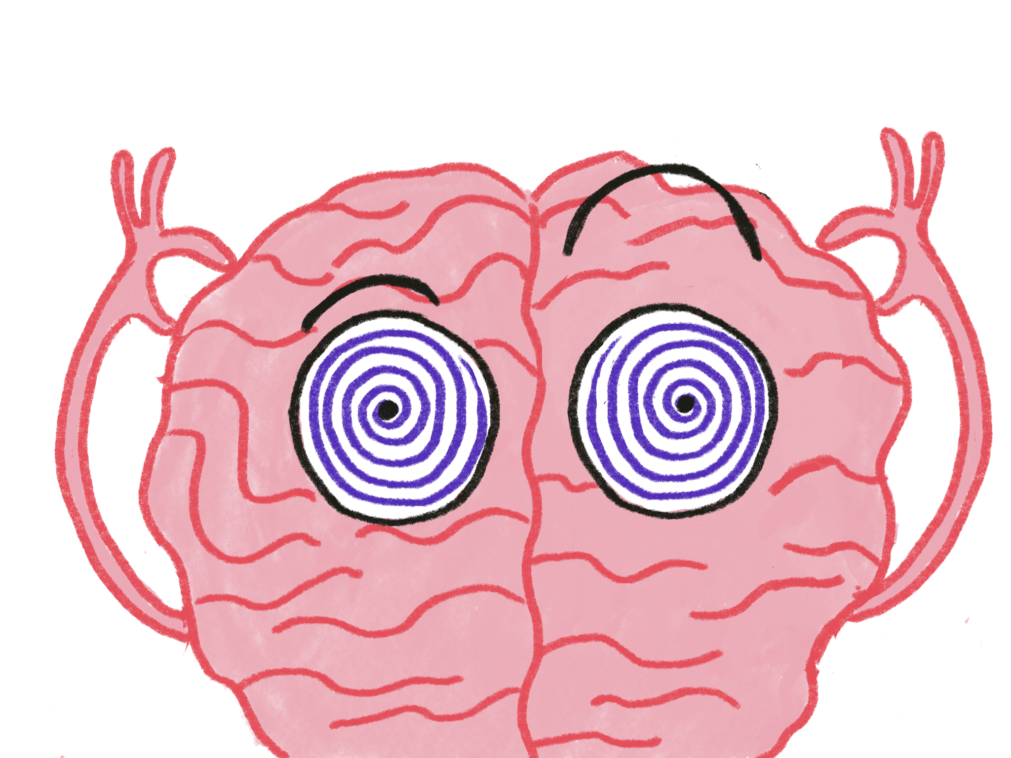
Notes:
This is another function of the Domain Network – we are always trying to read the minds of the people around us and interpret their motivations. Scientists call it “Theory of Mind,” and we are constantly working it. We are wired to assign motives and attributes to those with whom we interact. It’s such a powerful drive that we assign evil motivations to inanimate objects when they fail us. “The computer hates me today!” or “I’m going to smash that toaster!”
Who are possible adversaries?
Who are possible allies?
What are they thinking?
What is their motivation?

Slide 20
Notes:
We have a driving need to sort people into the roles of our narratives. We want to know if they’re mentors, allies, or antagonists.
This is a survival issue. We are social animals, and nothing is more critical to our existence than how we are connected to the community around us.

Slide 21
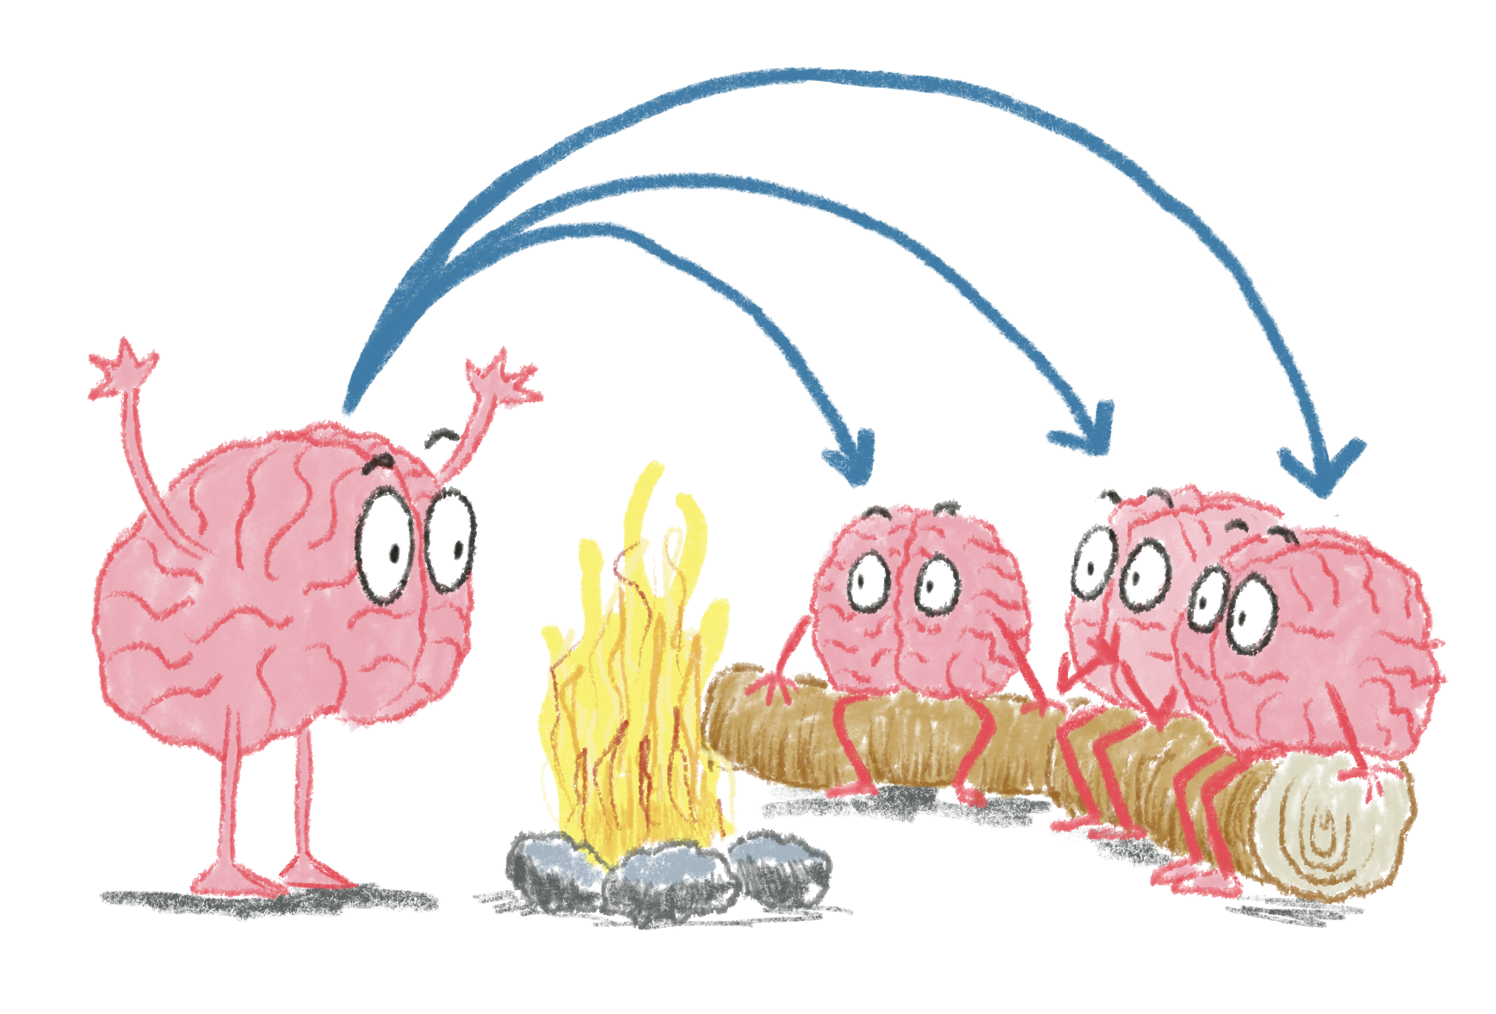
Notes:
Here is the most astounding part of this whole thing. We can transmit the stories in our heads into the brains of other people. As I mentioned at the beginning, it’s one of the dominant activities we engage in, every single day of our lives. The brain is wired to enable this, too. If I describe the sweet scent of a rose, or the delicate feel of the grass beneath my feet, the sensory areas in your brain will activate as if you were experiencing it yourself. If I read the tear-jerker scene from Where the Red Fern Grows, your limbic system will get all tied in knots as if it were happening to you. And your default network is also busy examining the interactions between any characters in the story I tell you, building up its library of information on relationships and motivations. We learn from these stories as if we lived them. It’s truly a mind meld.
This is how we have taught social emotional learning throughout human history.

Slide 22
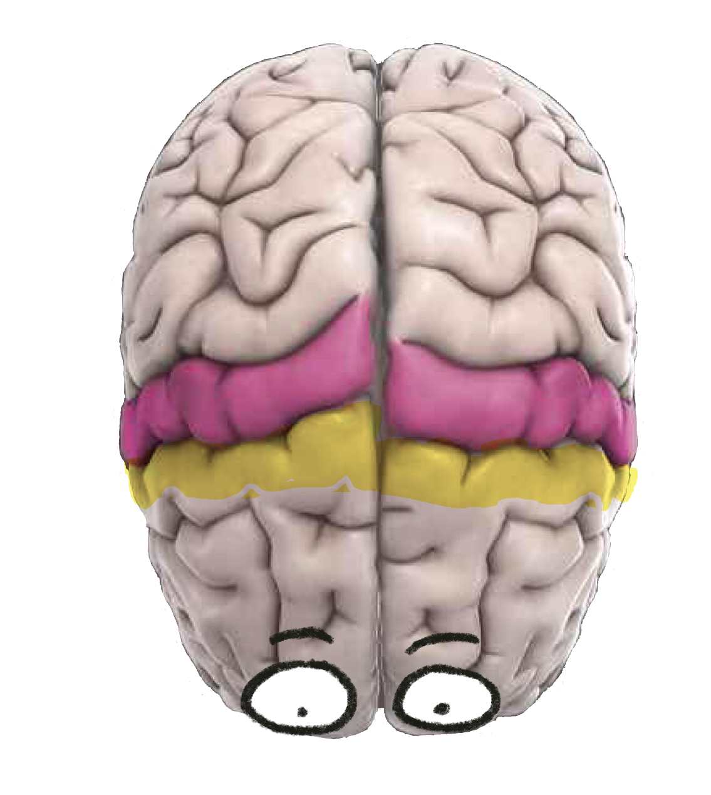
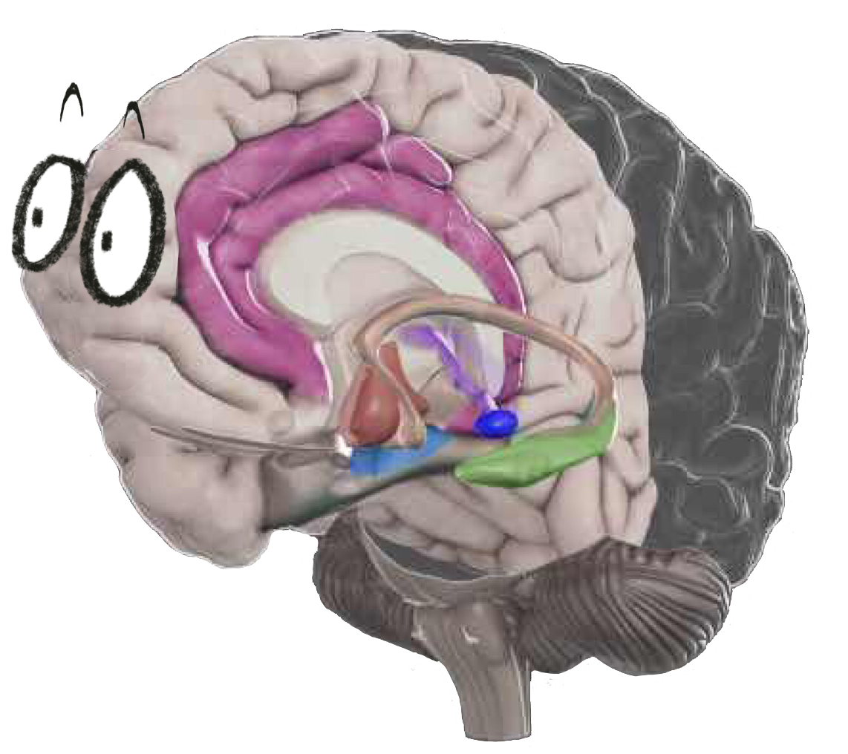

Slide 23
Notes:
https://upload.wikimedia.org/wikipedia/commons/9/9a/Default_mode_network-WRNMMC.jpg
Critically, something else that activates the DN is when we are listening to a story. It’s absorbing and processing what happens in the story as if you had experienced it yourself. New stories feed the need to understand what others are thinking and feeling.

Slide 24
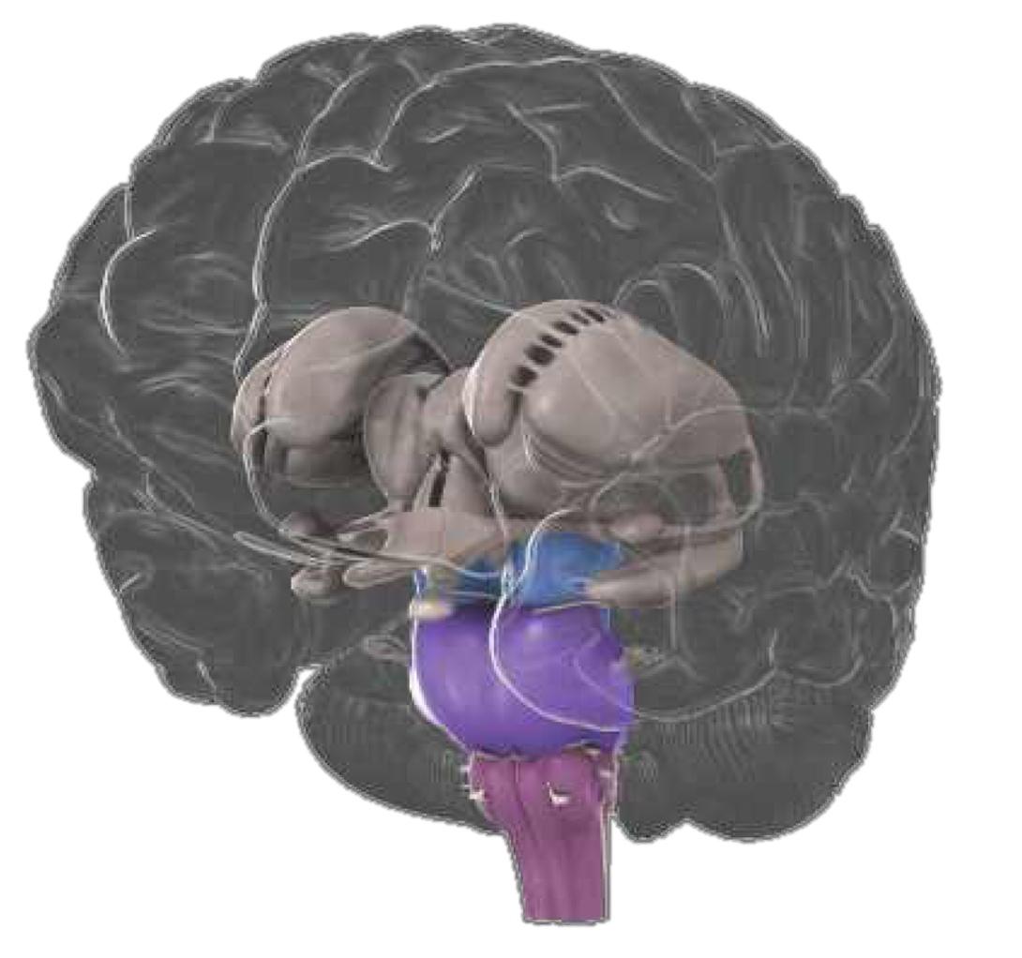
Notes:
In the brain this is reflected in the function of the Reticular Activating System, or RAS for short. This system filters the information coming into our brains, and the stories we hold impact that filter. It primarily lets through things that we value, that are new, or that are threats, and the criteria for that is largely driven by our narratives.

Slide 25
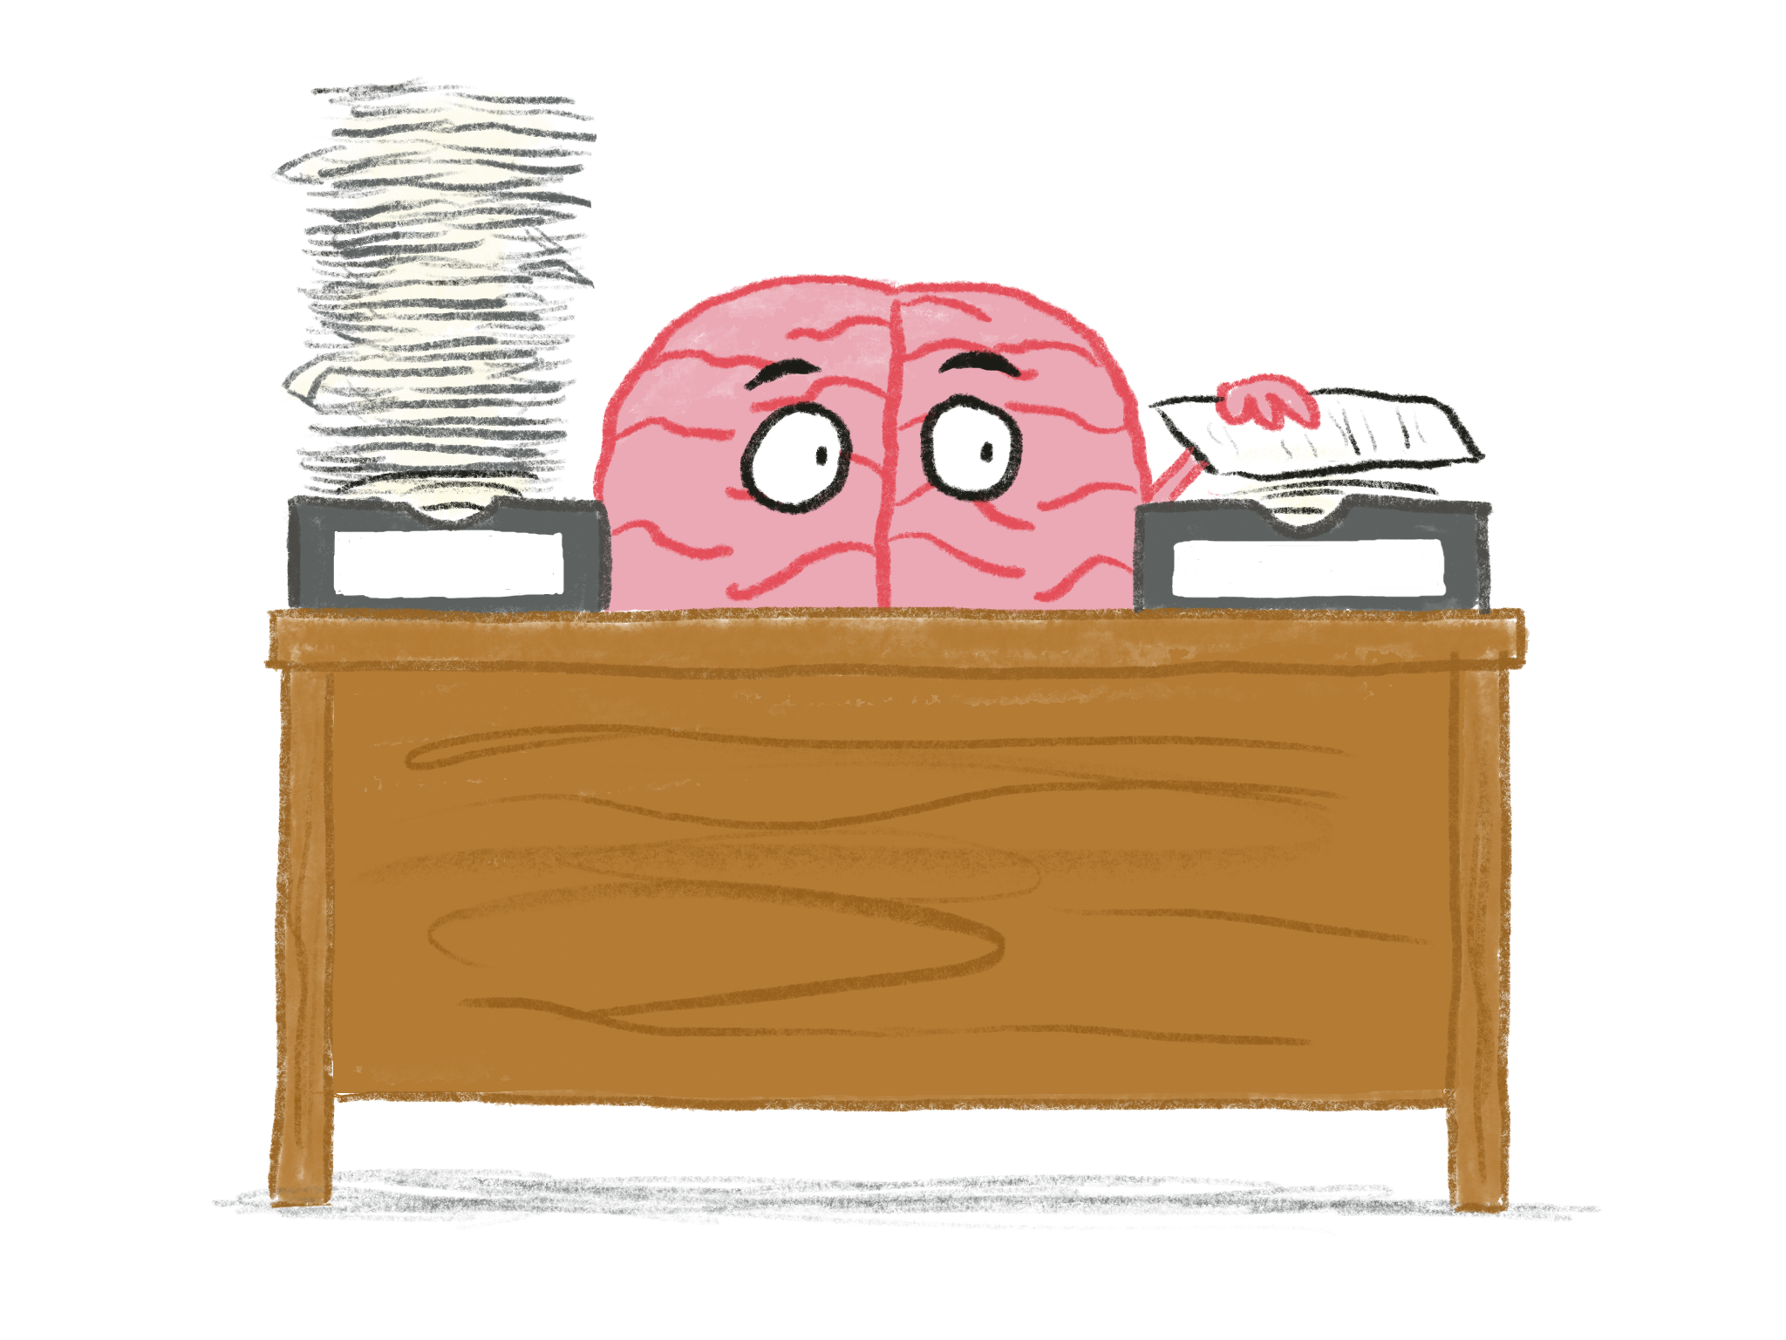
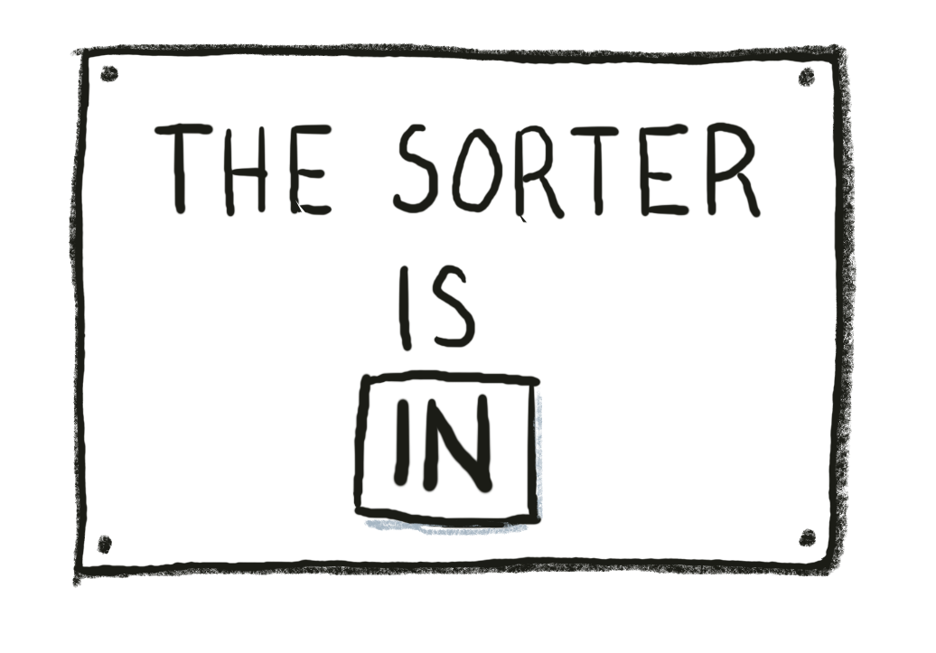
Notes:
As we process all the information and sensory data that comes our way, our filtering system decides what stays and what gets ignored. Our stories heavily influence this filtering process. Once our mind is secure with a story, it’s only interested in data that supports or reinforces the story. Everything else gets ignored.

Slide 26
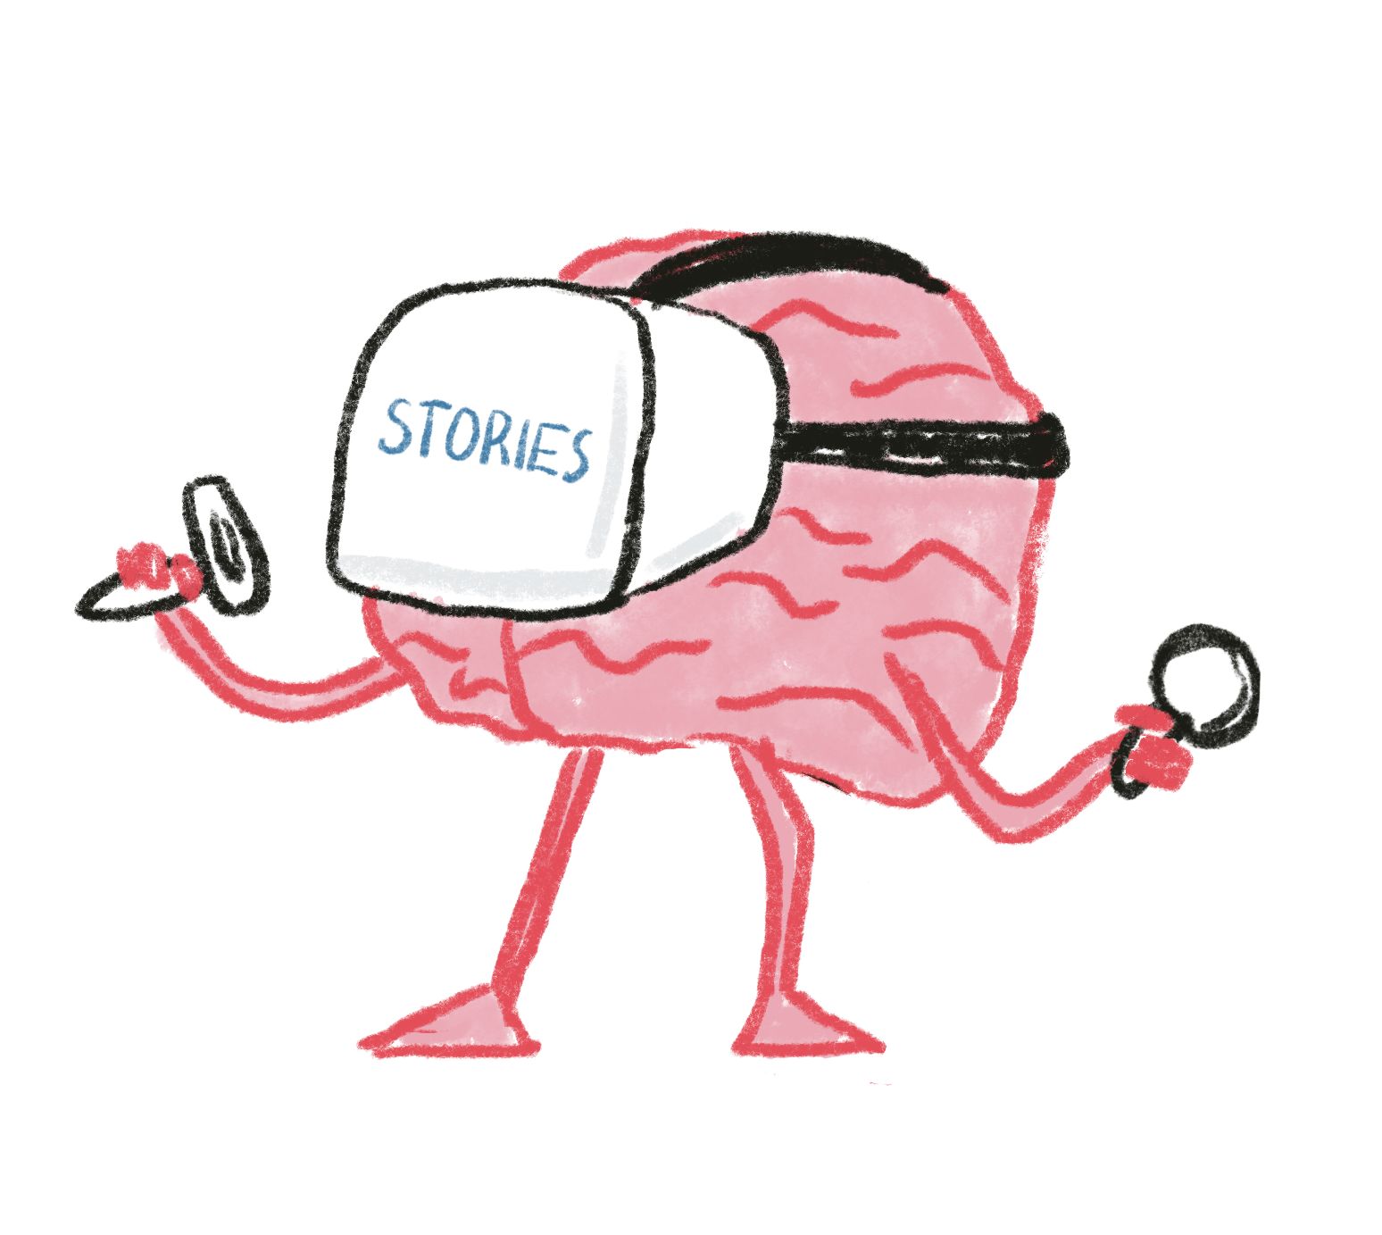
Notes:
Once a story is established, it filters our perceptions to maintain itself. Some narratives aren’t that deeply set, and they can be adapted more easily. Other stories are deeply held, and they are very hard to dislodge.
In working with our students, we need to be really intentional about the messages we send with our language and actions.

Slide 27
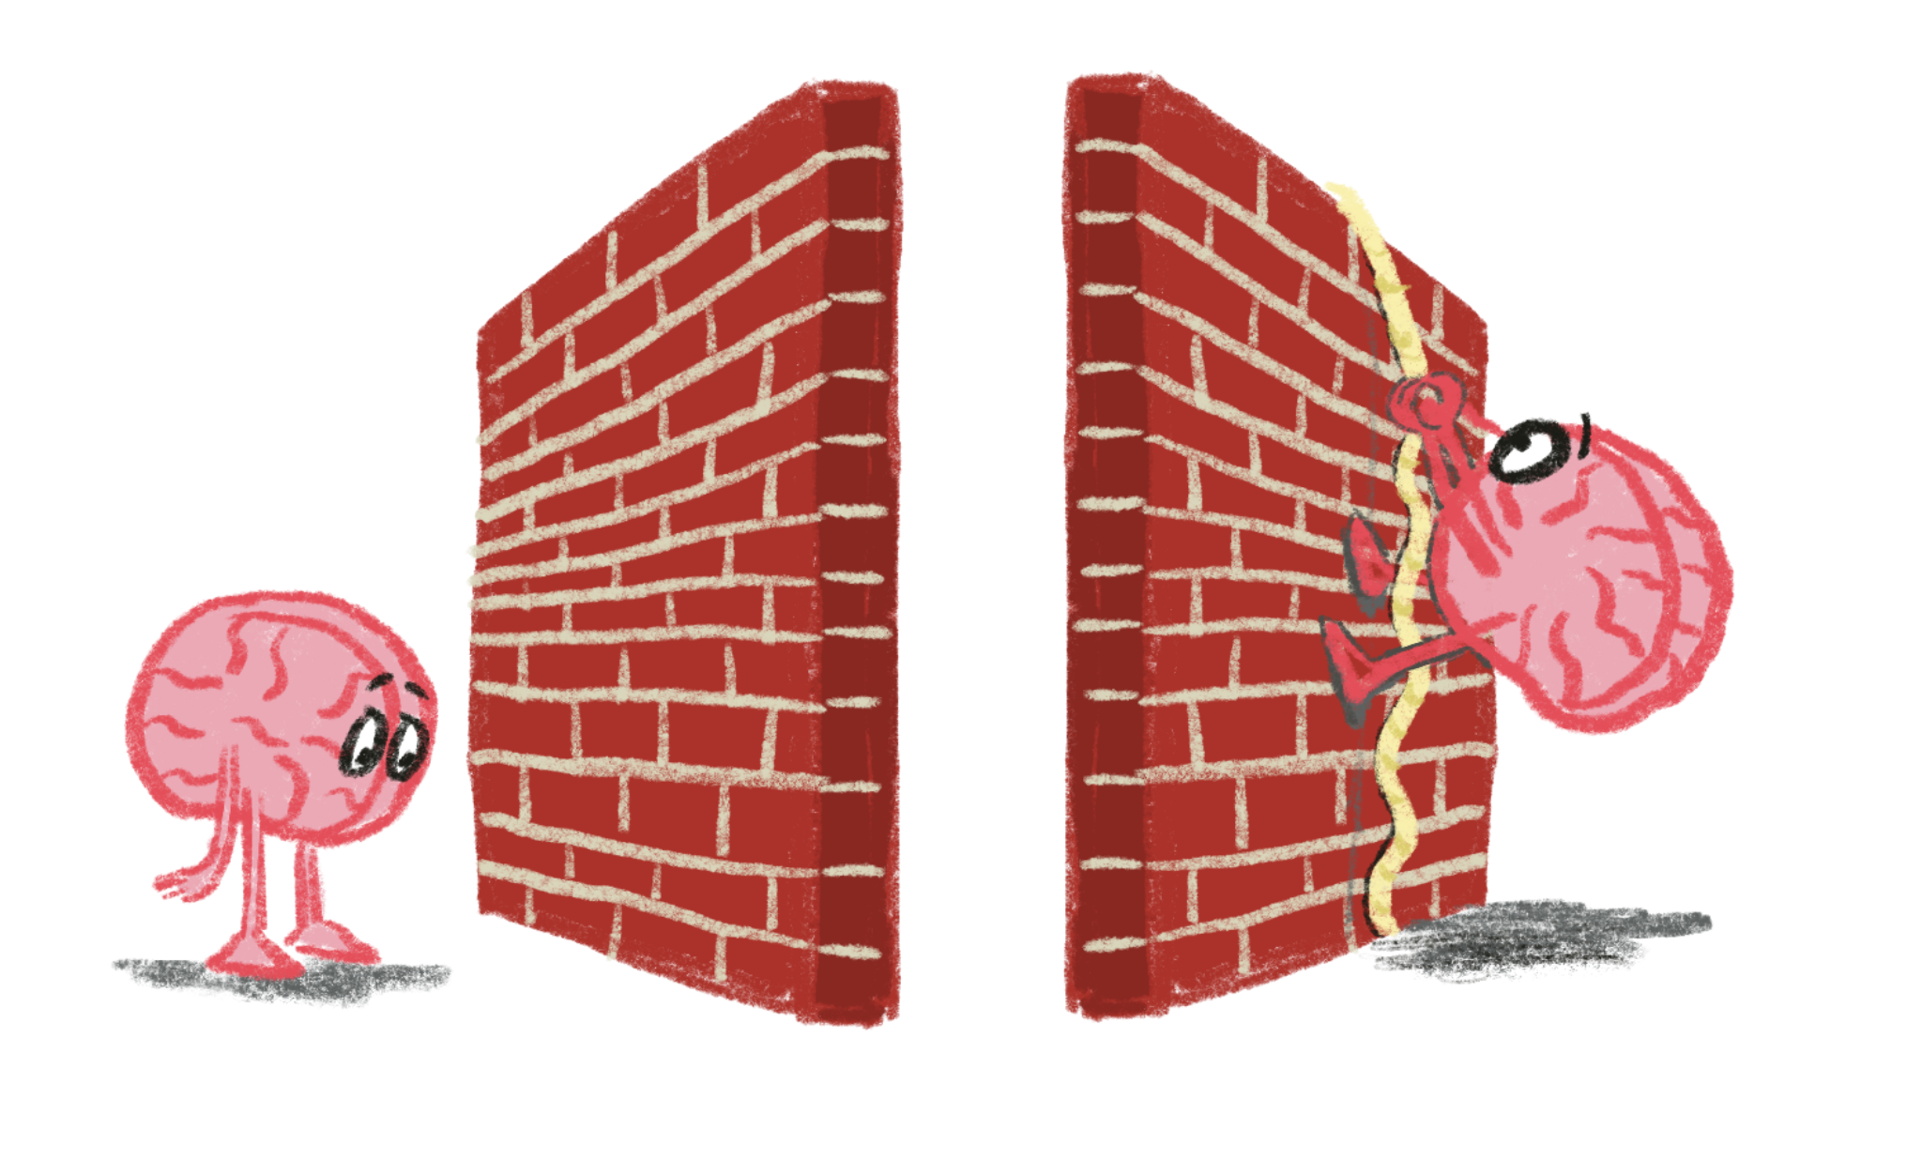

Slide 28
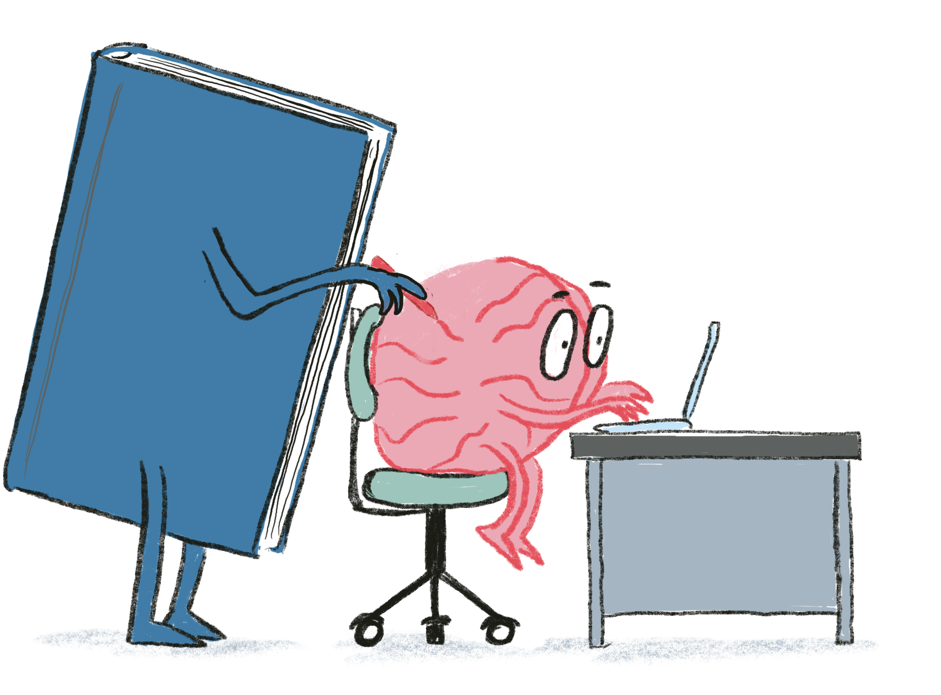
People think that stories are shaped by people. In fact it’s the other way around.
Terry Pratchett
Notes:
Many important traits we want to encourage in our students - persistence, growth mindset, self confidence, empathy, tolerance – they are all expressions of a story. “If I keep at it, I will succeed. I can improve if I keep practicing. People who are different than me aren’t bad.”

Slide 29
Reflection
What was surprising?
What did you already know, but now see in a new way?
What new questions do you have?
Notes:
Personal reflection

Slide 30
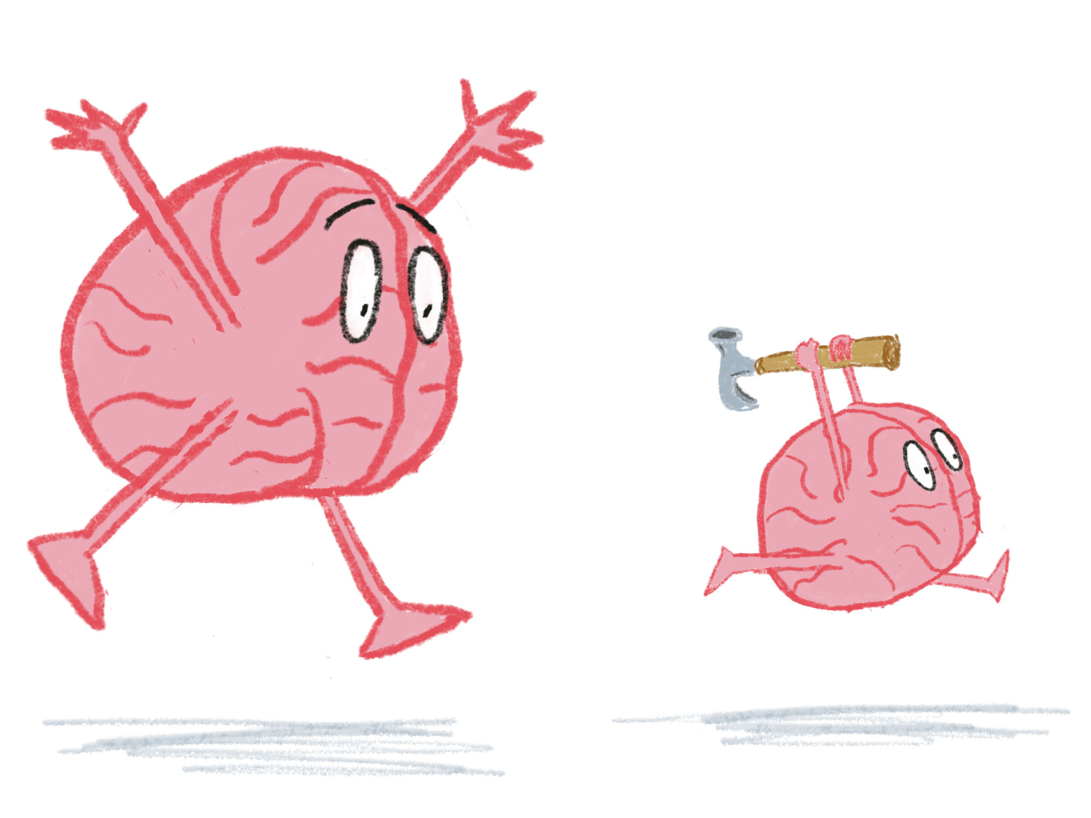
We shape our tools, and thereafter they shape us.
Fr. John Culkin
Notes:
If you want to see an immediate demonstration of how a tool can change our story, give a toddler a hammer.
Technology tools become part of our identity. They change our view of ourselves, and what we can do.
This is why I’m so interested in Maker Spaces, and have been for years. When kids are given the opportunity to explore tools and materials and create things they never knew they could, we are giving them the opportunity to redefine themselves.

Slide 31
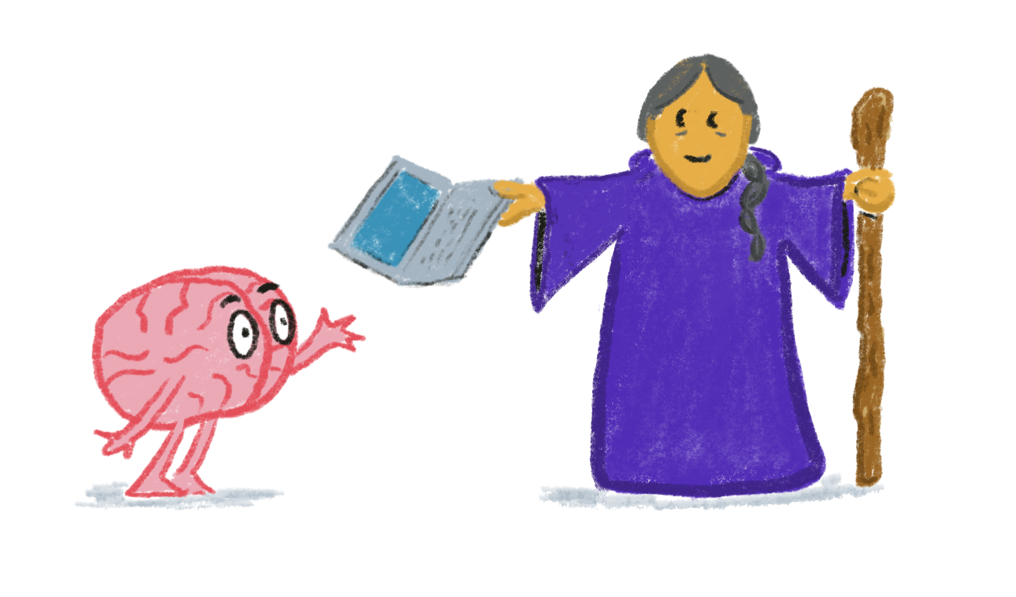
Notes:
For those of us who enjoy technology, we often envision ourselves as the mentor bringing the magic talisman to our student heroes or heroines. It’s what drives us to come to conferences such as this.
We all experience this ourselves. Imagine a store that sells things connected to a favorite activity. A hardware store, or a music store, or a weaving store, or a craft store. Close your eyes for a moment and cruise through the things you’d like to buy. That excitement you’re feeling is how getting those tools and materials will empower you to do something you want to do, they’re changing your story in a powerful, hopefully positive way!
But that’s because these things are aligned with the journey we want to pursue. Is that true for all of your students, or your colleagues?

Slide 32
Notes:
For that matter, what is the story about the technology itself?
I’ve long been frustrated by many lists of 21st Century Skills. They often lump technology under a heading like IT Skills, or computer literacy, or some other framing that what kids need to be able to do is use computers. I always want to ask “Where did the computers come from? Magic elves?” (Or mentors?)
I want kids learning that technology is something they do, not something they use that was developed by someone else.

Slide 33
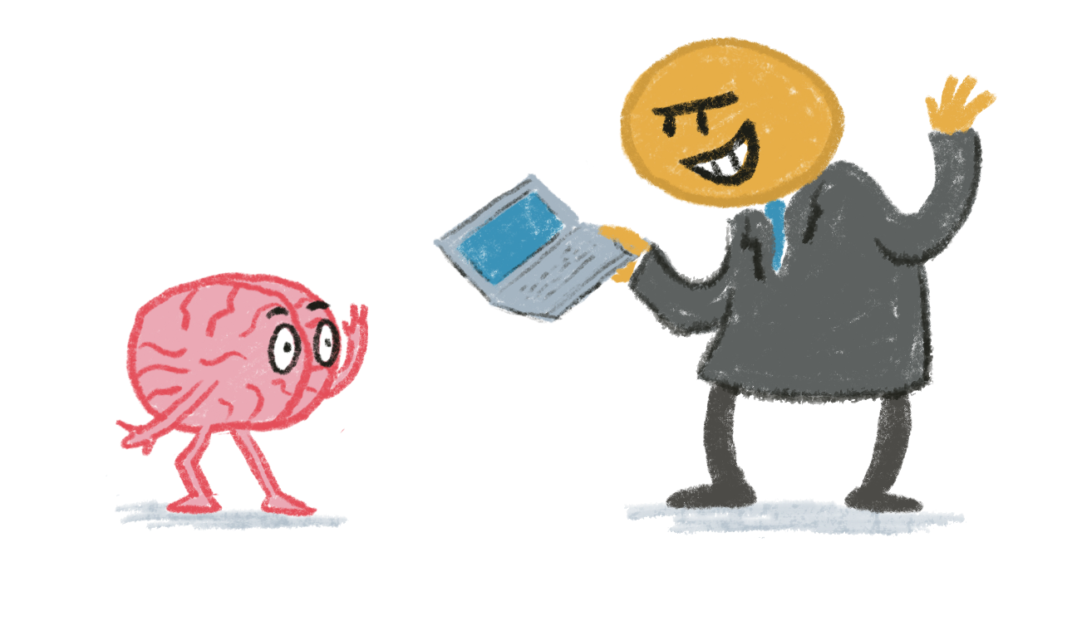
Notes:
For some of our kids, and sometimes our colleagues or ourselves, the introduction of a new technology isn’t a magic talisman at all, it’s one of the trials. Those who present the technology to us almost certainly hold a story of the wonderful benefits the technology can bring, and that story can be so powerful in their mind that they are blind to the problems that the technology brings.
Don’t be that person!

Slide 34
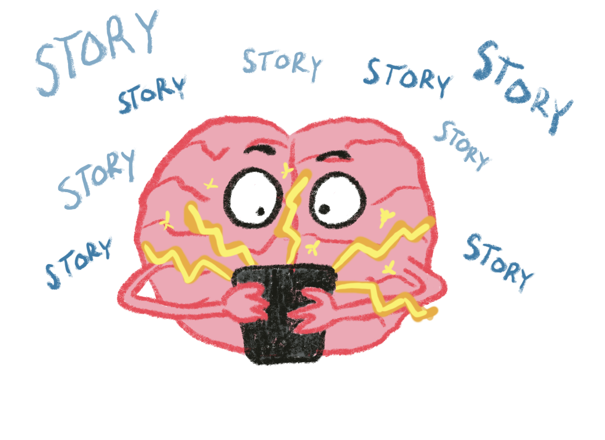
Notes:
And even a positive talisman can bring curses with it. One of the reasons that we are so drawn to this stuff has nothing to do with our desire to be empowered by it – we’re drawn to it because it’s a bottomless pit of new stories. That’s all social media really is – stories, stories, and more stories, particularly shallow stories that reinforce the stories already in our head. That makes us feel really good, and so we seek out even more, to the exclusion of more meaningful stories that can help us grow stronger social-emotional skills.

Slide 35
“What’s the story?”
Notes:
When we set out to address an issue, this should be our first framing question. Why is Eric acting out in class? Why are our students so off the wall after COVID? How can this new technology impact our school/classroom/library?
What is the story we want students to feel in our space, and what story are they actually experiencing? If they have the wrong story, what steps do we need to take to “disconfirm” their narrative?
What are the stories we are crafting each day with our actions and words? Is the story we want?

Slide 36
Notes:
So as we deal with technology in our schools and classrooms, we need to look at its role (or roles) in our stories. Is the story in my mind blinding me to the story in my students’ minds? Does the technology align with the goal in my story, and does it align with the stories in others’ minds? Does it help our heroes and heroines on their quest to find belonging, competence, and autonomy?

Slide 37
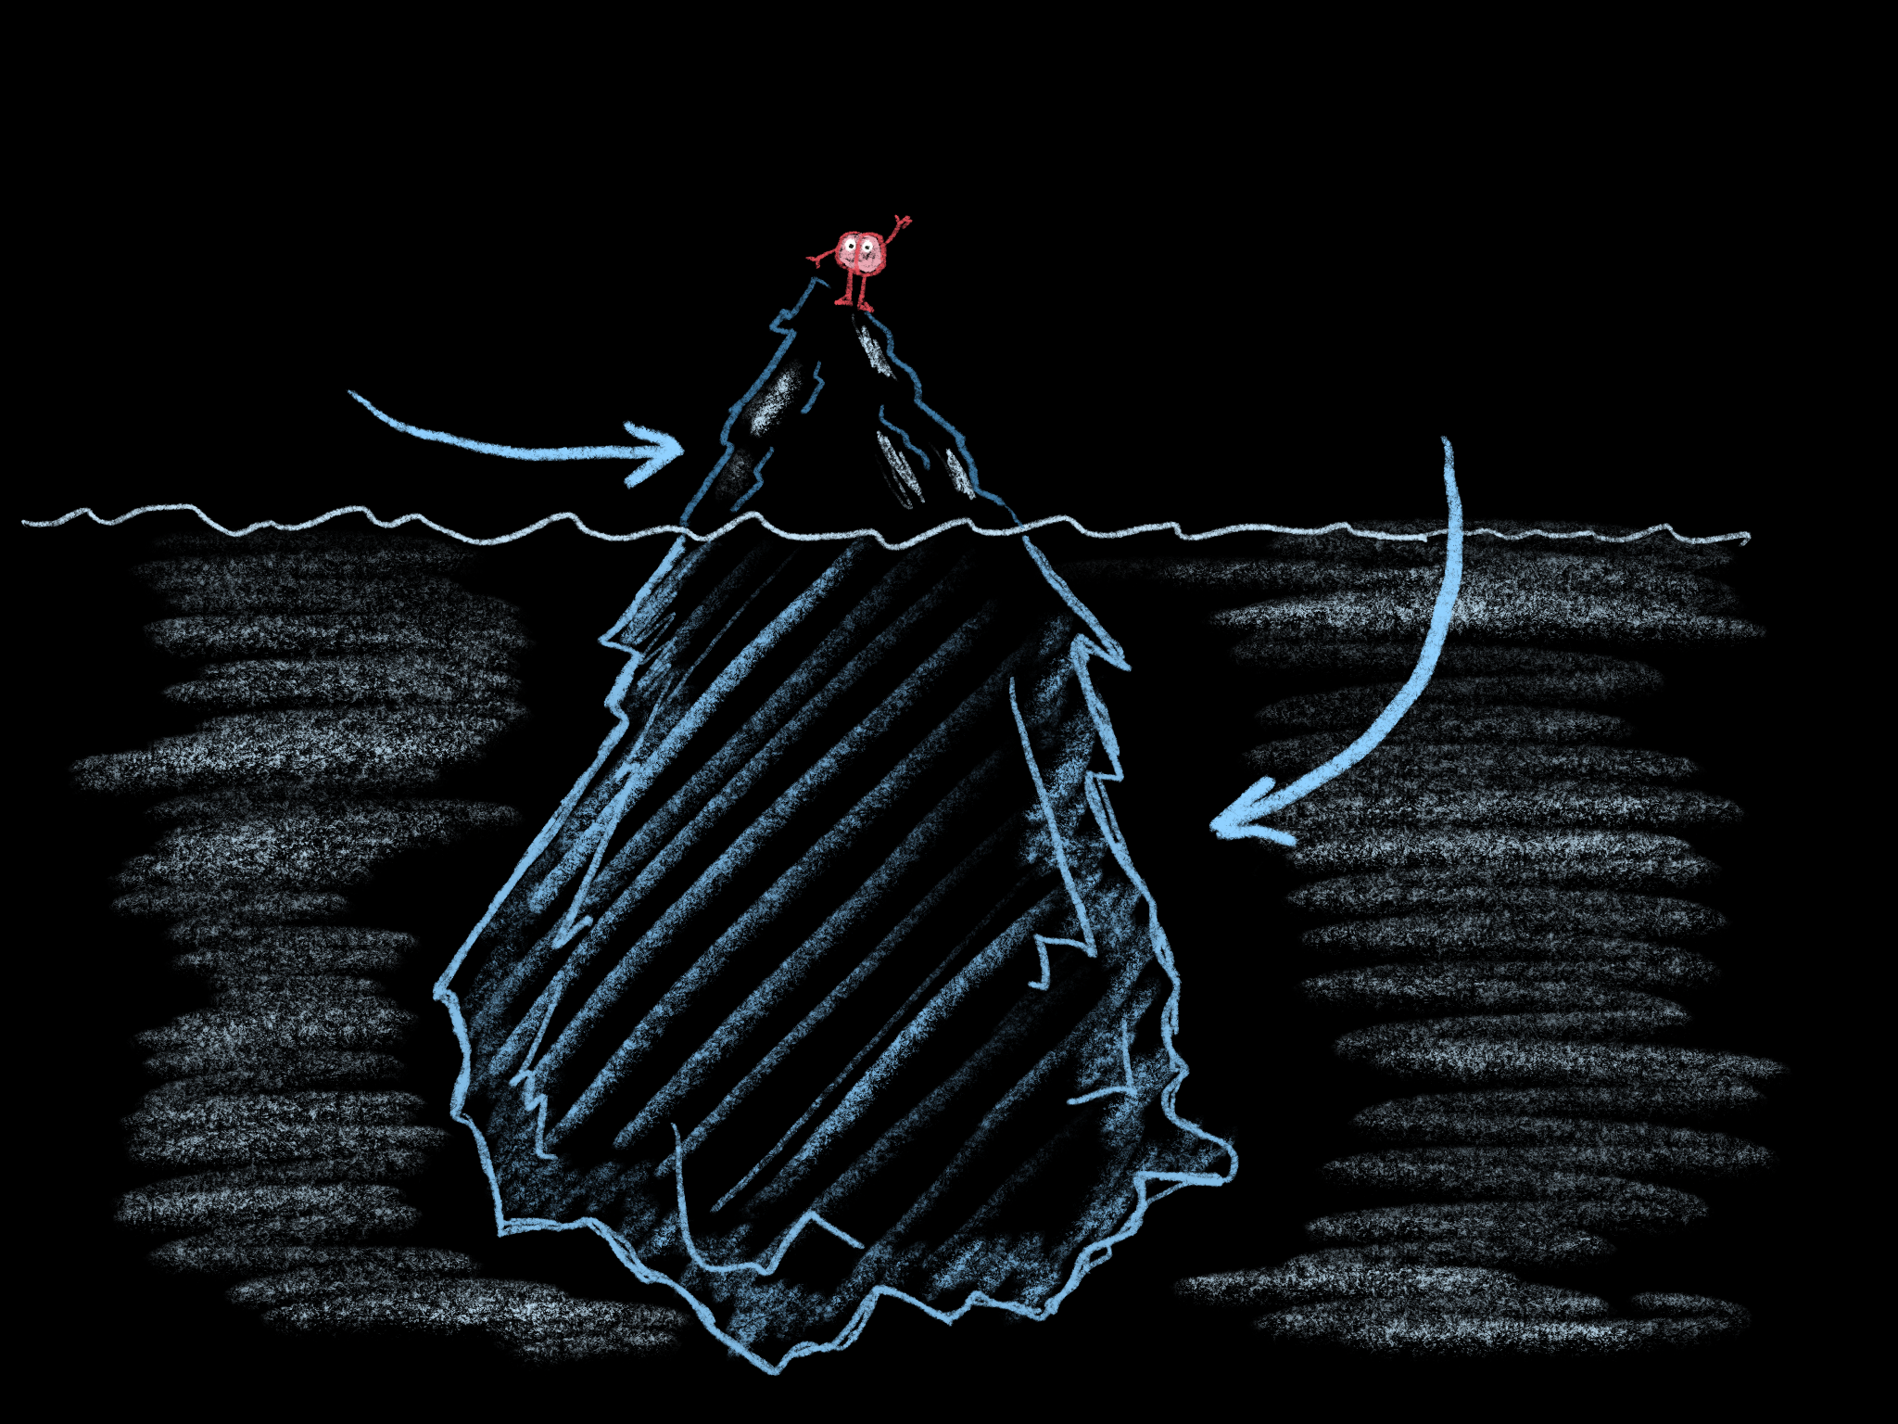
Stories we are consciously aware of
Stories we aren’t
Notes:
And it’s really important to recognize that some of the stories we (or our students) hold in their minds may be “silent” stories. They’re beliefs and feelings that we haven’t clearly articulated to ourselves. They are just as powerful as the other stories, though, which is why it’s important to examine them, acknowledge them, and if necessary seek to change them.

Slide 38
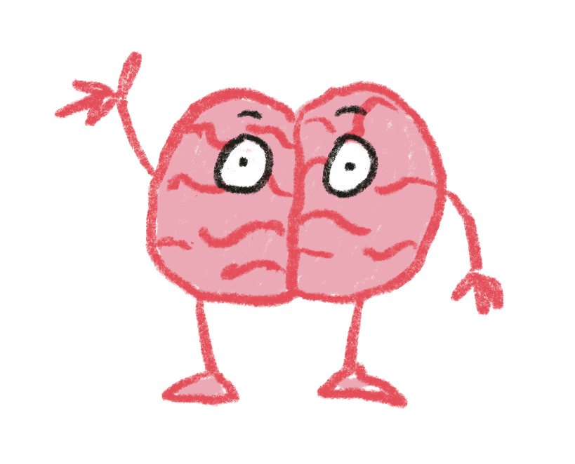
Notes:
Even small, subtle things can eventually have a big impact. This is just one idea of how we can begin to change our own stories.

Slide 39
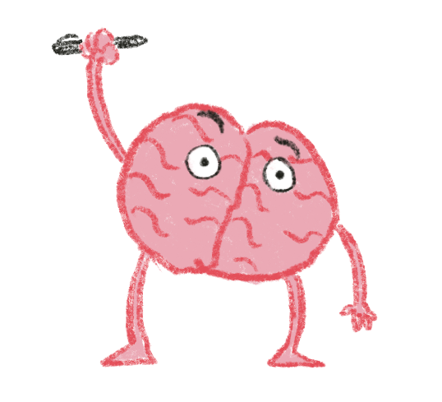
Freedom begins the moment you realize someone else has been writing your story and it’s time you took the pen from his hand and started writing it yourself.
Bill Moyers
Notes:
And this is a power that once we learn how to use it, we can give to our students. I first encountered this quote at Scriber High School, where teacher Marjie Bowker and her colleagues teach a phenomenal narrative writing program for students who have struggled in traditional settings. The power of learning how stories work and how to write their own narratives has had a huge impact on their kids.
The Acton Academy charter school network uses the Hero’s Journey as the conceptual framework for their students.

Slide 40
Reflection
What was surprising?
What did you already know, but now see in a new way?
What new questions do you have?
Notes:
Personal reflection

Slide 41
Enduring Understandings
Stories are both a reflection of how our brains work and a powerful influence on how we think
Technology has a powerful impact on our stories

Slide 42
Essential Ideas
Stories are the original SEL curriculum
The more varied stories we are exposed to, the more sophisticated our stories become
Stories are individual and communal
Places and settings have their own stories
Notes:
This is actually just the list of points Conn wants to make before the session is over if he wasn’t able to work them in somehow!

Slide 43
Essential Ideas
The current fights to censor school library books and curriculum reflect the importance of stories
Everything we do is telling a story to our students
Notes:
This is actually just the list of points Conn wants to make before the session is over if he wasn’t able to work them in somehow!

Slide 44
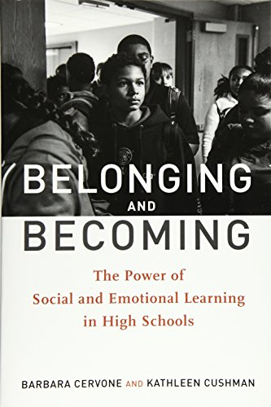

Slide 45
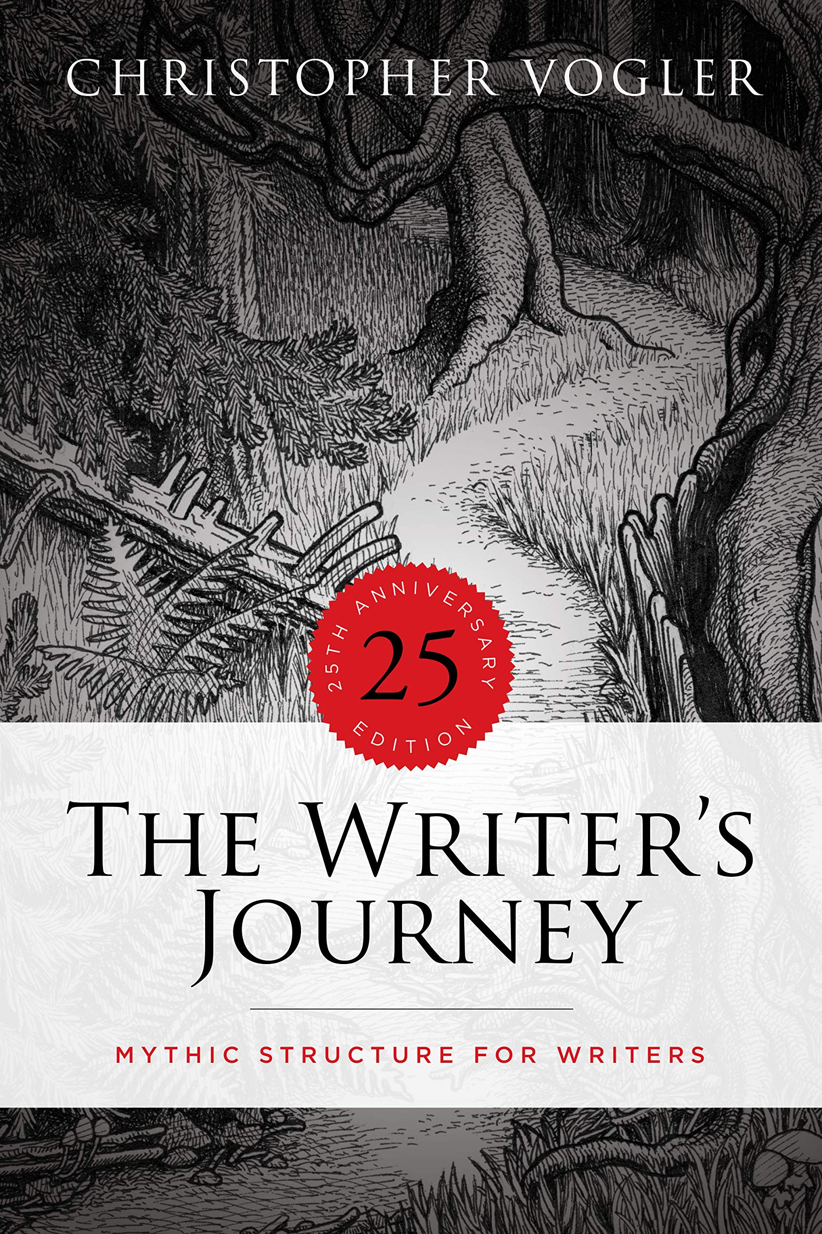

Slide 46
The universe is made of stories, not atoms.
Muriel Rukeyser

Slide 47
www.mcquinnable.com

Slide 48
www.mcquinnable.com

