Slide 1
The Neuroscience of Story
Scriber Lake December 14, 2017
Notes:
Book Image: http://disney.wikia.com/wiki/Once_Upon_a_Time_(Book)
Opening activity: Have each person write down three favorite books, then discuss with two-three people around them why these books were meaningful. It will often be a theme that the books made a deep emotional connection to the reader, and provided them a powerful insight into people of different backgrounds or communities. This illustrates how narrative can actually change our thinking, or that new stories we encounter can alter the stories we already inhabit.

Slide 2
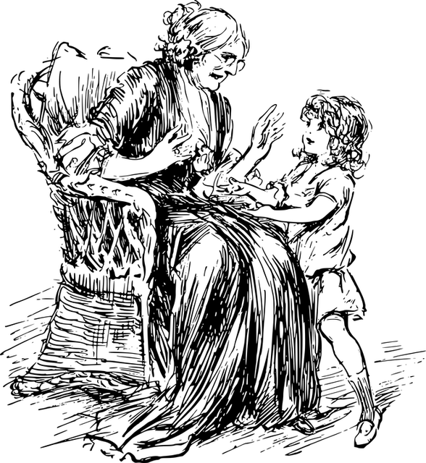
There have been great societies that did not use the wheel, but there have been no societies that did not tell stories.
Ursula K. Le Guin
Notes:
Image: https://pixabay.com/en/child-girl-grandma-grandmother-1293438/
Stories are so central to our lives and our thinking that all cultures have them. All families have them. Each of us as individuals have them. We are hard-wired at the neurological level for story.

Slide 3
Notes:
There’s a reason for this. The human brain is a pattern-seeking missile. We are driven to recognize patterns, and make predictions based on those patterns.

Slide 4
Notes:
There’s an image hidden under here, and I’m going to reveal it one square at a time. Raise your hand when you think you know what the picture is.

Slide 5
Notes:
Image: https://upload.wikimedia.org/wikipedia/commons/thumb/0/0c/Cow_female_black_white.jpg/1280px-Cow_female_black_white.jpg
It’s a cow! Did you feel a jolt of excitement when you first recognized it? Did you feel another little jolt when I completely uncovered it and it showed you were right? That’s the reward system in your brain encouraging you to look for patterns and make successful predictions. Think about the silly animated hydroplane races we see at things like Mariner games. It’s just cartoon boats, but we all go wild when we’ve picked the right color boat and it wins. It’s just a cartoon boat!

Slide 6
Notes:
Page 62, Scott McCloud Understanding Comics (If you have kids who love graphic novels, this book needs to be in your library!)
Comic strips, graphic novels, movies all work because of our pattern/prediction system. We fill in the blank between these two panels and make all sorts of assumptions about what has happened. Even though nothing is illustrated, we are pretty sure we know what happened. (It’s also a trick that movie makers/graphic novelists do to play with those assumptions and surprise us – perhaps in the next panel we see that the axe-wielding menace has tripped and fallen out the window. Psych!)

Slide 7
Notes:
The stories or narratives in our minds are the maps by which we navigate our lives. They are critically important.

Slide 8
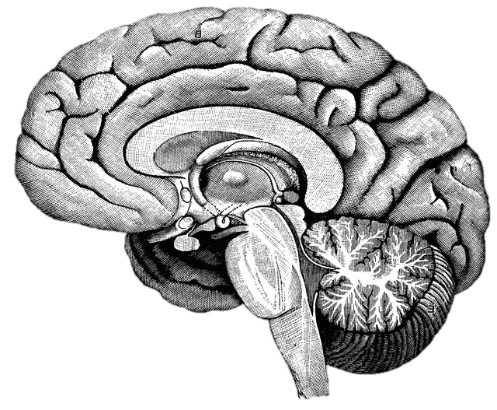
What happens in the brain when you learn?
Notes:
http://upload.wikimedia.org/wikipedia/commons/f/fe/14th-century_painters_-_Diagram_of_the_brain_-_WGA15761.jpg
Without discussing with anyone, write down what you already know about what happens in the brain when you learn. You will not need to share this with anyone.
After the one minute: This is from an instructional model called the NED Learning model, designed by Dr. Kieran O’Mahony. (You can read more about it at http://k12.nedlearning.com/index.html#free_printable_kit_details) By stating this fairly open question, I’m getting you to pull up your prior knowledge on the topic, which is important because all new knowledge has to be connected to prior knowledge. It’s also an emotional hook, since I have in essence asked you to guess what I’m going to tell you next, so you are more attentive to what I’m going to say. It’s like the silly cartoon hydroplane races at the Mariners games. Why should we care if the red, green, or yellow boat actually wins? But once we’ve picked a color we get really invested in the outcome and cheer or moan at the outcome.

Slide 9
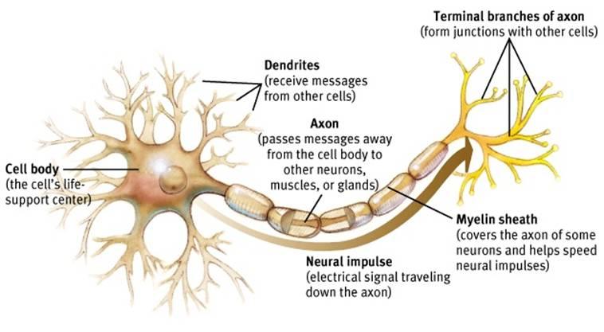
Neuron
Notes:
http://www.appsychology.com/Book/Biological/Biologypics/clip_image002.jpg
This is the basic model of a neuron. The branches on the left of this image are dendrites, where the neuron receives messages from from other neurons. This results in a electrical signal that travels down the axon to the terminals on the other end. There are actually many kinds of neurons in many shapes and arrangements, but they all have these basic parts.

Slide 10
Notes:
When the signal reaches the terminal, it turns out that neurons don’t directly touch. There is a tiny, tiny gap called a synapse, and the “upstream” neuron will release chemicals called neurotransmitters into this gap. On the dendrites of the “downstream” neuron are small sites that can receive individual molecules of the neurotransmitter. When enough receptor sites have been filled with the neurotransmitters, it will trigger an electrical pulse in the downstream neuron that will travel down to its terminals. The neurotransmitters will then float back into the synapse, and be reabsorbed by the original neuron. This is called “reuptake,” as in Sustained Serotonin Reuptake Inhibitor, or SSRI. Serotonin is a neurotransmitter that is part of many things, including depression, and SSRIs slows how quickly it is reabsorbed from the synapse, causing it to have a longer effect.

Slide 11
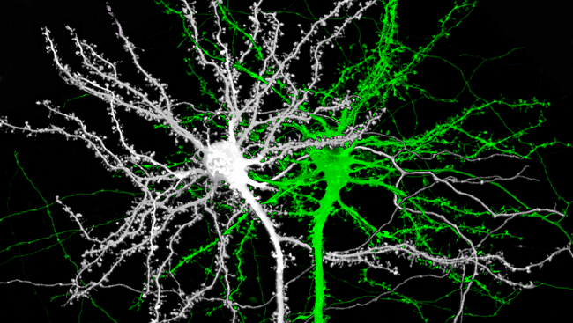
Notes:
Image source: http://www.brainfacts.org/thinking-sensing-and-behaving/learning-and-memory/2014/image-of-the-week-the-structure-of-memory
This is an image of two mouse neurons, and you can see the branches of the dendrites are covered with little knobs. They’re called spines, and they are where the dendrites grow to reach the terminals of other neurons.

Slide 12
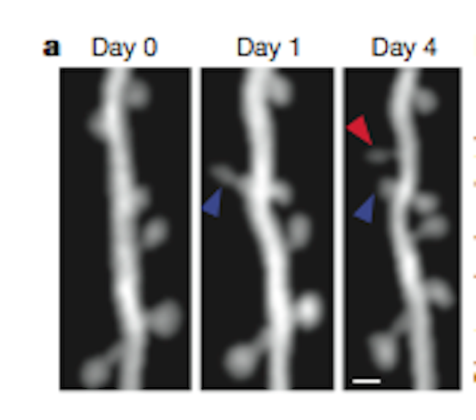
Notes:
Image source: http://blogs.scientificamerican.com/observations/files/2012/04/Screen-shot-2012-04-16-at-5.06.35-PM.png
Here is a real, live neuron growing new spines. They are growing toward neurotransmitter molecules. Notice that the spine by the blue arrow starts out long and thin, but then thickens over time. The neuron is building bridges to reach another active neuron, which is what happens in our brains when we learn. We are literally building learning connections.

Slide 13
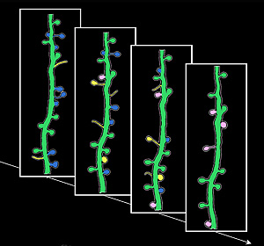
Notes:
Image source: http://news.ucsc.edu/2009/11/3413.html
Learning is not just about building new connections, though. The yellow spines are new ones growing and developing; the blue spines show the opposite, existing spines that disappear. This is called pruning, and they are going away because they aren’t being used. Neural connections are a literal “use it or lose it” proposition. One of the heaviest times of pruning is adolescence, with young teenagers starting out with twice as many connections as they will retain as adults. That’s why the patterns established as teenagers are so profound.

Slide 14
Notes:
Growing new spines on a dendrite provides more receptor sites for neurotransmitters to land. The triggering of the downstream neuron happens not from a single molecule of neurotransmitter, but from a certain quantity of sites being triggered. By having more sites, it is easier to reach that trigger point.

Slide 15
Reflection
What was surprising?
What did you already know, but now see in a new way?
What do you want to explore further?
Notes:
Another activity from the NED Model http://k12.nedlearning.com/index.html#free_printable_kit_details

Slide 16
Notes:
Individual neurons don’t really do much by themselves. It’s the vast networks they create that make our brains what they are.

Slide 17
Notes:
The networks of connections between neurons is increasingly recognized as the fundamental framework of brain function. In the same way that understanding the genome of our DNA has led to leaps in understandings of genetics and health, understanding the "Connectome" is now seen as key to understanding the brain.
With new sensing and imaging technologies, it is now possible to view the connectome in action, in real time. [https://youtu.be/dAIQeTeMJ-I] How complex is this? The brain contains roughly 86 billion neurons, and somewhere around one quadrillion synapses.

Slide 18
What are the major brain systems involved in learning?
Notes:
http://upload.wikimedia.org/wikipedia/commons/f/fe/14th-century_painters_-_Diagram_of_the_brain_-_WGA15761.jpg

Slide 19
Notes:
The pre-frontal cortex is where you do your basic thinking. It's the part of your brain that is (hopefully) engaged now with your awareness. It's the part of the brain we want the students using when they think, plan, and make choices. We know now that this is the last part of the brain to finish developing, often not until 23 or 24 years old. (Even older with some males, which will surprise no female.) There’s a reason kids don’t seem to think like us. They don’t.
It does not always perform at the same level. The PFC (as neuroscientists like to call it) is sensitive to a variety of factors. We’ll come back to this.
This and the following images are from the iPad App 3D Brain from Cold Spring Harbor Labs. There is a free and an HD pay version. (99 cents!)

Slide 20
Notes:
Another major system to understand is the limbic system. This is the part of the brain that deals with emotion and - interestingly enough - memory formation. Two critical parts are the amygdala and the hippocampus, one of each on opposite sides of the brain. The amygdala is one of the parts of the brain that manages your emotions.. The hippocampus is involved in the storage and retrieval of long-term memories, as well as routing information to the PFC.

Slide 21
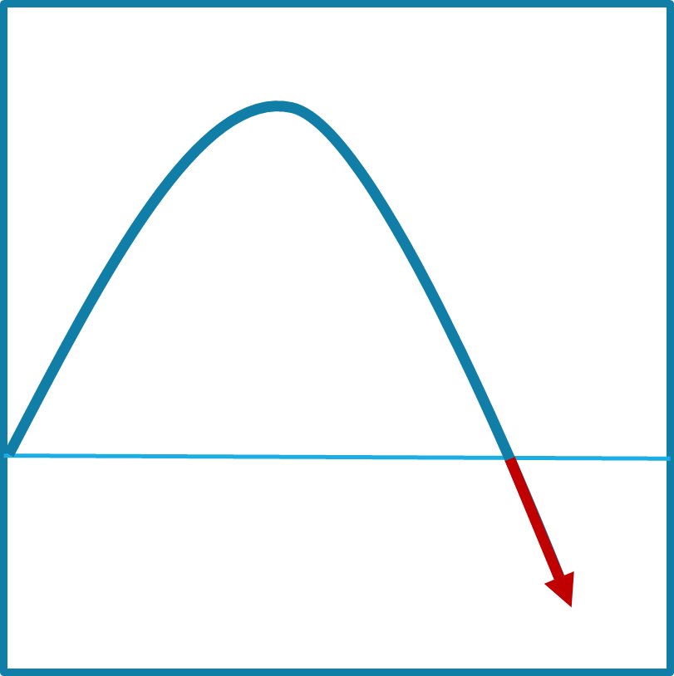
Notes:
On the front part of the stress curve, the function of the pre-frontal cortex is enhanced. If your limbic system is mildly engaged, it makes you more alert and focused. The neurotransmitters and hormones that are released enhance memory formation and cognitive function. This is what is happening with students when they are engaged and challenged.

Slide 22
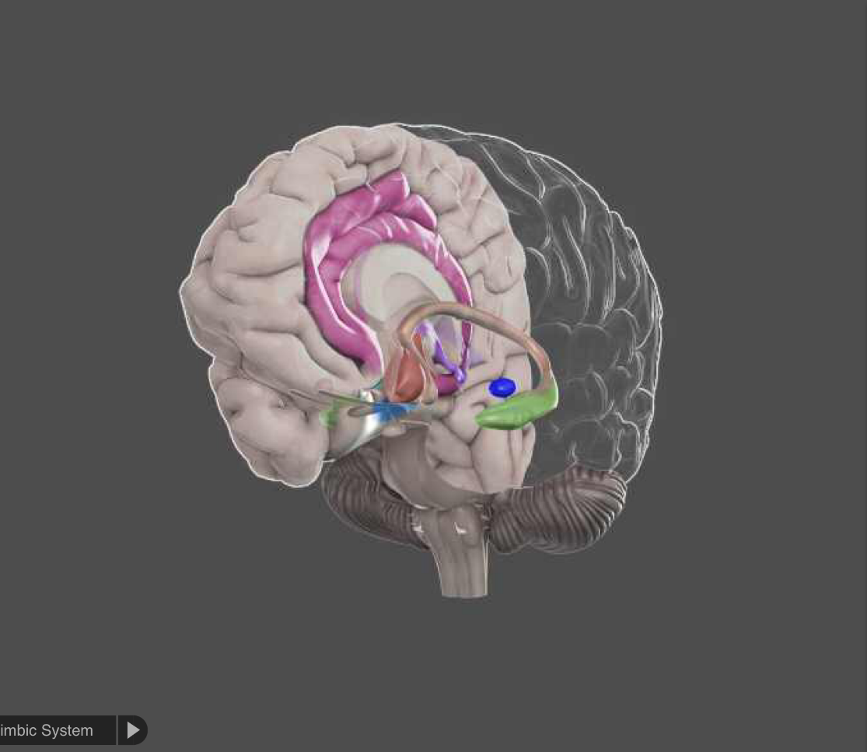
Notes:
On the down side, the limbic system dominates and other reactive parts of the brain take over. Whenthe amygdala gets overstimulated, particularly by stress or fear, the neurotransmitters and hormones that are released in the system are the type that engage your automatic body systems - heart rate, breathing, eye dilation, blood flow - to get you ready for fight, flight, or freeze. They are not the same kinds of neurotransmitters used by your pre-frontal cortex, and the sending of information to the PFC from the hippocampus is blocked, as is access to memory. When you are really upset, the thinking part of your brain is shut down, and the reacting part of your brain is powered up.
Have you (or your students) ever done anything when you were really upset and afterward thought "What was I thinking?" That's the problem. You weren't. You were reacting, and you were reacting at a time when your thinking ability was very limited. Drs. John and Julie Gottman of the University of Washington, experts in how couples relate to each other, say quite directly that when you are in that kind of upset state, it’s simply impossible to be rational. Some researches call that the amygdala hijack. The only rational choice is to step away until you can calm down.
There’s a reason for this. From a strictly biological perspective, when you see that lion hiding in the grass, it’s not a time to be contemplative. It’s a time to act, and act quickly. But stressing students (and teachers, for that matter) puts their brain in the least effective mode for learning.
And it gets worse. Cortisol is one of the hormones that is released in your system when you are stressed, and one of the effects it has is to dissolve the little spikes that grow on your dendrites when they are trying to build new synapses. It melts your learning away.

Slide 23
Performance
Stress
Notes:
To complicate our lives as teachers, each student has a different curve profile. What may be a positive challenge for one student can push another student under water.

Slide 24
Notes:
There is another network of structures in the brain stem called the reticular activating system, or thankfully RAS for short. This system is one of the core mechanisms for filtering sensory input. We can’t attend to all of the information flooding our senses at any one moment, and the RAS helps to decide what we are consciously aware of and what we aren’t‘.

Slide 25
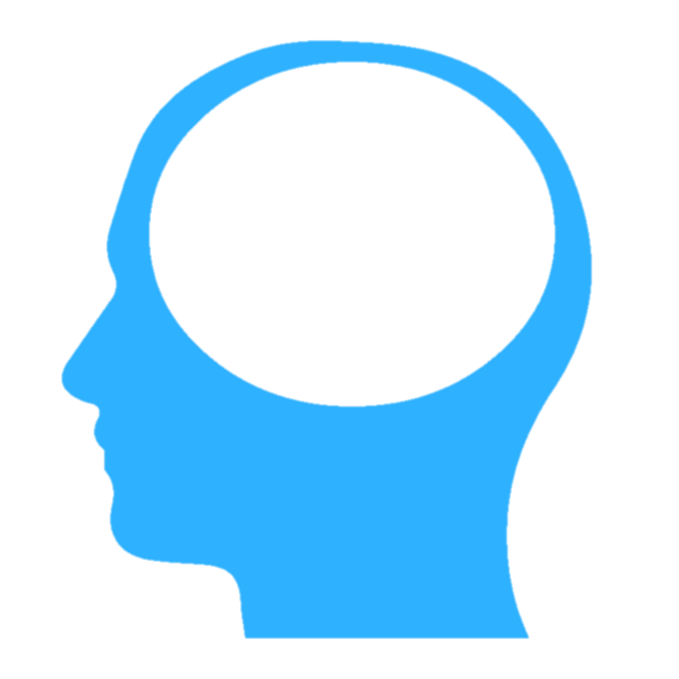
Notes:
There are three primary kinds of information that the RAS will prioritize.

Slide 26
!
NEW!
Notes:
Novelty is one. New things grab out attention quickly. (A new kid in class is always the center of attention, for good and bad.) That’s part of the dreadfully addictive nature of smart phones – they are bottomless pits of novelty.

Slide 27
!
Notes:
Things that we care about are also a high priority. When you are in a crowd of thousands of people, you can spot the face of a friend or family member, yet not be able to describe a single other face around them.

Slide 28
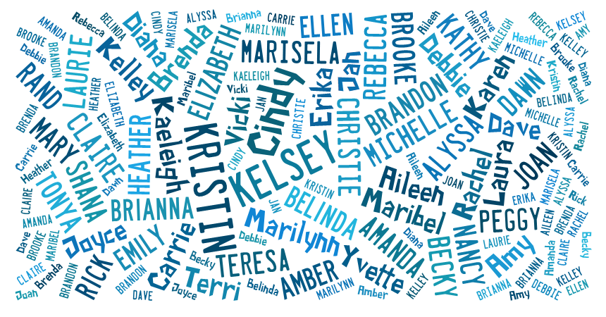
Notes:
How many times have you been at a party, and all of the background discussion is simply a blur of white noise – until someone says your name, which will pop out of that meaningless buzz. That’s your RAS at work.

Slide 29
It is literally neurologically impossible to learn deeply about something you don’t care about.
Dr. Mary Helen Immordino-Yang

Slide 30
!
Notes:
Image from https://en.wikipedia.org/wiki/Semi-automatic_firearm
The highest priority is threat. Our brain’s first job is survival, so threat is always put at the top of the list. There is a psychological observation called the ”Weapons Effect,” which describes the observation that someone who has been held up at gunpoint can often describe the gun in greater detail than the person holding it.

Slide 31
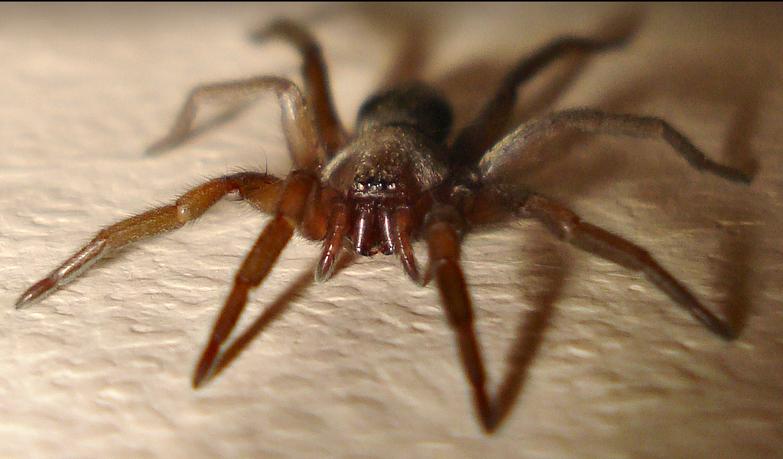
Notes:
http://www.flickr.com/photos/micks-wildlife-macros/
Some of these things that we react to are innate, but many are learned and highly individual. Some of you are not happy with the image I’ve put on the screen, while others don’t particularly care. And yes, it was mean of me to put it on the slow zoom.

Slide 32
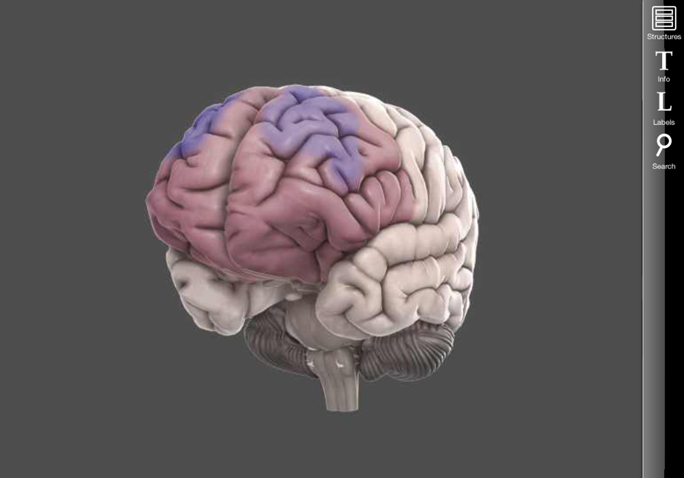
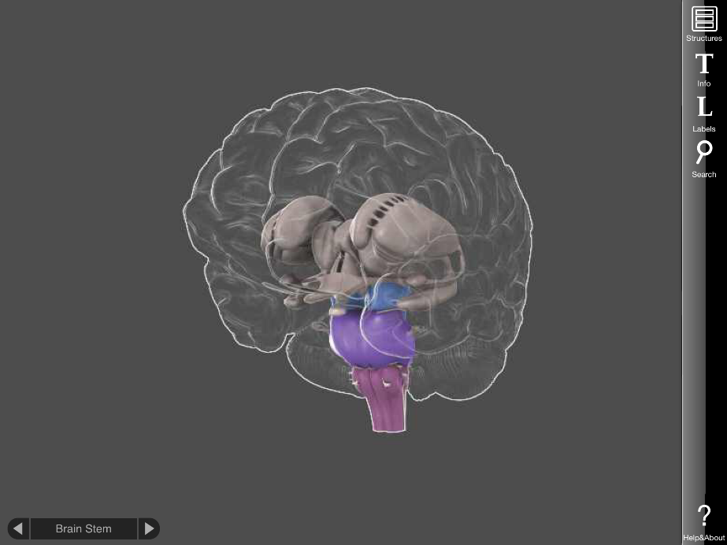
Notes:
What gets through the RAS in turn is what drives the PFC and the limbic system. If the information getting through is perceived as something interesting, or exciting, or desirable, or new, or surprising, your amygdala will be mildly stimulated, and you will pay more attention. And your pulse rate will rise slightly, your eyes will dilate, and other mild physical responses. If it’s perceived as a threat, depending on the severity of the threat, your limbic system may become so active as to cause the emotional and cognitive consequences we discussed earlier. The three systems work in a very complex, ever-changing dance. The important thing to remember is that there are modes of dance that result in much better learning (and happiness) than others.
The other key takeaway is that for many of the situations we face, whether or not we perceive it as a threat is up to us. Most of the triggers we experience are learned – which means they can be unlearned. And we as teachers can do our best to avoid creating and maintaining those triggers.

Slide 33
Reflection
What was surprising?
What did you already know, but now see in a new way?
What do you want to explore further?

Slide 34
Notes:
https://upload.wikimedia.org/wikipedia/commons/9/9a/Default_mode_network-WRNMMC.jpg

Slide 35
Notes:
Image: https://pixabay.com/p-1488213/?no_redirect

Slide 36
Notes:
https://upload.wikimedia.org/wikipedia/commons/f/fb/Mind-reading-Russell-Morgan.jpeg

Slide 37
Notes:
Image: https://pixabay.com/en/advert-advertising-banner-blank-84406/

Slide 39
Notes:
Image: https://upload.wikimedia.org/wikipedia/commons/7/7b/Paul_Brook_Mind_Reader.jpg

Slide 40
Notes:
Remake of the Heider-Simmel video
https://vimeo.com/36847727

Slide 41
Notes:
https://upload.wikimedia.org/wikipedia/commons/9/9a/Default_mode_network-WRNMMC.jpg

Slide 42
Notes:
Image: Personal collection

Slide 43
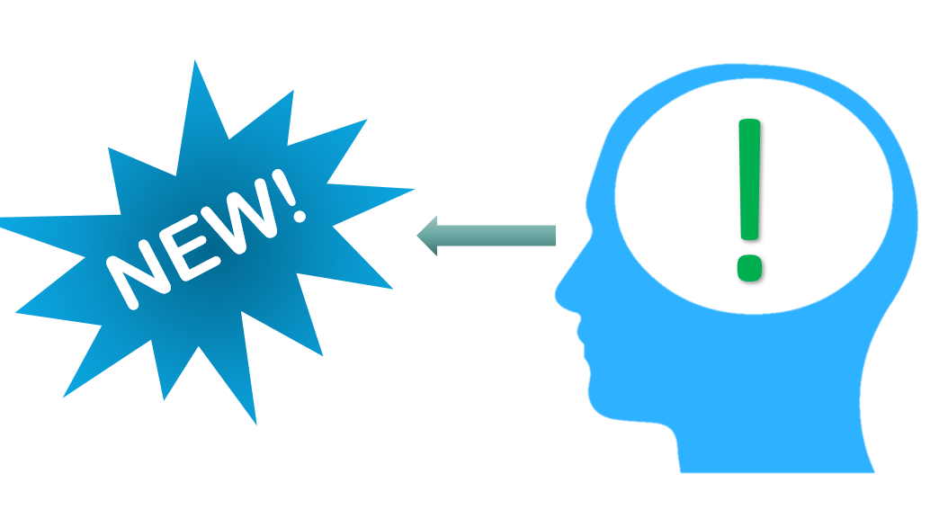
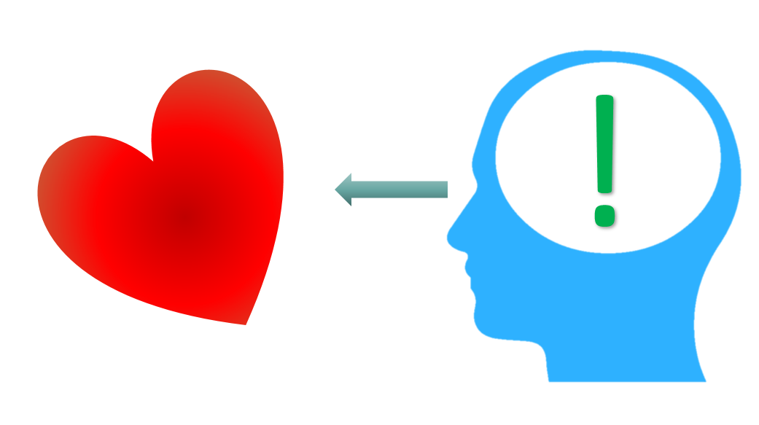
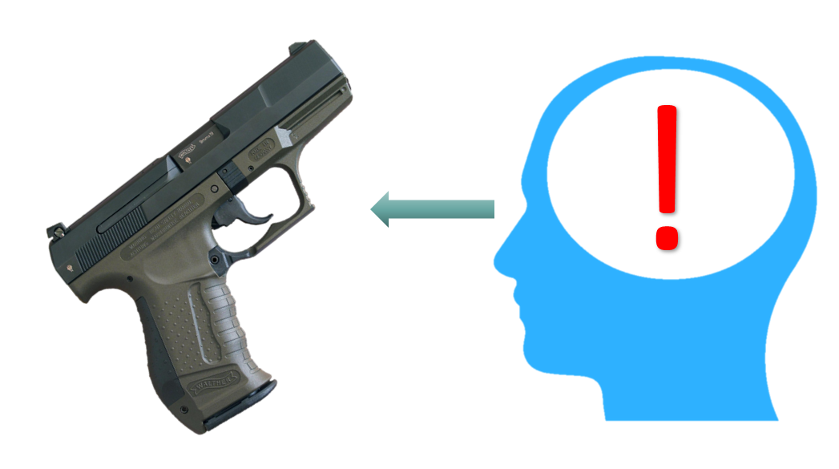

Slide 44
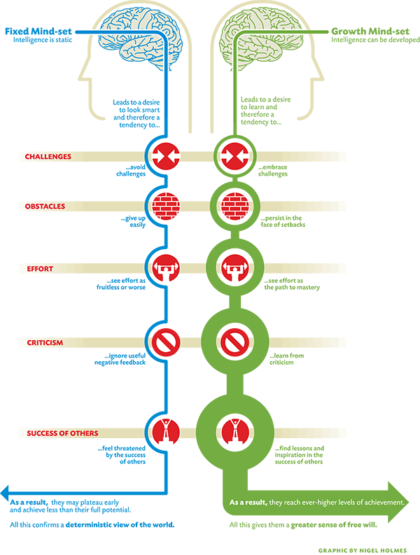
Notes:
Image source: http://lavendaire.com/knowing-mindset-fixed-vs-growth/

Slide 45
THREAT
THREAT
THREAT
Notes:
Image source: http://lavendaire.com/knowing-mindset-fixed-vs-growth/

Slide 46
THREAT
THREAT
Notes:
Image source: http://lavendaire.com/knowing-mindset-fixed-vs-growth/

Slide 48
Reflection
What was surprising?
What did you already know, but now see in a new way?
What do you want to explore further?

Slide 49
Notes:
https://upload.wikimedia.org/wikipedia/commons/0/0b/Grevys_zebra.jpg

Slide 52
Mentor
Ally
Herald

Slide 53
Antagonist
Threshold
Guardian
Shadow

Slide 54
The need to belong and feel connected
Notes:
We all share three sets of basic needs. We need to feel that we belong and feel connected to others.

Slide 55
The need for self-determination and autonomy
Notes:
We have a need to have autonomy and ability to make choices. https://commons.wikimedia.org/wiki/File:Boracay_Sailing_Paraw.jpg

Slide 56
The need to feel competent
Notes:
We need to feel a sense of competence, and that what we do has meaning.

Slide 57
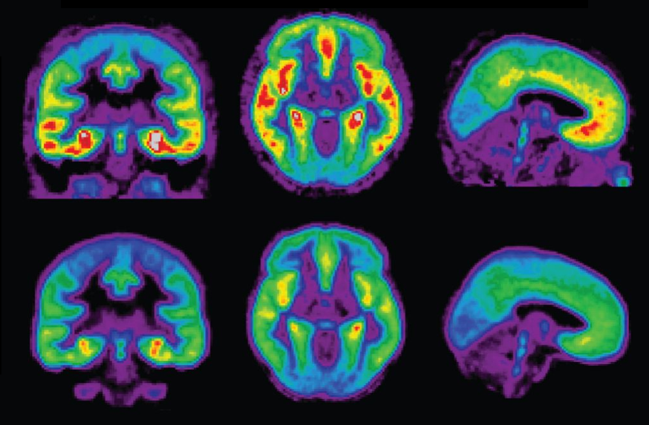
Notes:
https://upload.wikimedia.org/wikipedia/commons/9/9a/Default_mode_network-WRNMMC.jpg
https://etc.usf.edu/clipart/19900/19909/girlread_19909.htm

Slide 59
Contact Information
Conn McQuinn
McQuinnable Educational Services
conn@mcquinnable.com
www.mcquinnable.com

