Slide 1
Neuroscience and Learning
Snoqualmie Valley ELEMENTARY SCHOOL conn mcquinn
Notes:
Neuron Image: http://cdn1.collective-evolution.com/assets/uploads/2012/11/FEATURE.jpg

Slide 2
Notes:
You’re brain is buzzing right now from all of the excitement and stimulation of this conference. We’re going to start this session with sixty seconds of quiet to help you focus. For the next minute just close your eyes and take slow, deep breaths, concentrating just on the sensation of the air entering and leaving. I’ll set a timer.

Slide 3
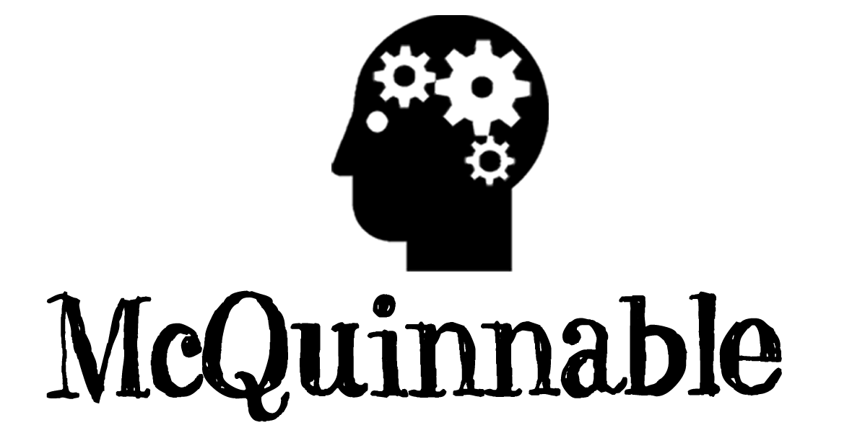
www.mcquinnable.com

Slide 4
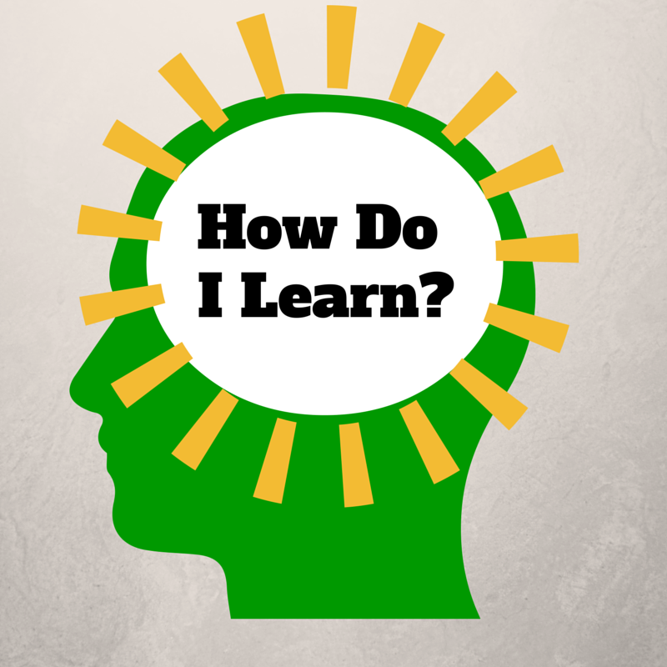
Notes:
The “How Do I Learn” grant is funded by the NIH Blueprint for Neuroscience Research and administered by National Institute on Drug Abuse (NIDA), part of the National Institutes of Health.
This presentation is based on work that we have done for the last five years in the grant program How Do I Learn? Our project is a partnership between various schools and departments at the University of Washington and Puget Sound ESD. It is supported by a grant from the Blueprint for Neuroscience Research and is administered by the National Institute on Drug Abuse, part of the National Institute of Health. The underlying concept is that if parents, students and teachers have a basic understanding of neuroscience and learning, they can use that knowledge to improve theirs and others’ learning. I have been doing grant work that focuses on neuroscience since the decade of the brain, some 20 years ago. The new technologies that allow for imaging and measuring activity in the brain have allowed us to learn more about the brain in the last twenty years than in the previous twenty centuries.
The “How Do I Learn” grant is funded by the NIH Blueprint for Neuroscience Research and administered by National Institute on Drug Abuse (NIDA), part of the National Institutes of Health.

Slide 5
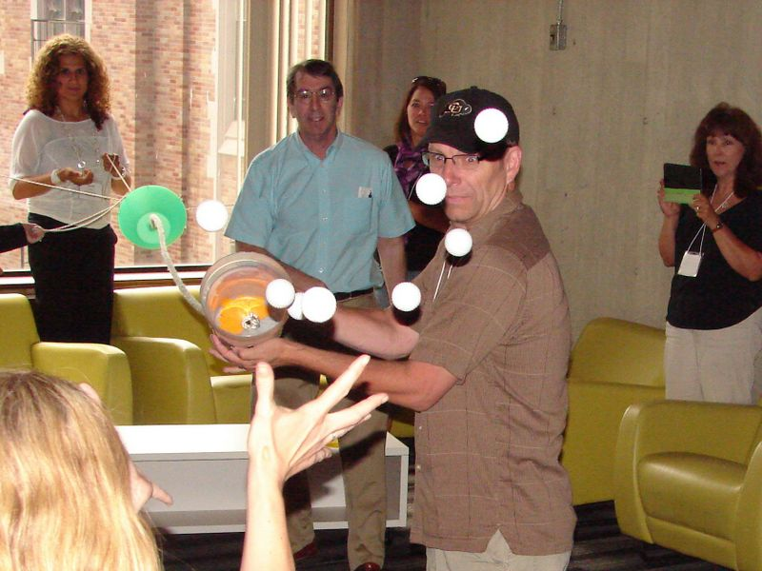
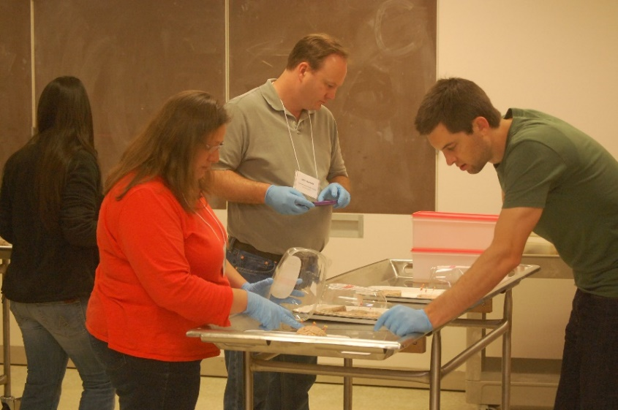
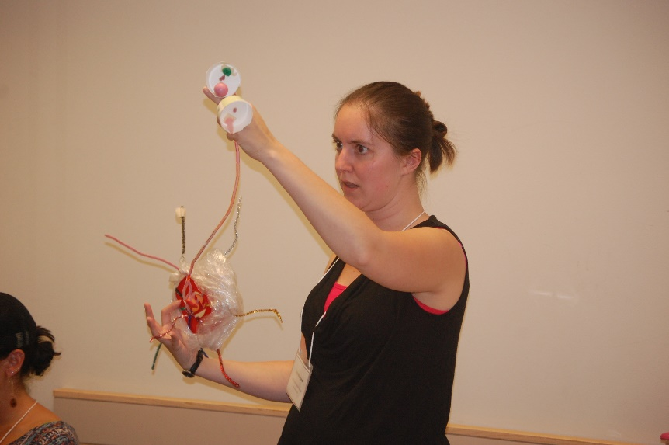
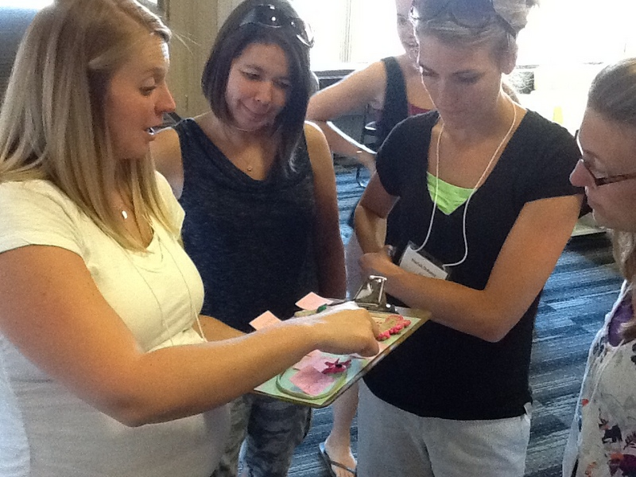

Slide 6
We’ve learned more about the brain in the last 25 years than we did in the previous 2,500.
Dr. Eric Chudler, University of Washington

Slide 7
Notes:
http://static.pexels.com/wp-content/uploads/2014/07/astronomy-constellation-dark-2150.jpg
We are not going to try to jam everything about neuroscience and learning into this presentation. (That would be dreadfully wrong from a neuroscience perspective!) The human brain is the most complex structure in the known universe, and there is still a lot that hasn't been figured out yet. What we are going to go over are a few key concepts that our participating teachers have found useful and that are fundamental to understanding any application of neuroscience to learning, and how those concepts tie directly to important ideas around mindset, technology, and stress.

Slide 8
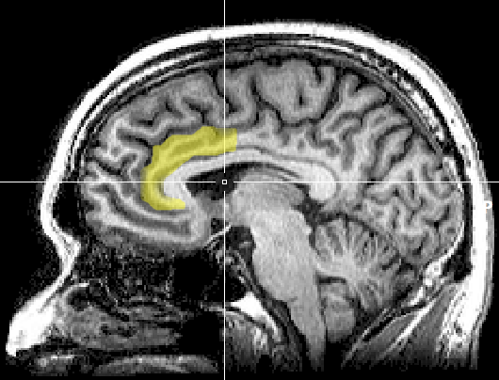
Notes:
https://upload.wikimedia.org/wikipedia/commons/1/10/MRI_anterior_cingulate.png
A note of caution right up front, however. There has been a lot of misapplication of neuroscience, or misinterpretation, to outright myths that have sprung up around this area of study. Often a minor research result gets blown up into a complex model of application that is touted as being "proven by science," when the original research might only have suggestive implications.
Original image caption: There is evidence suggesting that the more the anterior cingulate cortex signals conflict, the more dissonance a person experiences and the more their attitudes may change.

Slide 9
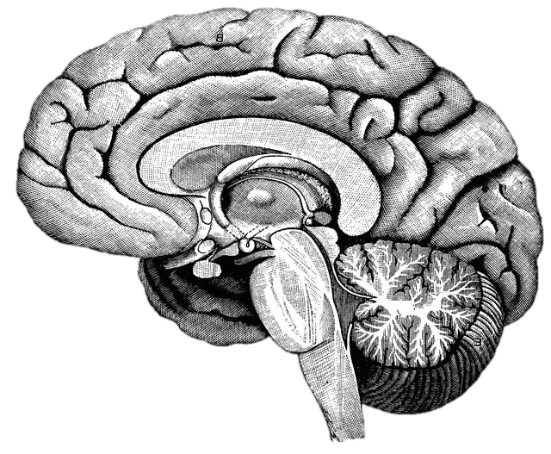
What happens in the brain when you learn?
Notes:
http://upload.wikimedia.org/wikipedia/commons/f/fe/14th-century_painters_-_Diagram_of_the_brain_-_WGA15761.jpg
Without discussing with anyone, write down what you already know about what happens in the brain when you learn. You will not need to share this with anyone.
After the one minute: This is from an instructional model called the NED Learning model, designed by Dr. Kieran O’Mahony. (You can read more about it at http://k12.nedlearning.com/index.html#free_printable_kit_details) By stating this fairly open question, I’m getting you to pull up your prior knowledge on the topic, which is important because all new knowledge has to be connected to prior knowledge. It’s also an emotional hook, since I have in essence asked you to guess what I’m going to tell you next, so you are more attentive to what I’m going to say. It’s like the silly cartoon hydroplane races at the Mariners games. Why should we care if the red, green, or yellow boat actually wins? But once we’ve picked a color we get really invested in the outcome and cheer or moan at the outcome.

Slide 10
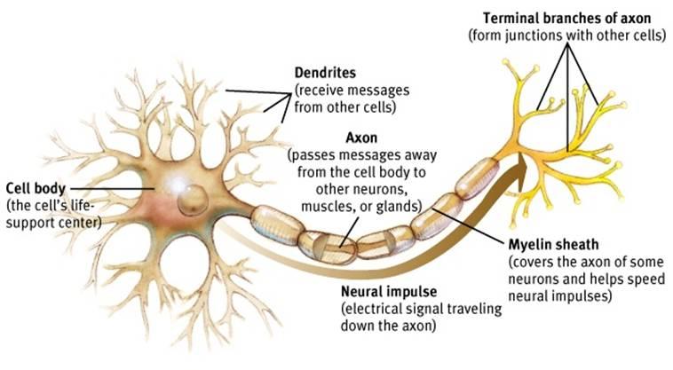
Neuron
Notes:
Dendrites receive signals from other neurons – like a baseball glove catches a ball. And axons and their axon terminals send the message to other neurons – just like a baseball player throwing a ball to another player.
http://www.appsychology.com/Book/Biological/Biologypics/clip_image002.jpg

Slide 11
Notes:
https://www.youtube.com/watch?v=PQcmw15rzkA

Slide 12
Notes:
When a neuron receives a signal at the dendrite end, the chemical message is changed to an electrical pulse. At the beginning of the axon, all these electrical pulses are summed up, and if it reaches a critical threshold, it fires a signal that travels down the axon. The myelin increases the speed of this electrical signal. (It’s important to know that brains are not fully myelinated until you’re in your early 20s!) When that pulse reaches the terminal, it causes the release of neurotransmitters that diffuse across the space between the two neurons. When enough excitatory neurotransmitters dock on dendrite on the post synaptic neuron, it triggers electrical pulses that shoots down the next axon. After docking on the post synaptic neuron, neurotransmitters then float away and are recycled back into the pre-synaptic neuron’s axon terminals. Communication between neurons is an chemical process.
ASK FOR 3 VOLUNTEERS TO DRESS UP AS NEURONS! Have volunteers demo this after explanation.

Slide 13
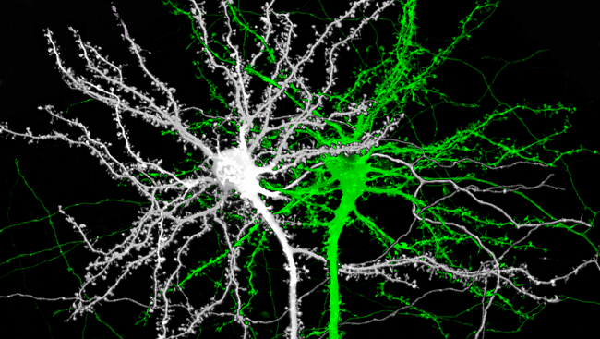
Notes:
Image source: http://www.brainfacts.org/thinking-sensing-and-behaving/learning-and-memory/2014/image-of-the-week-the-structure-of-memory
This is an image of two mouse neurons, and you can see the branches of the dendrites are covered with little knobs. They’re called spines, and they are where the dendrites grow to reach the terminals of other neurons.

Slide 14
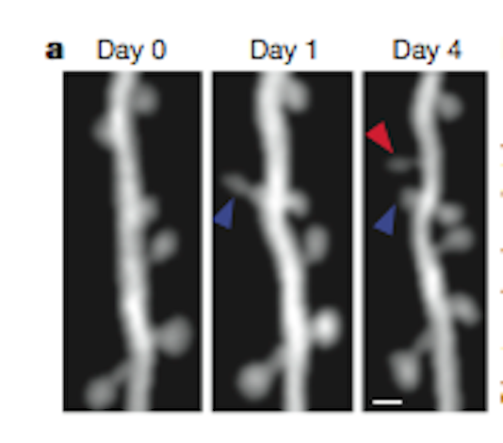
Notes:
Image source: http://blogs.scientificamerican.com/observations/files/2012/04/Screen-shot-2012-04-16-at-5.06.35-PM.png
Here is a real, live neuron growing new spines. They are growing toward neurotransmitter molecules. Notice that the spine by the blue arrow starts out long and thin, but then thickens over time. The neuron is building bridges to reach another active neuron, which is what happens in our brains when we learn. We are literally building learning connections.

Slide 15
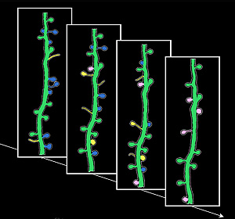
Notes:
Image source: http://news.ucsc.edu/2009/11/3413.html
Learning is not just about building new connections, though. The yellow spines are new ones growing and developing; the blue spines show the opposite, existing spines that disappear. This is called pruning, and they are going away because they aren’t being used. Neural connections are a literal “use it or lose it” proposition. One of the heaviest times of pruning is adolescence, with young teenagers starting out with twice as many connections as they will retain as adults. That’s why the patterns established as teenagers are so profound.

Slide 17
Notes:
Growing new spines on a dendrite provides more receptor sites for neurotransmitters to land. The triggering of the downstream neuron happens not from a single molecule of neurotransmitter, but from a certain quantity of sites being triggered. By having more sites, it is easier to reach that trigger point.

Slide 18
Neuron
Notes:
http://www.appsychology.com/Book/Biological/Biologypics/clip_image002.jpg
One part of the neuron I didn’t mention was the myelin sheath. These are deposits of fat on the axon that act like the insulation on an electrical wire. They increase the speed and strength of the signal that travels down the neuron. The amount of myelin is impacted by diet (it’s one reason that babies have high-fat diets), but most importantly through normal development and repeated firing of the neuron. It’s another part of neurological development enhanced by repetition and practice. (It’s also the “white matter” of the brain.)
We’ll come back to myelin when we talk about the parts of the brain.

Slide 19
Notes:
Image from https://upload.wikimedia.org/wikipedia/commons/4/48/Saltatory_Conduction.gif showing how myelin improves electrical transmission down the axon.
This image shows how dramatically myelin can effect the neuron signal. A myelinated neuron transmits information up to ten times faster! Multiple sclerosis is a disease that attacks the myelin of muscle neurons, which is why it has such devastating impact on mobility.

Slide 20
Notes:
https://commons.wikimedia.org/wiki/File:Dog.in.sleep.jpg
What can we do to improve neuron connections? Sleep is #1. Spines consolidate during sleep, and lack of sleep can seriously impact the learning from the day before.

Slide 21
Repetition
Repetition
Repetition
Notes:
Repetition is critical to learning facts and skills, particularly repetition with good coaching or feedback.

Slide 22
Notes:
Exercise is important as well. Aerobic exercise generates Brain Derived Neurotropic Factor, which enhances neuron growth.

Slide 23
Notes:
Stress damages new neuron spines, or prevents them from forming.

Slide 24
Notes:
Image source: https://www.flickr.com/photos/lentzstudios/3884839779
Boredom is a form of stress!

Slide 25
Reflection
What was surprising?
What did you already know, but now see in a new way?
What new questions do you have?

Slide 26
Reflection
What was surprising?
What did you already know, but now see in a new way?
What new questions do you have?

Slide 27
Multitasking is a lie
1 2 3 4 5 6 7 8 9 10 11 12 13 14 15 16 17 18
Notes:
This is adapted from this video by Dave Crenshaw - https://www.youtube.com/watch?v=BCeGKxz3Q8Q

Slide 29
Notes:
Let's go back to those connected neurons. The networks of connections between neurons is increasingly recognized as the fundamental framework of brain function. In the same way that understanding the genome of our DNA has led to leaps in understandings of genetics and health, understanding the "Connectome" is now seen as key to understanding the brain.
With new sensing and imaging technologies, it is now possible to view the connectome in action, in real time. [https://youtu.be/dAIQeTeMJ-I] How complex is this? The brain contains roughly 86 billion neurons, and somewhere around one quadrillion synapses.

Slide 30
Notes:
https://www.youtube.com/watch?v=6Sz-l6RDrvU

Slide 31
What are the major brain systems involved in learning?
Notes:
http://upload.wikimedia.org/wikipedia/commons/f/fe/14th-century_painters_-_Diagram_of_the_brain_-_WGA15761.jpg

Slide 32
Notes:
The pre-frontal cortex is where you do your basic thinking. It's the part of your brain that is (hopefully) engaged now with your awareness. It's the part of the brain we want the students using when they think, plan, and make choices. We know now that this is the last part of the brain to finish developing, often not until 23 or 24 years old. (Even older with some males, which will surprise no female.) There’s a reason kids don’t seem to think like us. They don’t.
It does not always perform at the same level. The PFC (as neuroscientists like to call it) is sensitive to a variety of factors. We’ll come back to this.
This and the following images are from the iPad App 3D Brain from Cold Spring Harbor Labs. There is a free and an HD pay version. (99 cents!)

Slide 33
Notes:
Another major system to understand is the limbic system. This is the part of the brain that deals with emotion and - interestingly enough - memory formation. Two critical parts are the amygdala and the hippocampus, one of each on opposite sides of the brain. The amygdala is one of the parts of the brain that manages your emotions.. The hippocampus is involved in the storage and retrieval of long-term memories, as well as routing information to the PFC.
If your limbic system is mildly engaged, it makes you more alert and focused. The neurotransmitters and hormones that are released enhance memory formation and cognitive function. This is what is happening with students when they are engaged and challenged.
However, if the amygdala gets overstimulated, particularly by stress or fear, the neurotransmitters and hormones that are released in the system are the type that engage your automatic body systems - heart rate, breathing, eye dilation, blood flow - to get you ready for fight, flight, or freeze. They are not the same kinds of neurotransmitters used by your pre-frontal cortex, and the sending of information to the PFC from the hippocampus is blocked, as is access to memory. When you are really upset, the thinking part of your brain is shut down, and the reacting part of your brain is powered up.
Have you (or your students) ever done anything when you were really upset and afterward thought "What was I thinking?" That's the problem. You weren't. You were reacting, and you were reacting at a time when your thinking ability was very limited. Dr. John Gottman of the University of Washington, an expert in how couples relate to each other, says quite directly that when you are in that kind of upset state, it’s simply impossible to be rational. Some researches call that the amygdala hijack. The only rational choice is to step away until you can calm down.
There’s a reason for this. From a strictly biological perspective, when you see that lion hiding in the grass, it’s not a time to be contemplative. It’s a time to act, and act quickly. But stressing students (and teachers, for that matter) puts their brain in the least effective mode for learning.
And it gets worse. Cortisol is one of the hormones that is released in your system when you are stressed, and one of the effects it has is to dissolve the little spikes that grow on your dendrites when they are trying to build new synapses. It melts your learning away.

Slide 34
Performance
Stress
Notes:
A little stress improves performance, but too much degrades it.

Slide 35
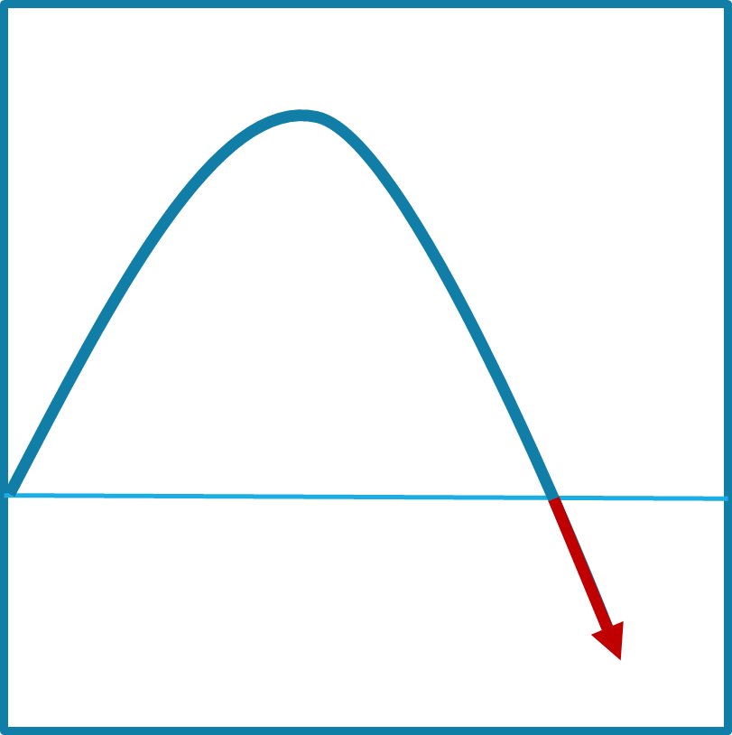
Notes:
On the front part of the stress curve, the function of the pre-frontal cortex is enhanced.

Slide 36
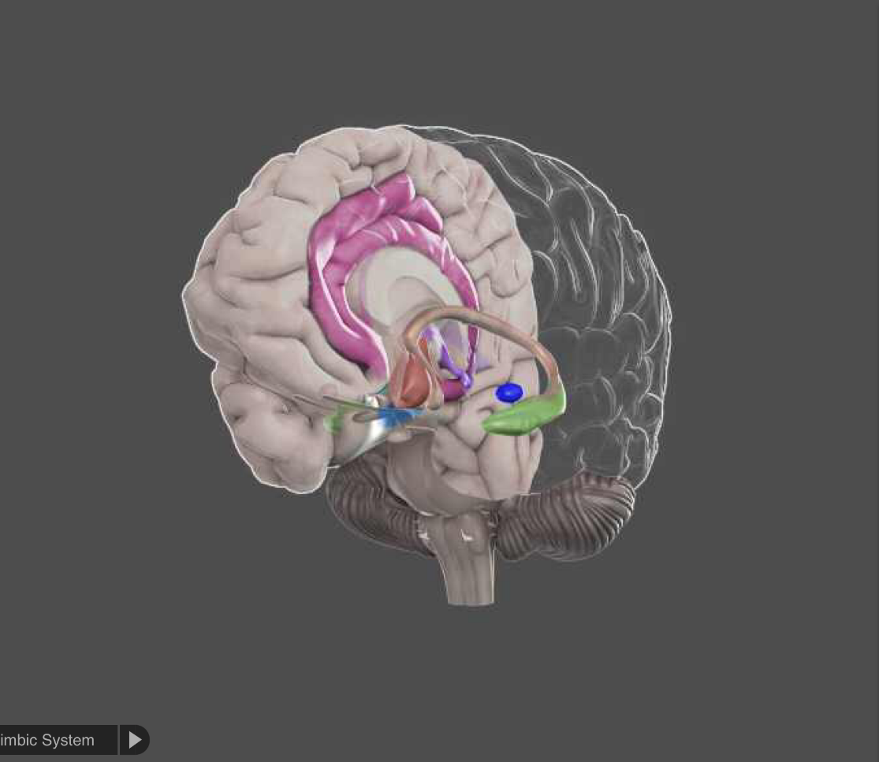
Notes:
On the down side, the limbic system dominates and other reactive parts of the brain take over. The pre-frontal cortex bypassed in favor of more automatic responses.

Slide 37
Where
What were
you thinking?
Notes:
When someone was upset, the right question is “Where were you thinking?”

Slide 38
Performance
Stress
Notes:
To complicate our lives as teachers, each student has a different curve profile. What may be a positive challenge for one student can push another student under water.

Slide 39
Notes:
There is a network of structures in the brain stem called the reticular activating system, or thankfully RAS for short. This system is one of the core mechanisms for filtering sensory input. We can’t attend to all of the information flooding our senses at any one moment, and the RAS helps to decide what we are consciously aware of and what we aren’t‘.

Slide 40
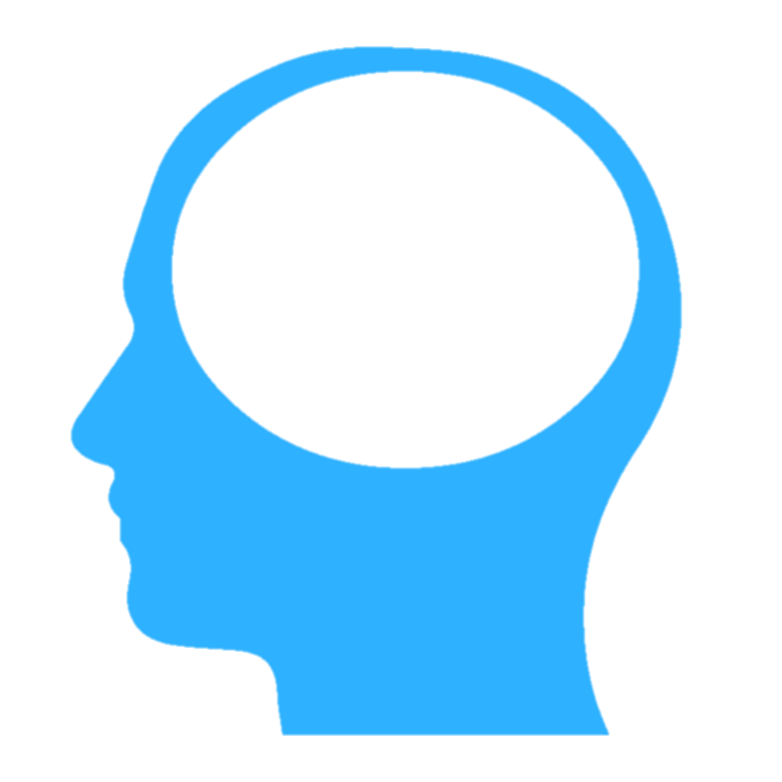
Notes:
There are three primary kinds of information that the RAS will prioritize.

Slide 41
!
NEW!
Notes:
Novelty is one. New things grab out attention quickly. (A new kid in class is always the center of attention, for good and bad.) That’s part of the dreadfully addictive nature of smart phones – they are bottomless pits of novelty.

Slide 42
!
Notes:
Things that we care about are also a high priority. When you are in a crowd of thousands of people, you can spot the face of a friend or family member, yet not be able to describe a single other face around them.

Slide 43
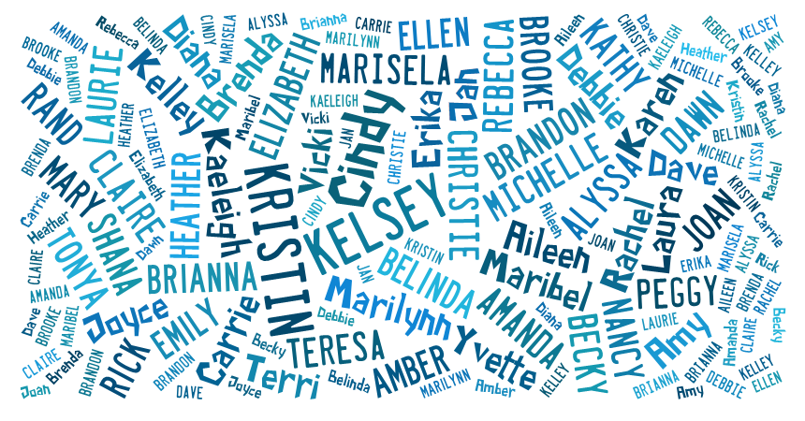
Notes:
How many times have you been at a party, and all of the background discussion is simply a blur of white noise – until someone says your name, which will pop out of that meaningless buzz. That’s your RAS at work.

Slide 44
It is literally neurologically impossible to learn deeply about something you don’t care about.
Dr. Mary Helen Immordino-Yang

Slide 45
!
Notes:
Image from https://en.wikipedia.org/wiki/Semi-automatic_firearm
The highest priority is threat. Our brain’s first job is survival, so threat is always put at the top of the list. There is a psychological observation called the ”Weapons Effect,” which describes the observation that someone who has been held up at gunpoint can often describe the gun in greater detail than the person holding it.

Slide 46
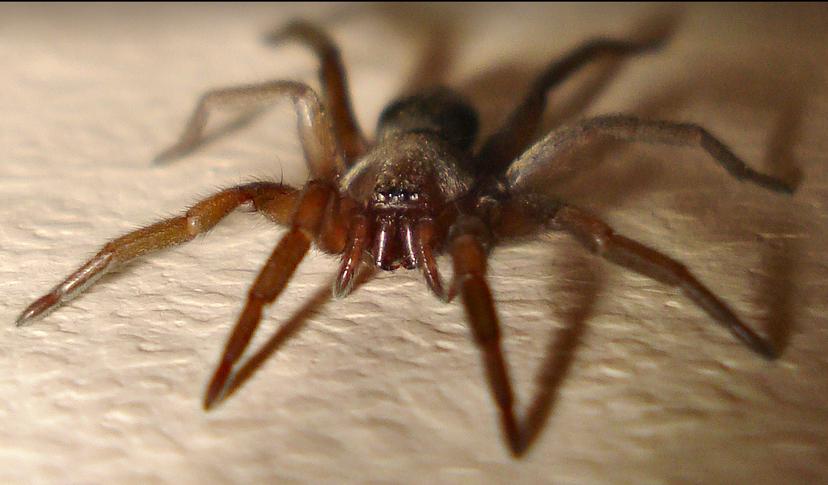
Notes:
http://www.flickr.com/photos/micks-wildlife-macros/
Some of these things that we react to are innate, but many are learned and highly individual. Some of you are not happy with the image I’ve put on the screen, while others don’t particularly care. And yes, it was mean of me to put it on the slow zoom.

Slide 47
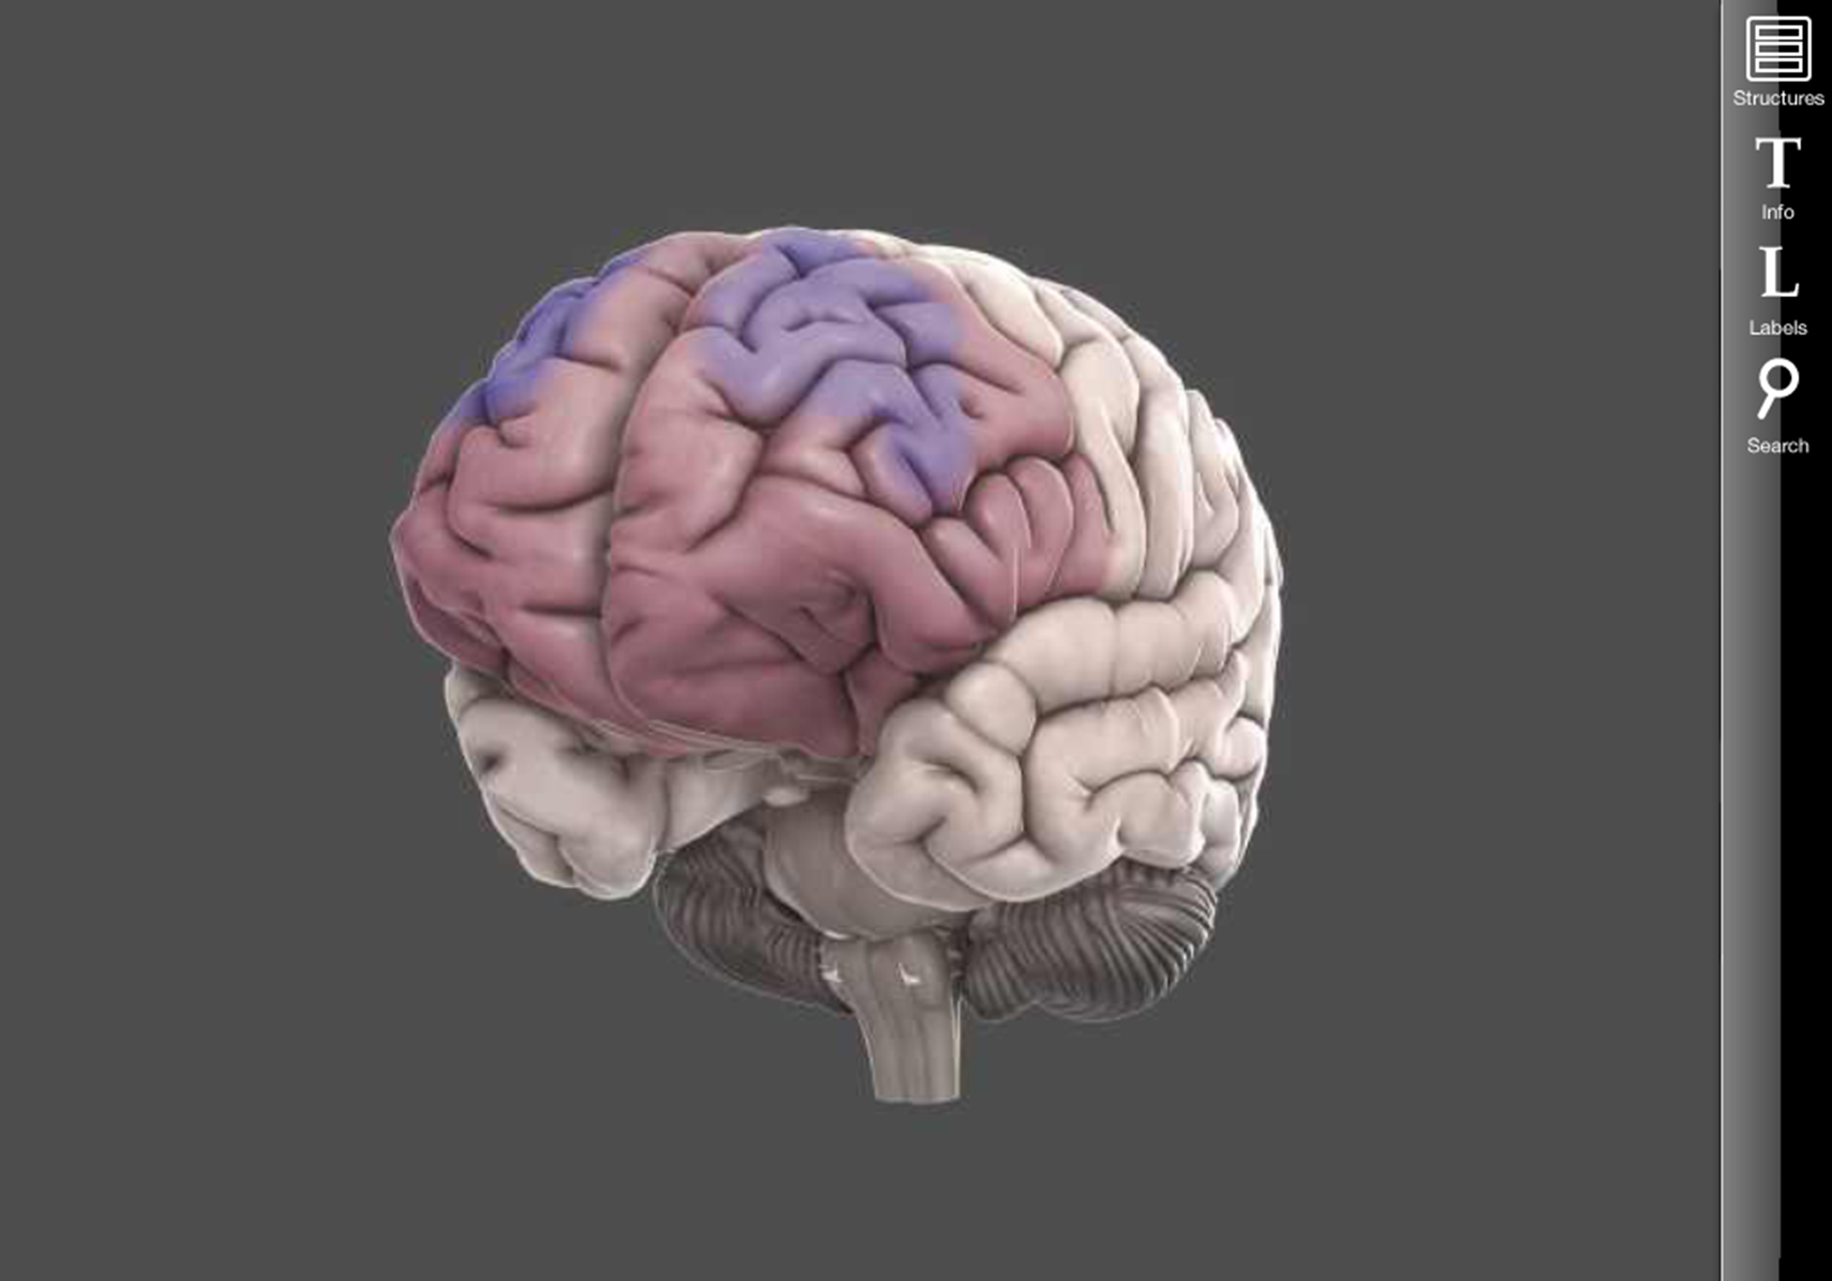
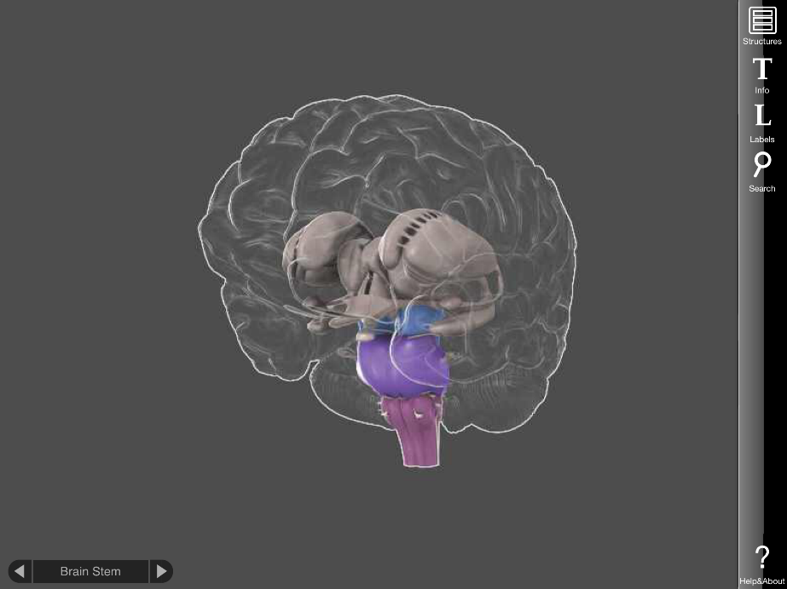
Notes:
What gets through the RAS in turn is what drives the PFC and the limbic system. If the information getting through is perceived as something interesting, or exciting, or desirable, or new, or surprising, your amygdala will be mildly stimulated, and you will pay more attention. And your pulse rate will rise slightly, your eyes will dilate, and other mild physical responses. If it’s perceived as a threat, depending on the severity of the threat, your limbic system may become so active as to cause the emotional and cognitive consequences we discussed earlier. The three systems work in a very complex, ever-changing dance. The important thing to remember is that there are modes of dance that result in much better learning (and happiness) than others.
The other key takeaway is that for many of the situations we face, whether or not we perceive it as a threat is up to us. Most of the triggers we experience are learned – which means they can be unlearned. And we as teachers can do our best to avoid creating and maintaining those triggers.

Slide 48
Student attention
What things in the classroom are getting students’ attention? For what reasons?
What things in their lives are causing them stress? In the classroom?

Slide 49
Stress level
Acute Stress
Time
Notes:
Acute stress is short-lived, and is easier to manage.

Slide 50
Stress level
Chronic Stress
Time
Notes:
Chronic stress is ongoing, and can have widespread toxic effects.

Slide 51
Notes:
The prefrontal cortex and the hippocampi will actually reduce in volume, and the amygdala will increase. The brain wires to be more vigilant.

Slide 52
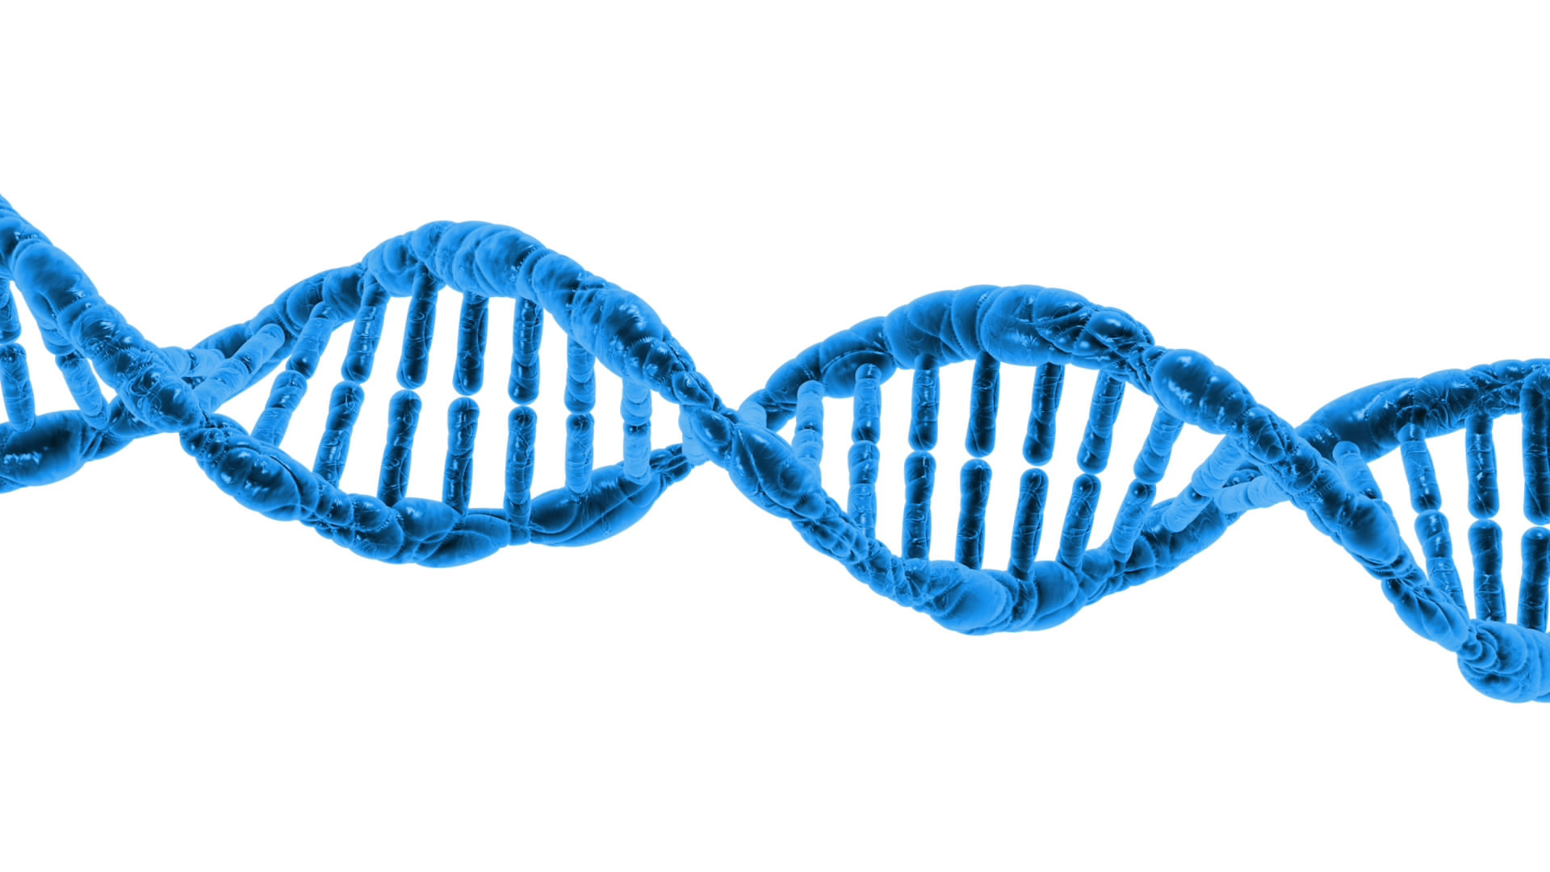
Notes:
Image retrieved from http://www.publicdomainpictures.net/pictures/50000/velka/dna-1370603787LgY.jpg
The change happens at the DNA level. Some changes are inheritable.

Slide 53
Notes:
We think of the brain as being separate from the body, but they’re all part of one big system. Emotional stress (“all in the mind”) can harm the rest of the body; physical stress in the body can harm the brain.

Slide 54
Reflection
What was surprising?
What did you already know, but now see in a new way?
What do you want to explore further?

Slide 55
Reflection
What was surprising?
What did you already know, but now see in a new way?
What do you want to explore further?

Slide 56
Environment
Resiliency
Notes:
https://simple.wikipedia.org/wiki/Primary_school#/media/File:Heiwa_elementary_school_18.jpg
https://www.flickr.com/photos/mindfulness/25466002

Slide 57
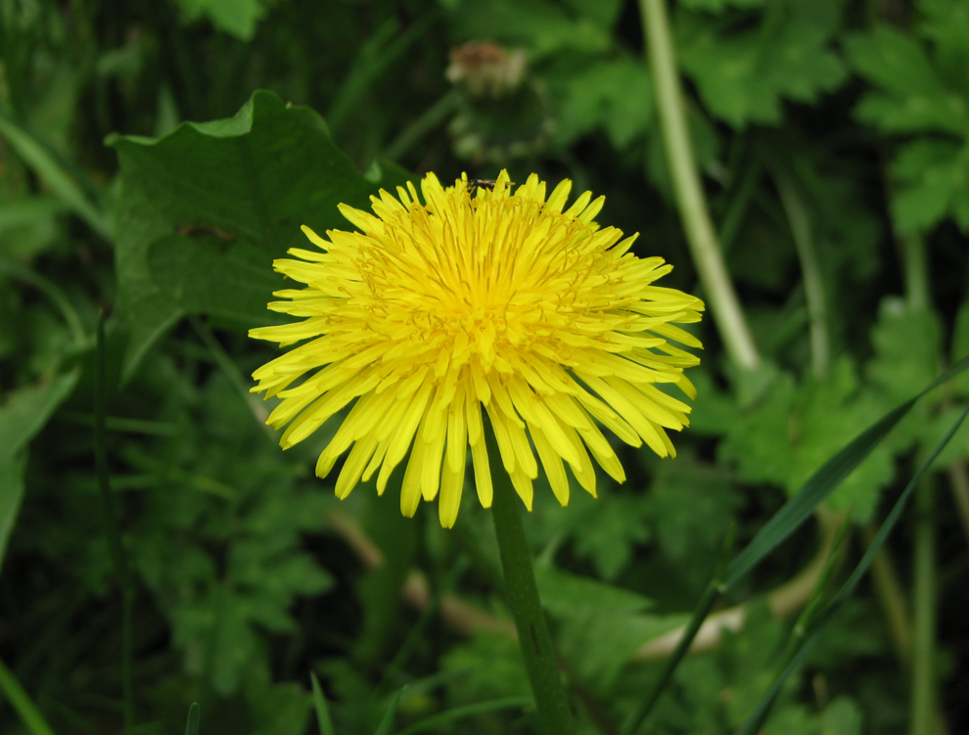
Notes:
https://commons.wikimedia.org/wiki/File:Dandelion_flower_Taraxacum.jpg
Some kids are dandelions, some are orchids. (It’s true of our co-workers, too.)

Slide 58
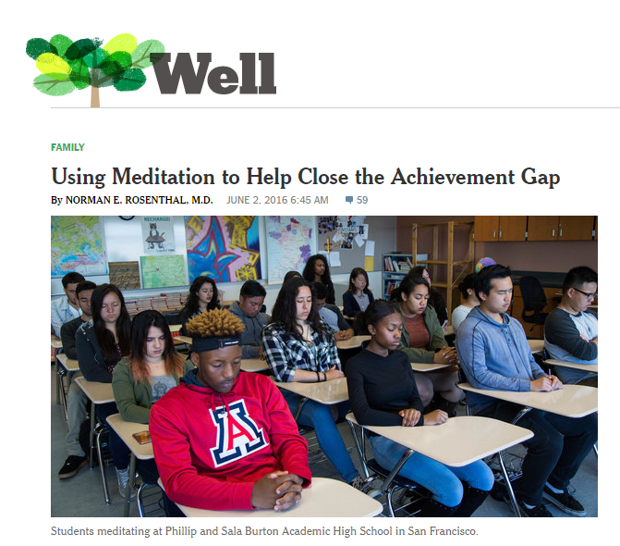
Notes:
http://well.blogs.nytimes.com/2016/06/02/using-meditation-to-help-close-the-achievement-gap/?_r=0
Mindfulness helps. Research says! (But it’s not a silver bullet, and it doesn’t help all people the same.)

Slide 59
The need to belong and feel connected
Notes:
We all share three sets of basic needs. A lack of those needs can be a source of chronic stress.
We need to feel that we belong and feel connected to others.

Slide 60
The need for self-determination and autonomy
Notes:
We have a need to have autonomy and ability to make choices. https://commons.wikimedia.org/wiki/File:Boracay_Sailing_Paraw.jpg

Slide 61
The need to feel competent
Notes:
We need to feel a sense of competence, and that what we do has meaning.

Slide 62
Cura personalis
Old news, dude.
Notes:
St. Ignatius of the Jesuit tradition focused on cura personalis, the care of the entire person. Neuroscience is simply confirming what many of us already knew – or suspected.

Slide 63
“How do you know that
InsertYourName
cares about your success?”

Slide 64
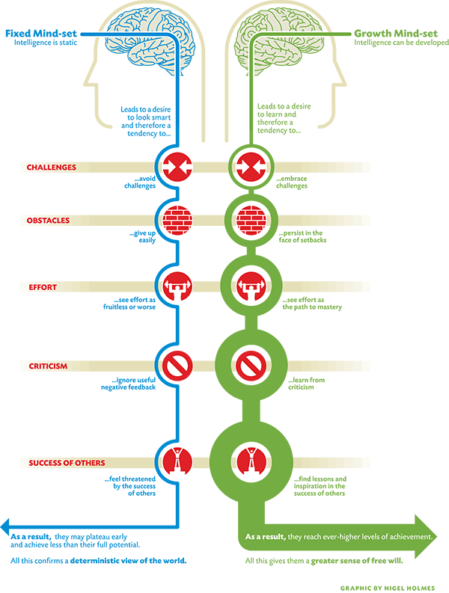
THREAT
THREAT
THREAT
THREAT
THREAT
Notes:
Image source: http://lavendaire.com/knowing-mindset-fixed-vs-growth/

Slide 65
P=p-i
Performance
potential
interference
Timothy Gallwey, Inner Game of… books

Slide 66
Nemo dat quod non habet
You cannot provide
what you do not have.

Slide 67
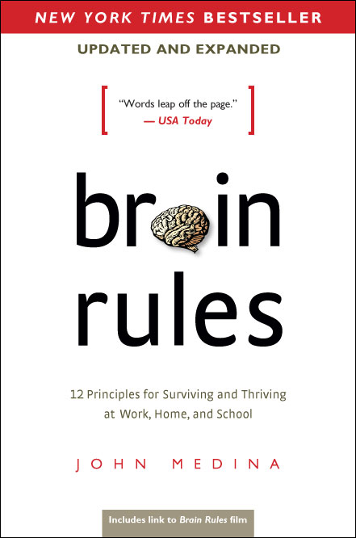

Slide 68
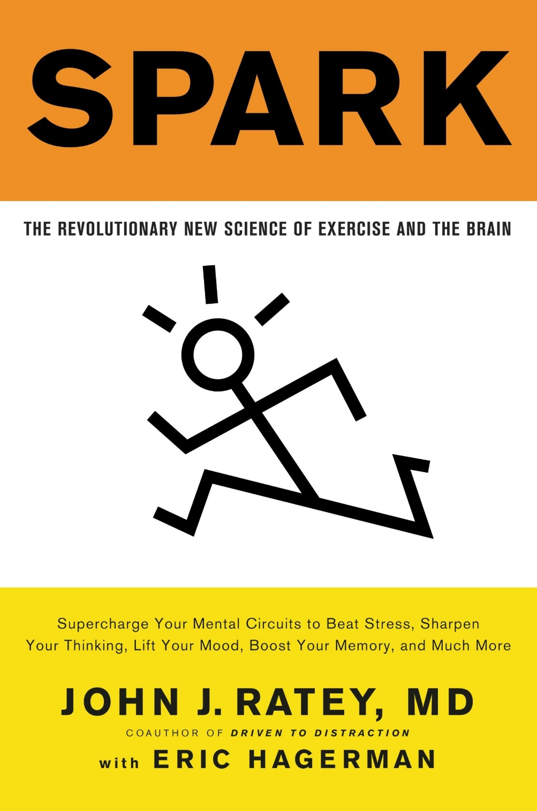

Slide 69
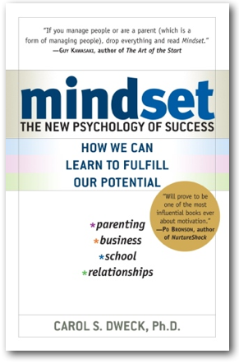
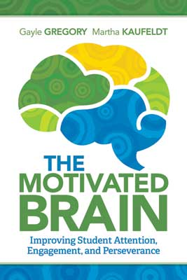

Slide 70
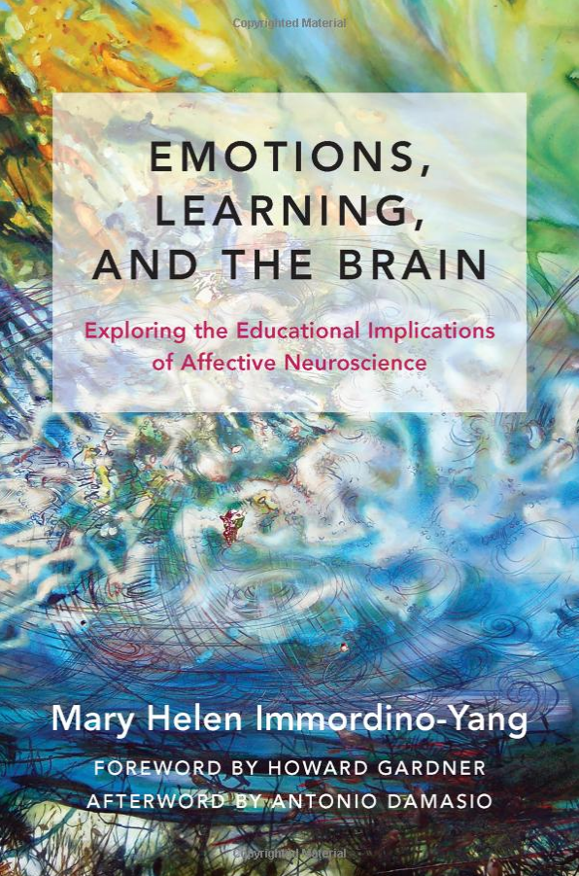

Slide 72
Contact Information
Conn McQuinn
McQuinnable Educational Services
conn@mcquinnable.com
Download presentation: http://www.mcquinnable.com

