Slide 1
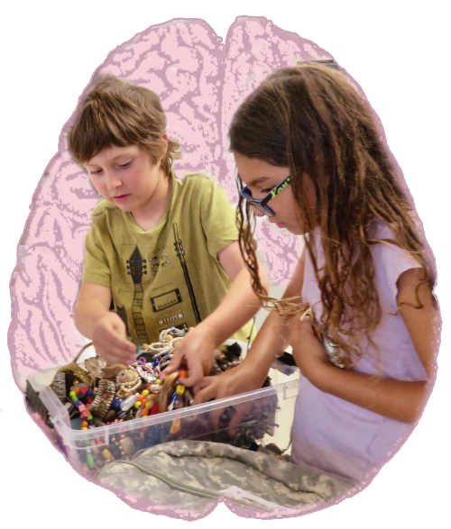
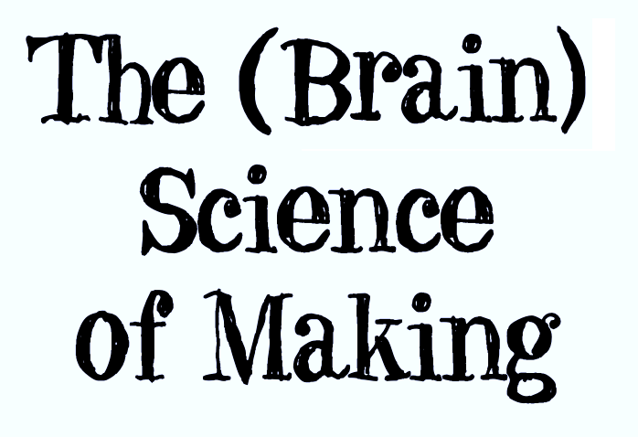
Notes:
Image Credits:
Makerspace image incorporated in title slide: https://www.flickr.com/photos/fabola/37328727661 [Modified by Conn McQuinn]
Neuron Image https://commons.wikimedia.org/wiki/File:R%C3%A9seau_de_neurones.jpg [Modified by Conn McQuinn]
Homunculus https://upload.wikimedia.org/wikipedia/commons/0/0a/Sensory_and_motor_homunculi.jpg [Modified by Conn McQuinn]
Images of the brain: 3D Brain iPad app, by Cold Springs Harbor

Slide 2
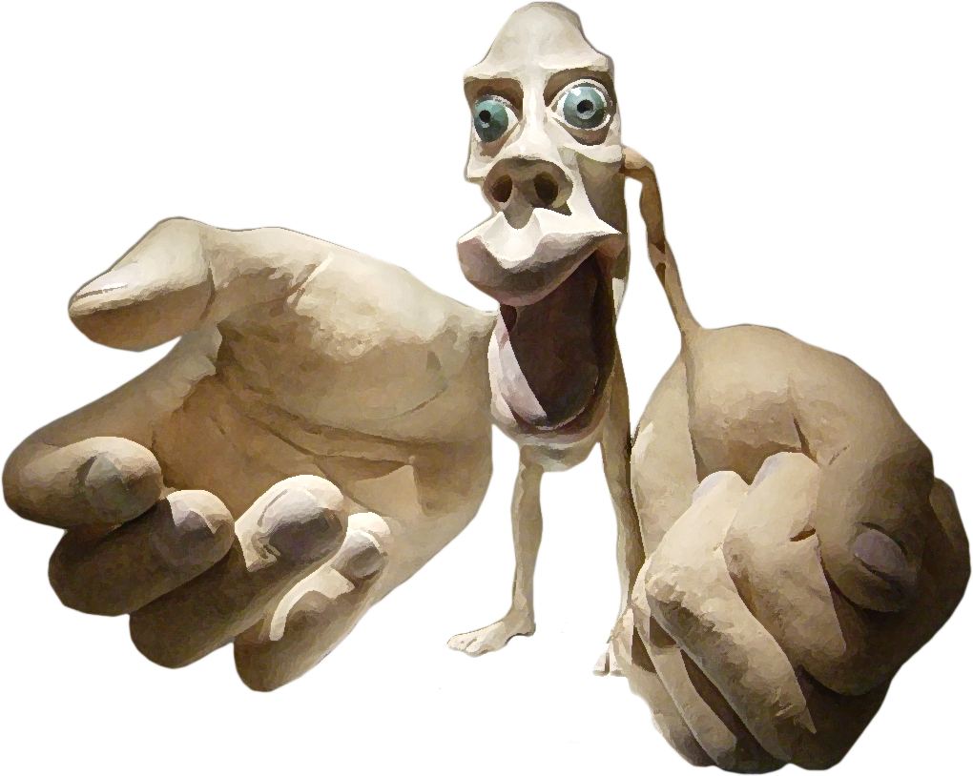
Notes:
This guy is called the homunculus. He is a physical representation of how many motor neurons you have in your brain for different body parts. There is a matching model of the sensory homunculus, which models the number of sensory neurons in your brain for different parts of the body. The hands are outsized on that one, too. (It also has other parts that I’m too embarrassed to put up on the screen.)

Slide 3
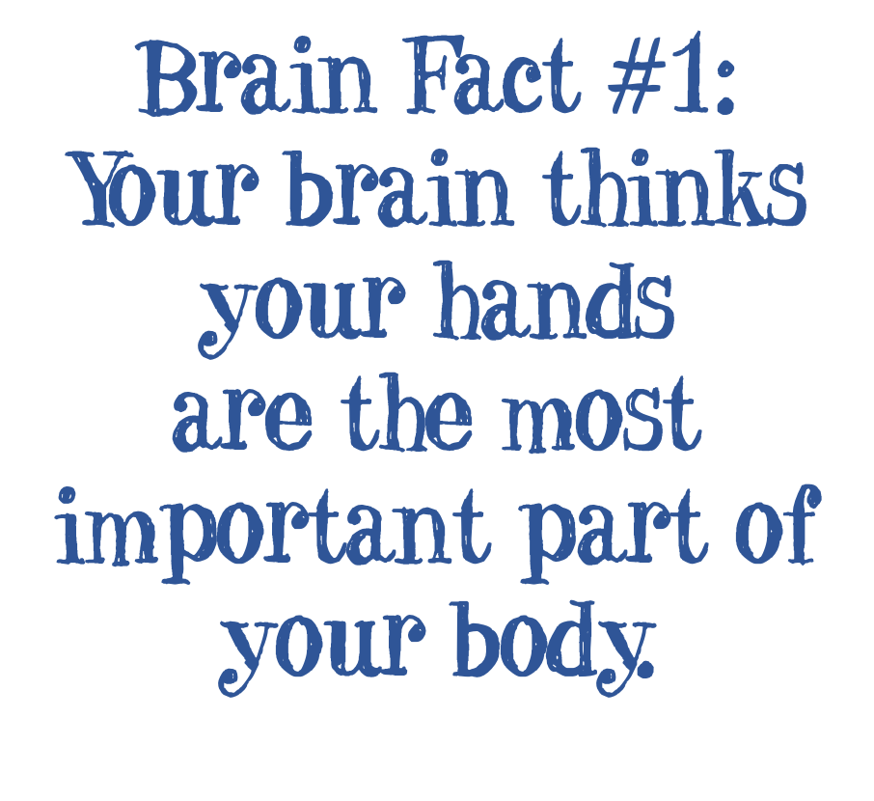
Notes:
Part of why Making is so intrinsically motivating is that it ties into the fundamental primacy of our hands.

Slide 4
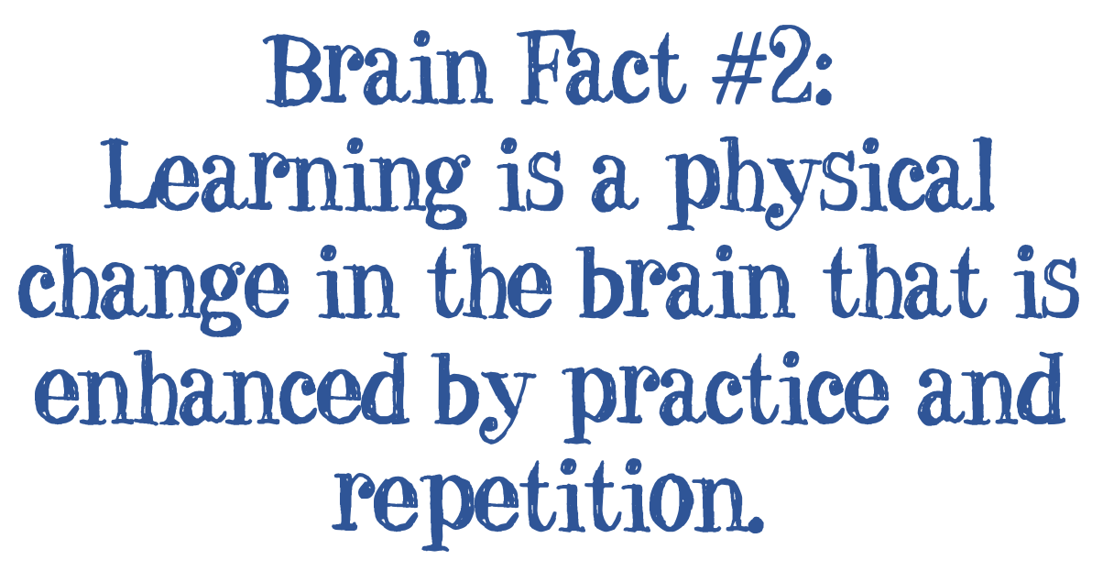

Slide 5
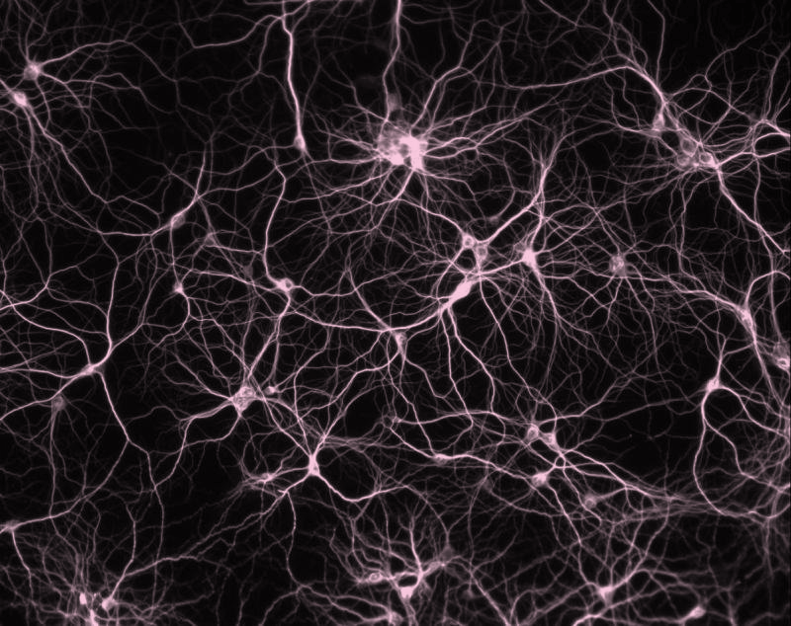
Notes:
When we learn something new, we add new connections to networks of neurons in our brain. Every new fact, new idea, new experience, new skill is a rewiring of our brain. These networks communicate through a electrical and chemical signals.

Slide 6
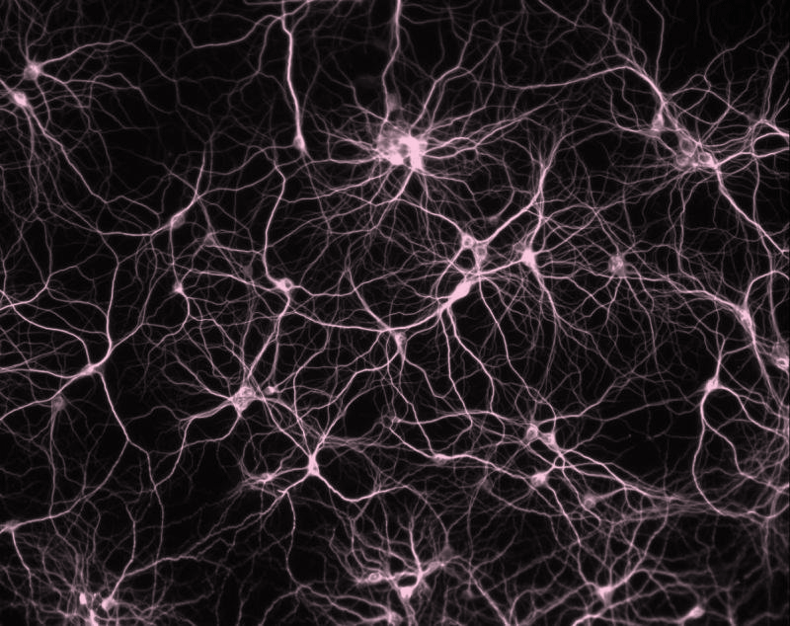
Notes:
These networks are strengthened by repeated firing. There’s a neuroscience rule called Hebb’s Law: The neurons that fire together, wire together. The more times the network is fired, the stronger and faster the signals get. The flip side, is that the less you fire them, the weaker they get, and can eventually be eliminated entirely. Adolescence is a critical period for this “pruning.” Teenagers have twice as many connections in their brain as adults, and their brains are actively eliminating connections that aren’t being regularly used. It’s why adolescence is the second most critical period for brain development.

Slide 7
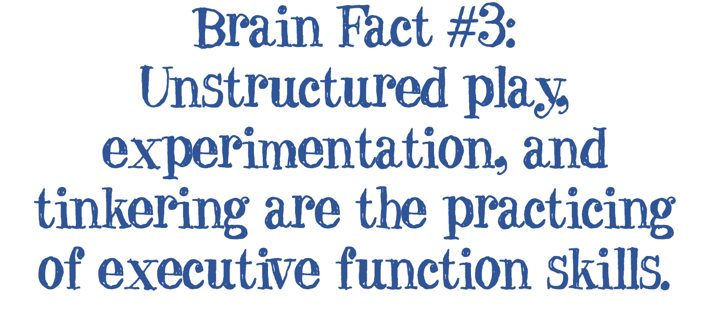

Slide 8
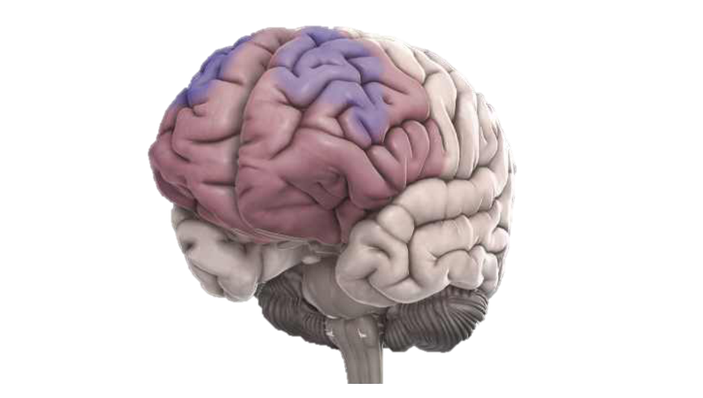
Notes:
This is the prefrontal cortex, the part of the brain responsible for executive function. It’s the last part of the brain to finish developing, extending into the early 20s for most people, or even early 30s for some men. (This will shock few women.) Like any set of neural networks, it improves its functioning through repeated use and practice. Playing for children is practice making decisions, trying things out and evaluating results, making plans, and other forms of practicing executive functions. If we over-structure our children’s lives (and school experiences), we shouldn’t be surprised when we give them the opportunity to self-direct and they stare at us like deer in the headlights. This is born out in research, where the amount of time children spend in unstructured play as preschoolers correlates with higher levels of executive function as older children. Tinkering and self-directed Making are opportunities for students to practice and develop executive function. As Maria Montessori put it, ”Play is the work of a child.”

Slide 9
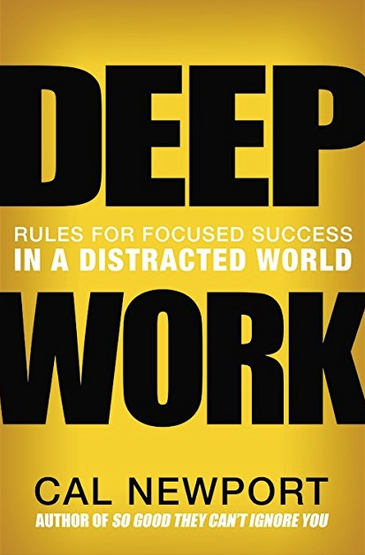
Notes:
Another issue that concerns me is attention. How we practice using our attention becomes our habit, and in our distracted world we often practice paying attention in short, tiny snippets to a variety of shallow things such as tweets, text messages, and Facebook posts. That is what we are wiring our brains to do, and worse, we may be degrading our ability to pay attention deeply over an extended period of time. That’s the thesis of Deep Work, by Cal Newport. The way we structure our school day, do we provide students the opportunity to practice and develop the skills to focus deeply for a long period of time? Making is an opportunity for students to have that exact kind of experience, and build that capacity. The main theme of the book for me, by the way, is that our attention is our most valuable resource – what are we choosing to use it for?

Slide 10
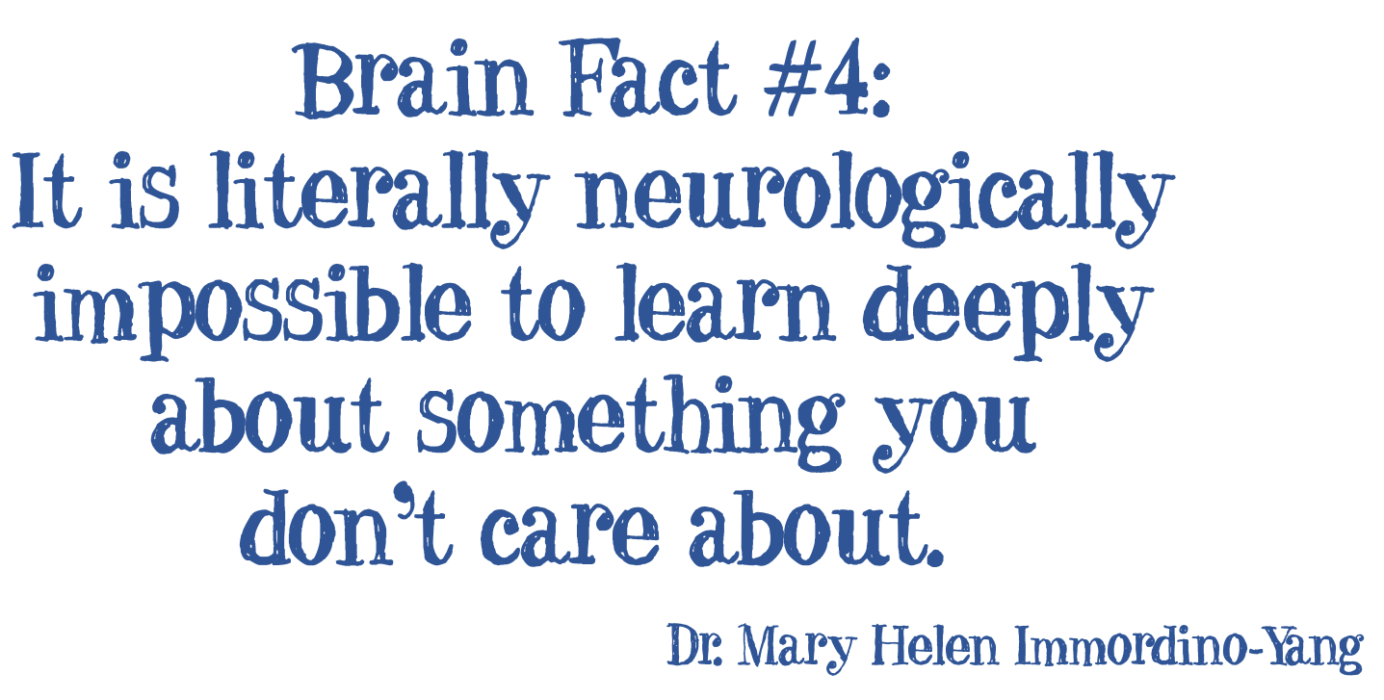

Slide 11
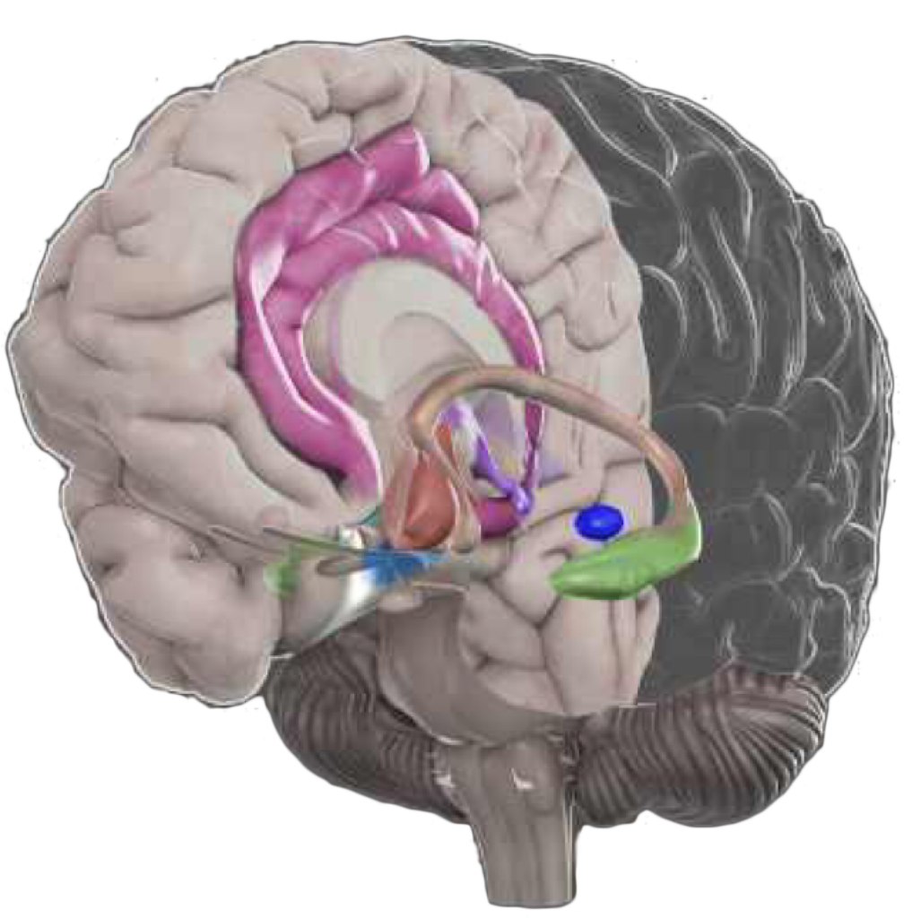
Notes:
The green structure in this diagram is the hippocampus, the part of the brain that directs the formation of long-term memories. It is part of a larger set of structures known together as the limbic system – the emotional system. This is a critical point, and it underscores that learning and memory formation are emotional events. A speaker I heard many years ago (who’s name I have been unable to find) said “In an atmosphere of ecstasy, learning is not only enhanced, it is inevitable.” When you are having fun, you will be learning. Making is first and foremost fun, and students will be learning while they are engaged in it.

Slide 12
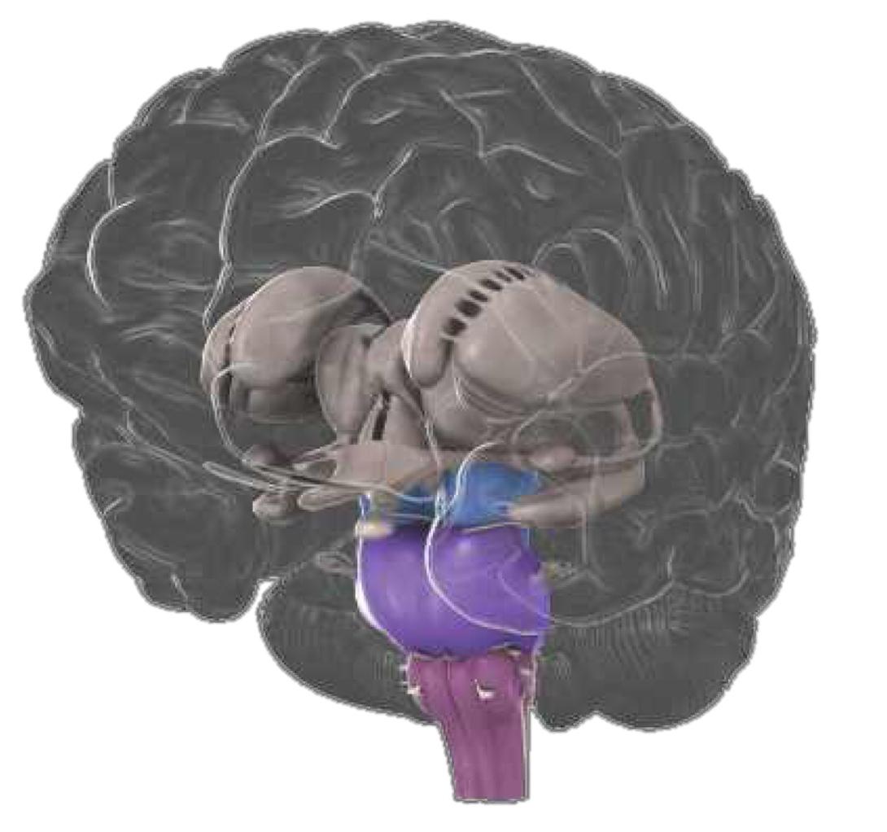
Notes:
This set of structures work together to act as the filtering system for your brain. There is far too much happening around us at most times for your brain to process it all, so it has to filter all those sounds, sights, and other sensations and prioritize what you are going to actually respond to. The filter screens for things that are threatening (survival is the highest priority), new, and emotionally meaningful. The filter is a combination of automatic and executive function, so we do have some mental control over what we choose to pay attention to – it’s a form of impulse control. We need to give students opportunities to choose to pay attention and practice that skill.

Slide 13
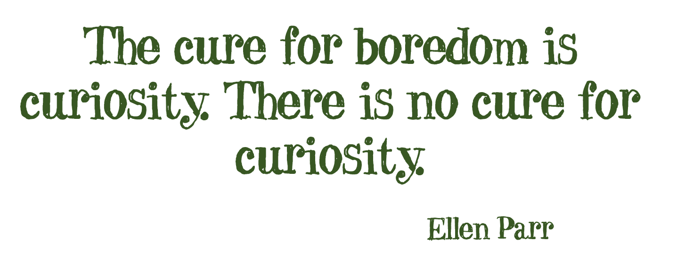
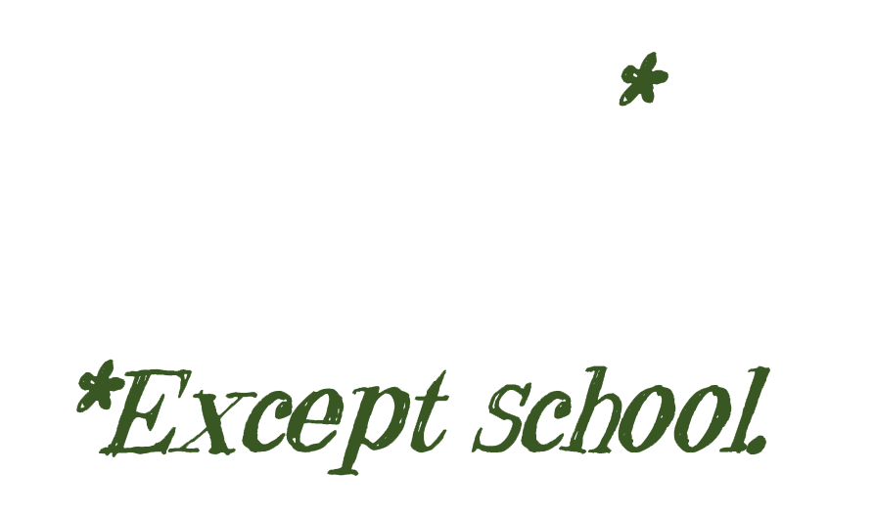
Notes:
Research shows that a person experiencing curiosity will better remember anything they encounter, whether or not it has anything to do with what they are currently curious about. Kids are born curious, but somehow in school we are working that out of them. Researcher Wendy Ostruff has measured how many questions per hour students ask, and for four and five year-olds, it’s about 72 per hour. By fifth grade, it’s less than one. Learning should be about deepening curiosity, not squelching it. Makerspaces are built on a foundation of curiosity, and give kids the opportunity to create their own questions and explore for answers.

Slide 14
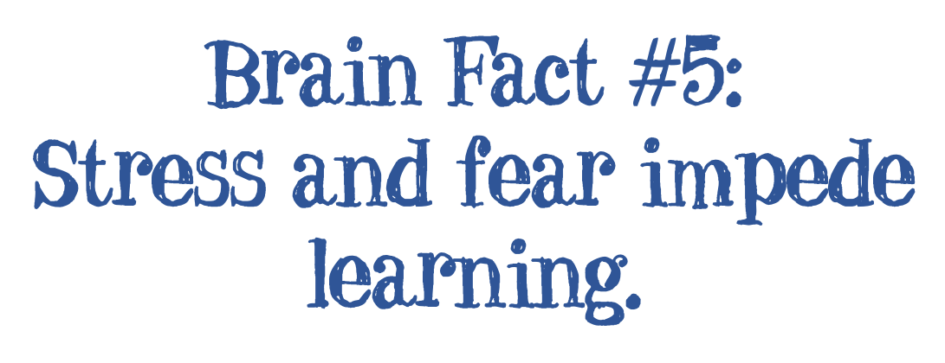

Slide 15
Notes:
This is your amygdala. It’s the part of the brain that deals with fear and other intense negative emotions. At low levels of activity, it enhances your focus and attention. At high levels of activity, it reroutes the connections in your brain and pretty much tunes out the prefrontal cortex. You lose executive function and go into straight-up reactive mode. Another part of this physiological response impedes the new connections in your brain that are part of learning.
This is the underlying mechanism of the Growth Mindset. If you have a fixed mindset, if you make a mistake, or get challenged by something you can’t do, you have a strong threat response, and your thinking ability is shut down. You go into a defensive, reactive frame of mind, and you can’t learn – or what you “learn” is to avoid those situations again in the future. If you have a growth mindset, you don’t go into the threat response, but instead fire up the optimal level of mild concern and curiosity: “How can I make this better?”

Slide 16
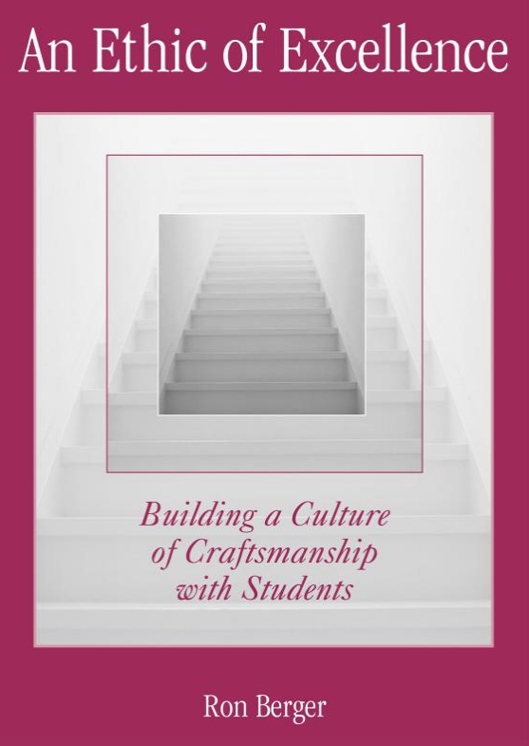
Notes:
That’s the underlying idea behind this great little book by Ron Berger. The school he describes in this 2003 book is all about the growth mindset before most of us new what the term meant. Students learn the concept of intrinsic desire to achieve at their highest ability, and learn a cycle of draft, feedback, and revision. (They also learn the skills needed to give meaningful feedback.) The students not only didn’t shrink from having their work evaluated, they sought it in order to improve. Makerspaces are an ideal setting for students to practice this kind of cycle.

Slide 17
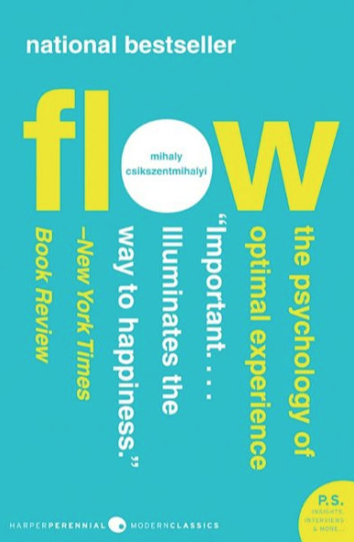
Notes:
Developing a growth mindset and persistence through making helps make students resilient, so they respond to challenges in a positive way and not react with stress. Making can also help students reduce stress they are already experiencing. Mihaly Csikszentmihalyi (pronounced “chick sent me high”) has documented the experience of “Flow,” the deeply emotionally satisfying experience of being so absorbed in an activity that you lose track of time, place, and pretty much everything else. This can only be experienced by spending uninterrupted time working on something both meaningful and challenging. Makerspaces are ideal places for this to happen, and it is a form of mindfulness that has been shown by research to reduce stress and depression.

Slide 18
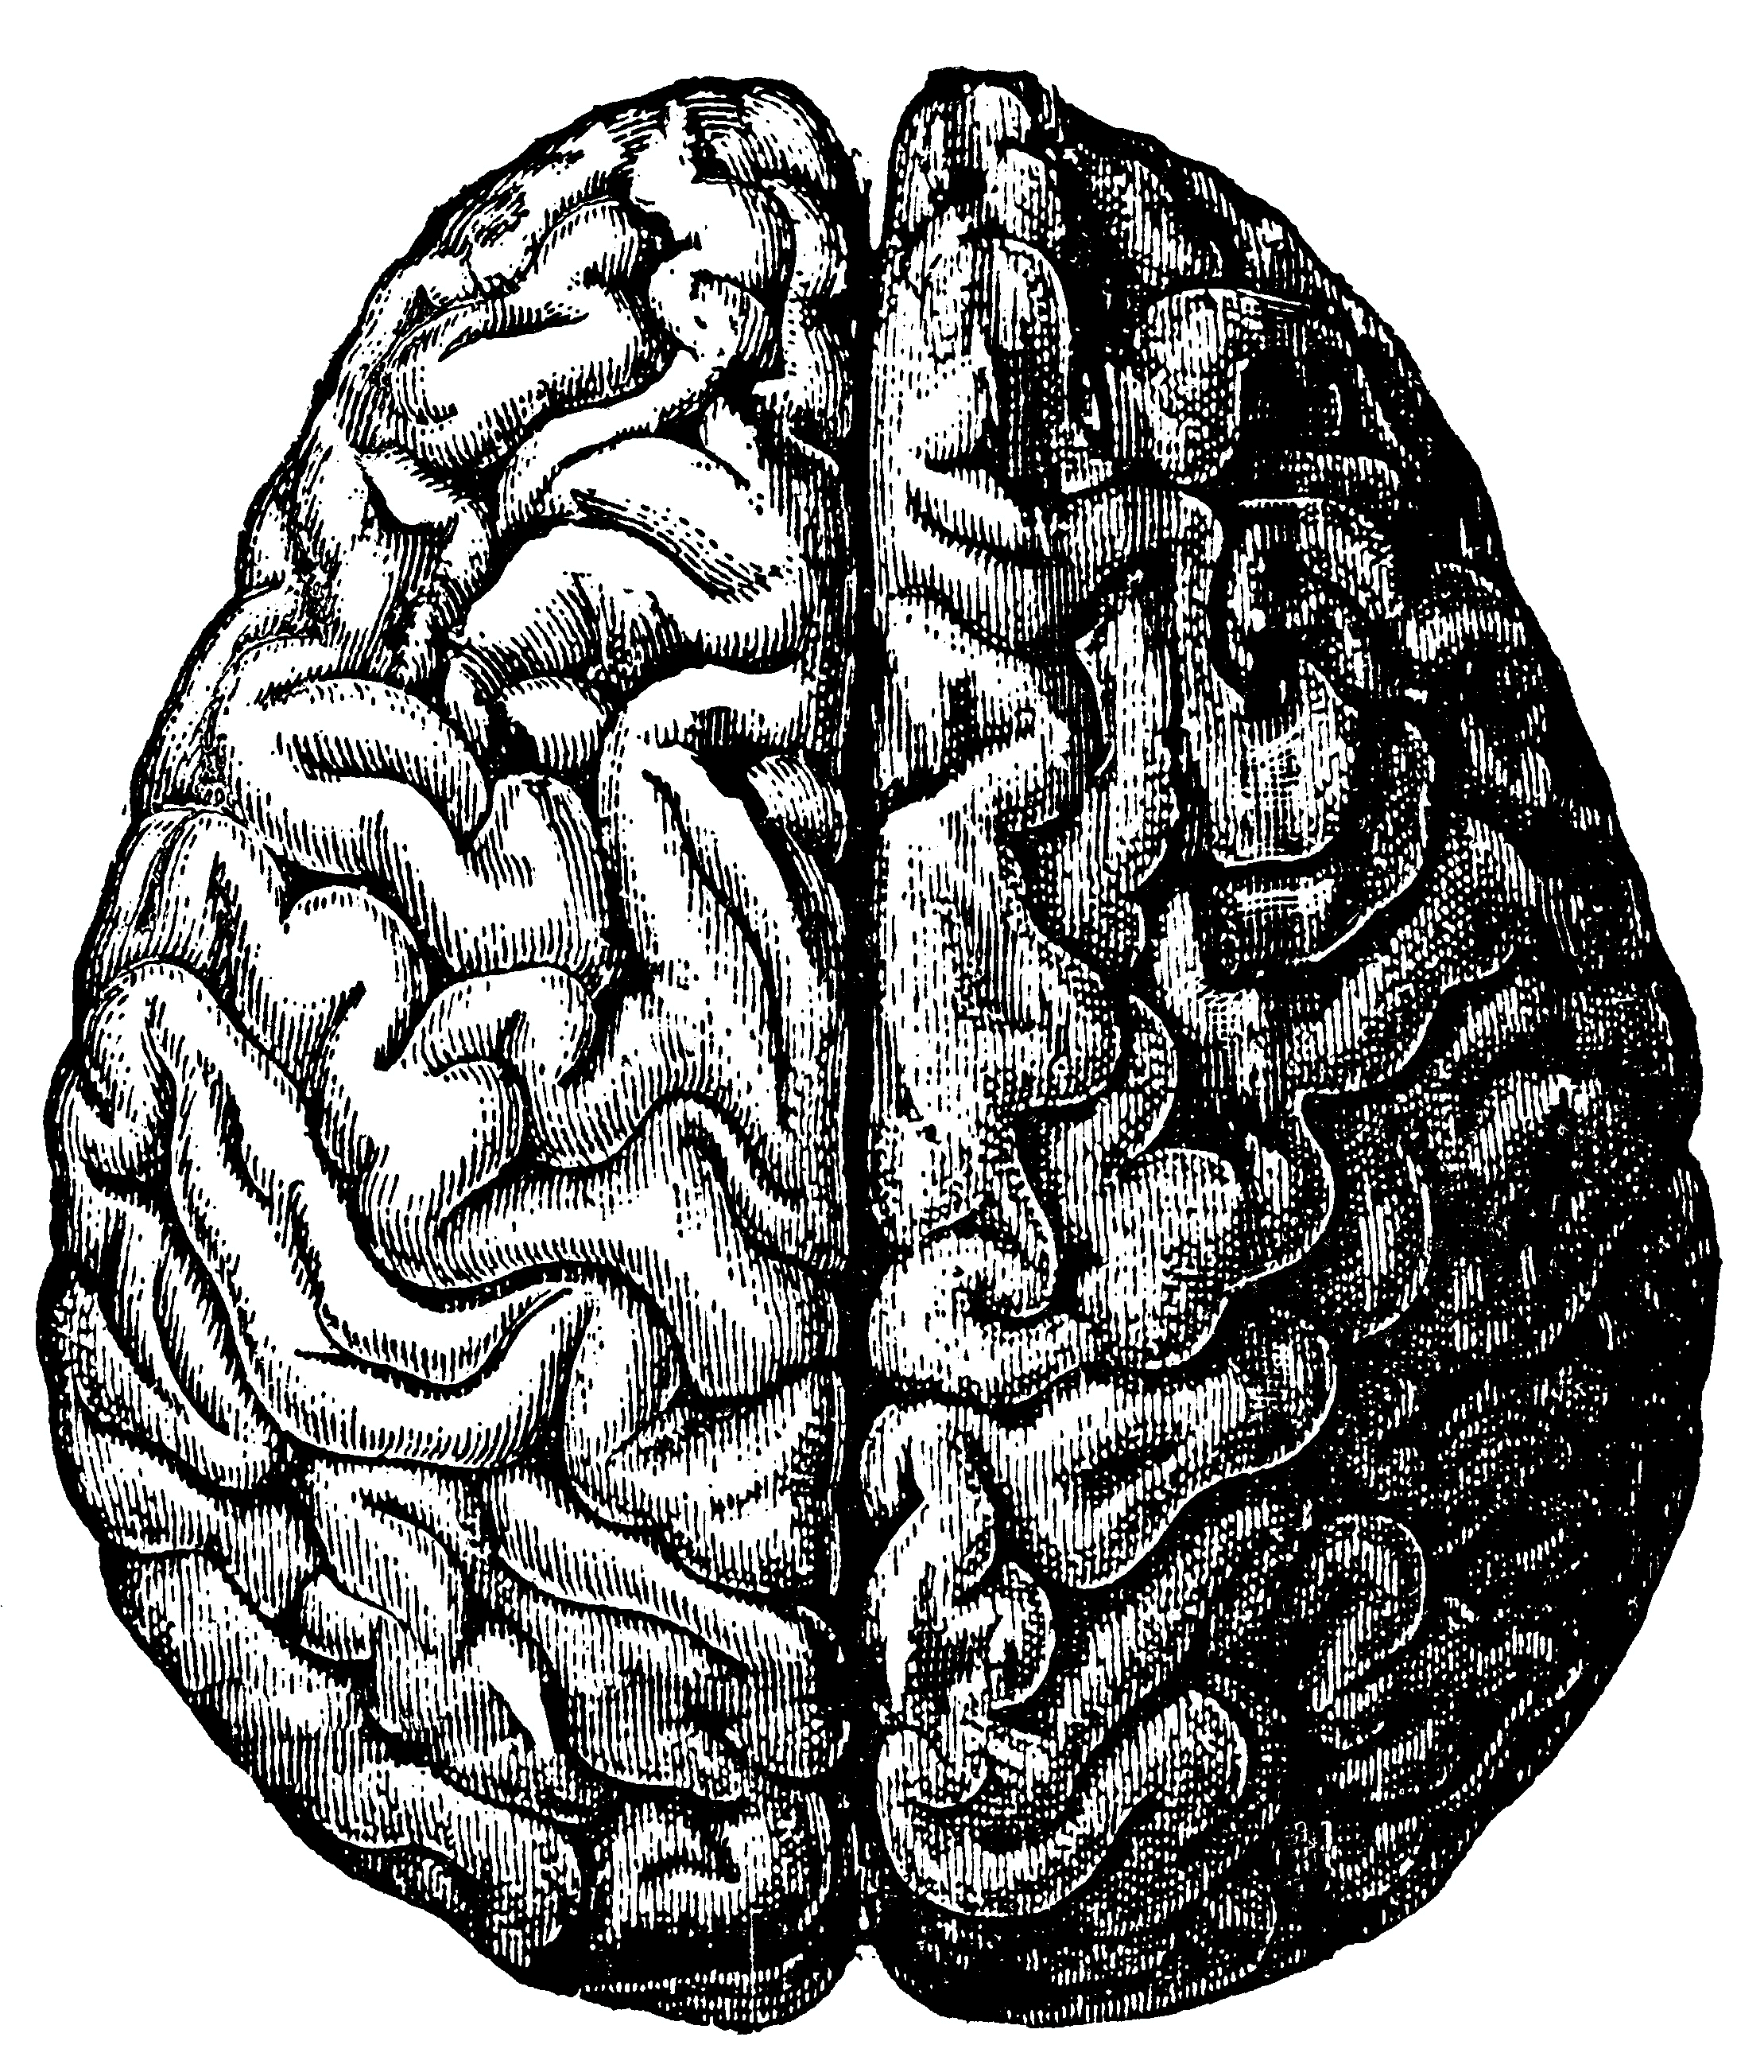
Making reflects the neurological primacy of our hands
Making provides opportunities for students to develop executive function abilities, such as self-direction, decision making, focus, planning, and reflection
Making provides opportunities to for deeper learning through focused, extended work and tapping into (and expanding) intrinsic interests and curiosity

Slide 19
Making provides opportunities for developing growth mindset and persistence in an environment of design, test, feedback, and revision
Making provides mindful, meaningful activities that reduce student stress and calm their social disractions

Slide 20
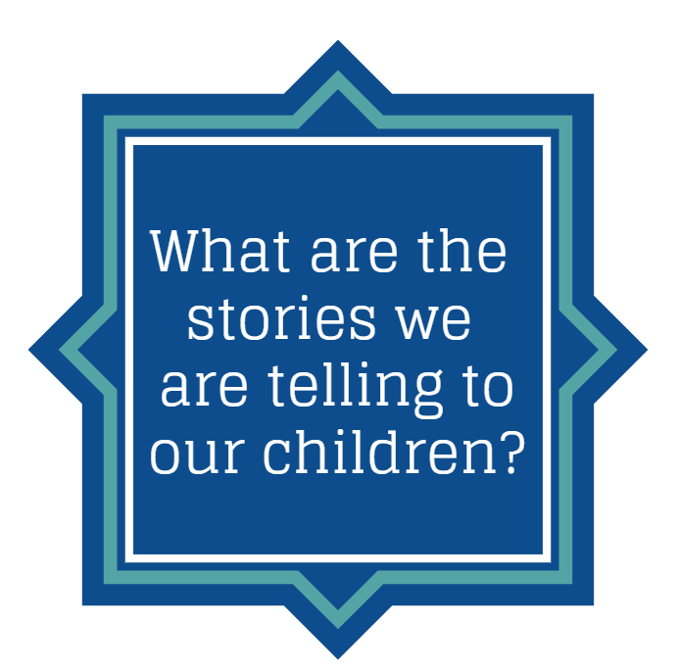
Notes:
Everything our students experience in school is contributing to a story – the story of who they are, the story of what your classroom is, the story of your school. We need to be clear ourselves what that story is. Making helps to create a story of student ownership, student success, and student as a member of a community where they belong.

Slide 21
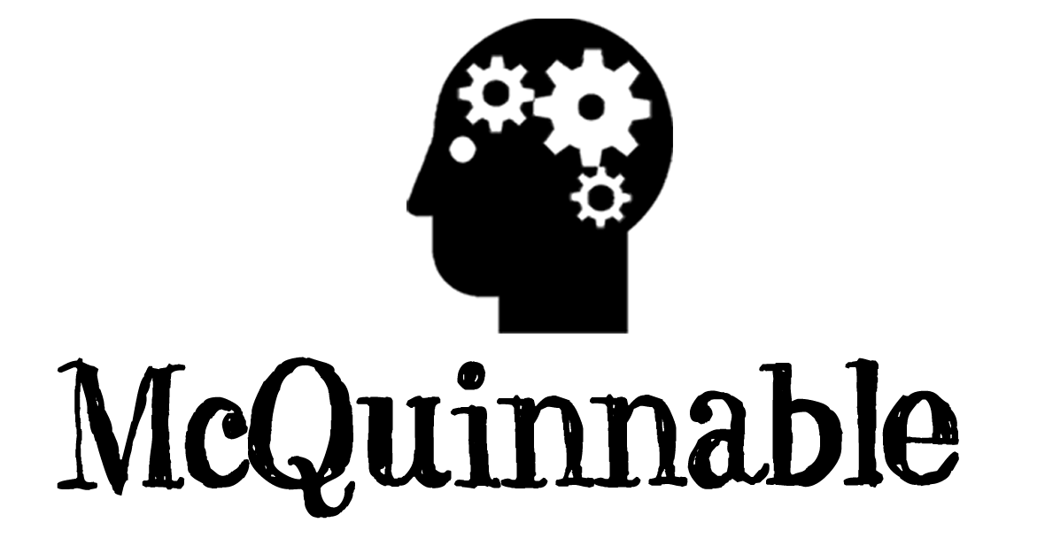
www.mcquinnable.com

