Slide 1
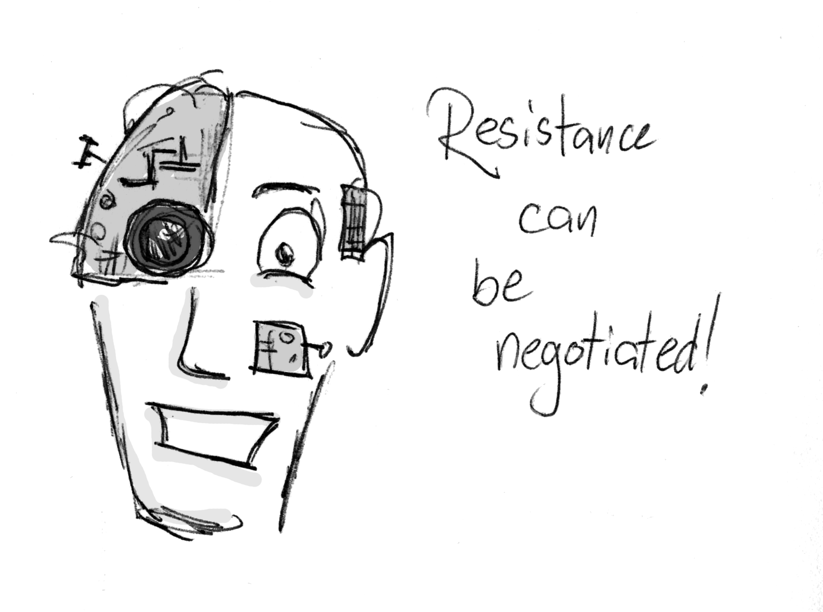

Slide 2
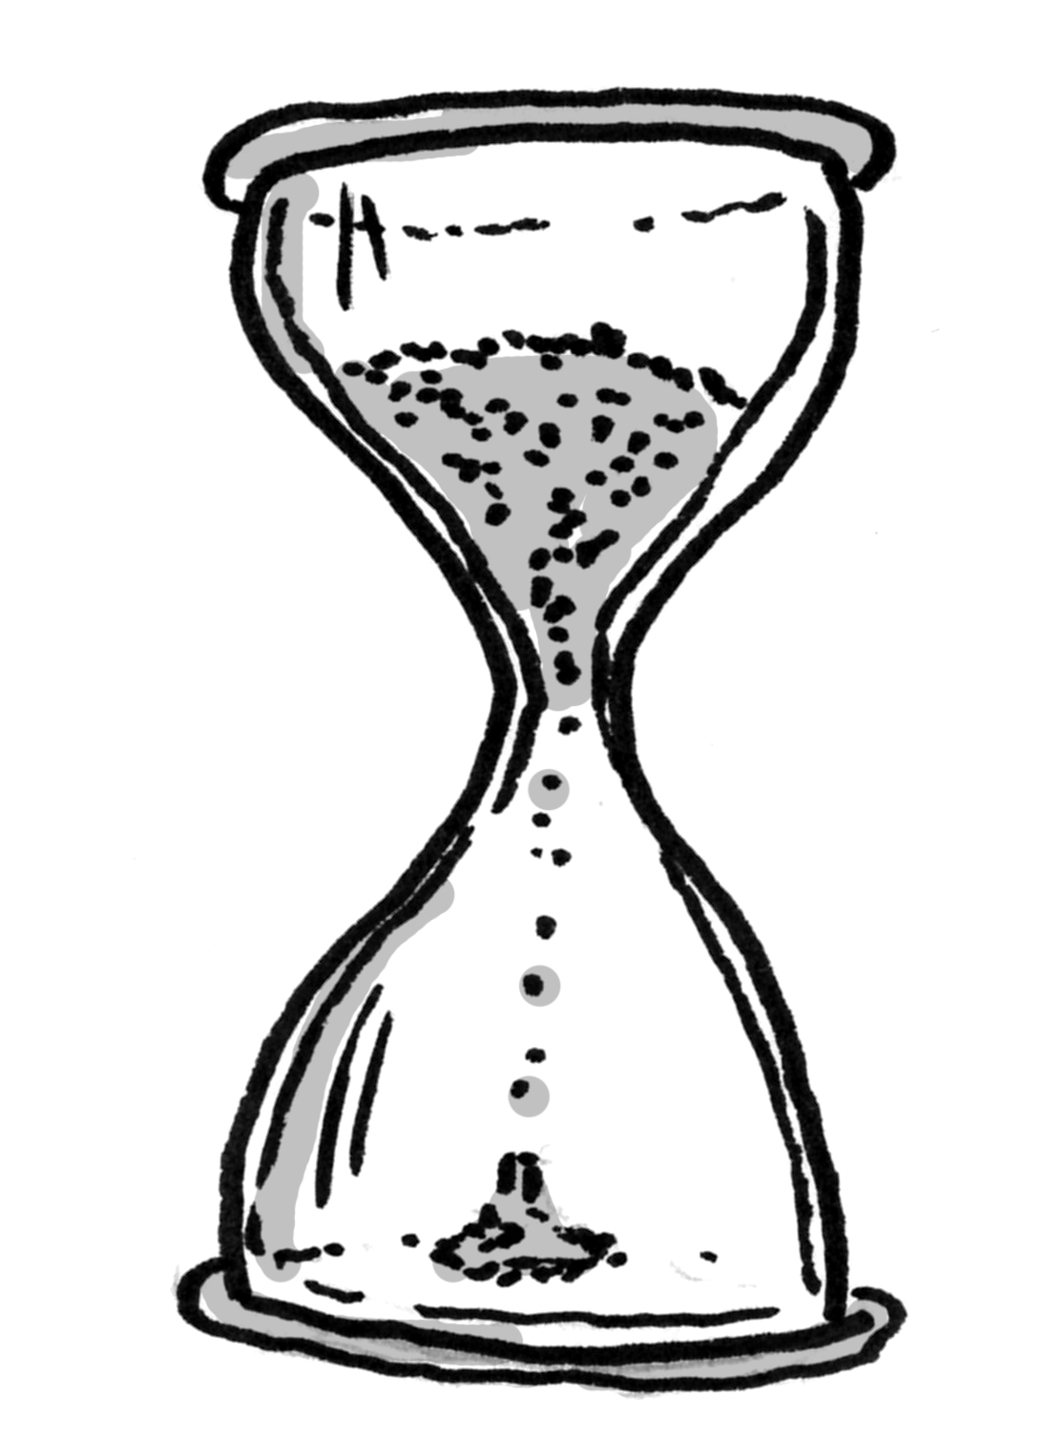

Slide 5
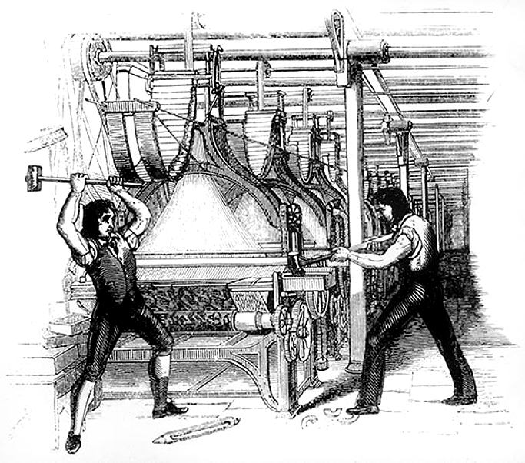
Notes:
https://en.wikipedia.org/wiki/Luddite#/media/File:FrameBreaking-1812.jpg

Slide 6
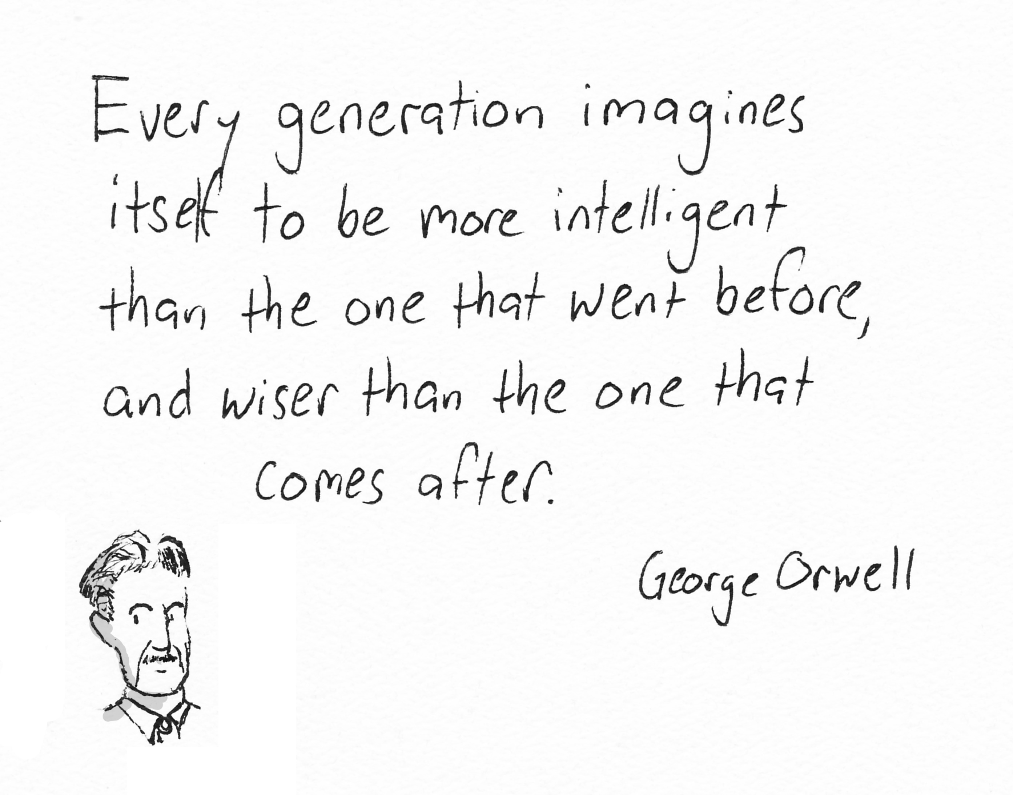

Slide 8
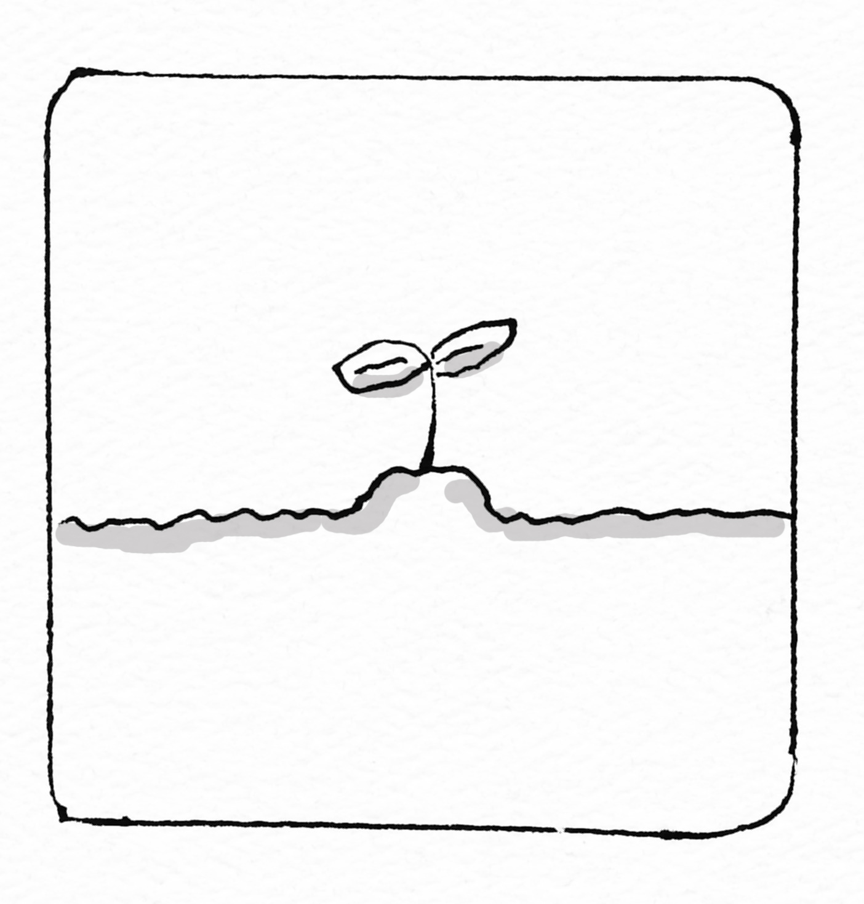
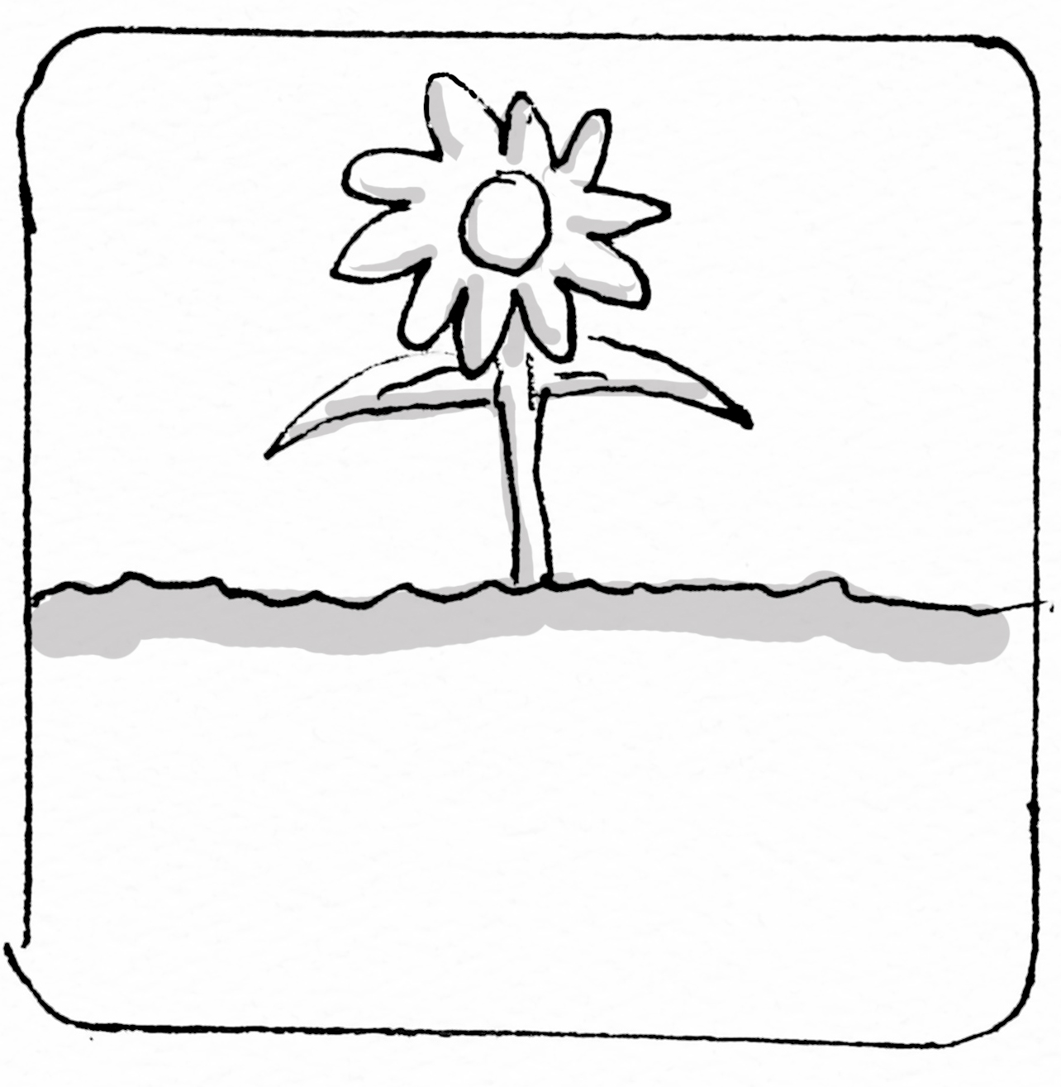
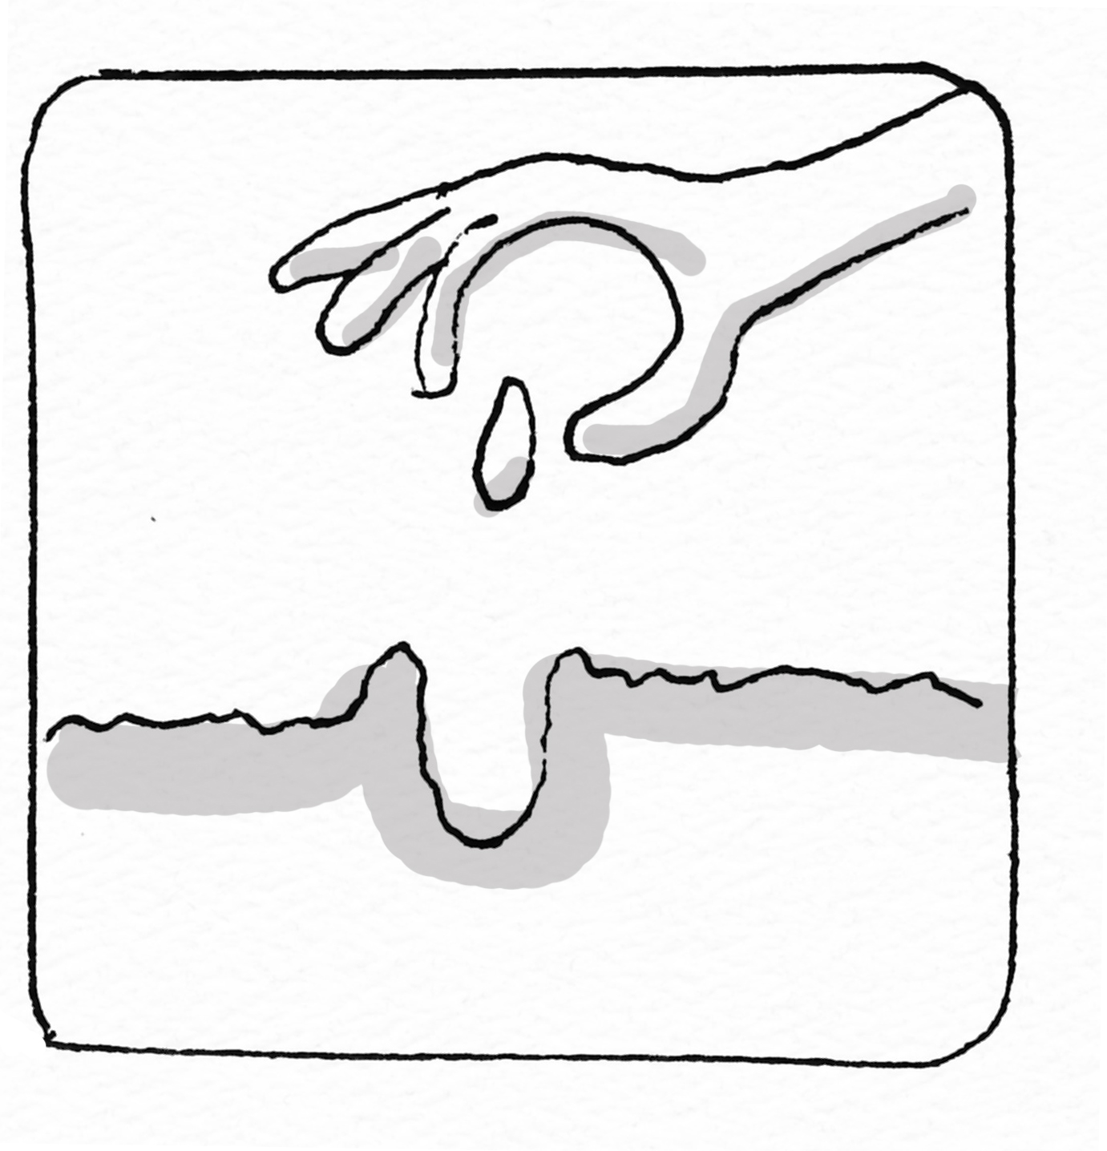
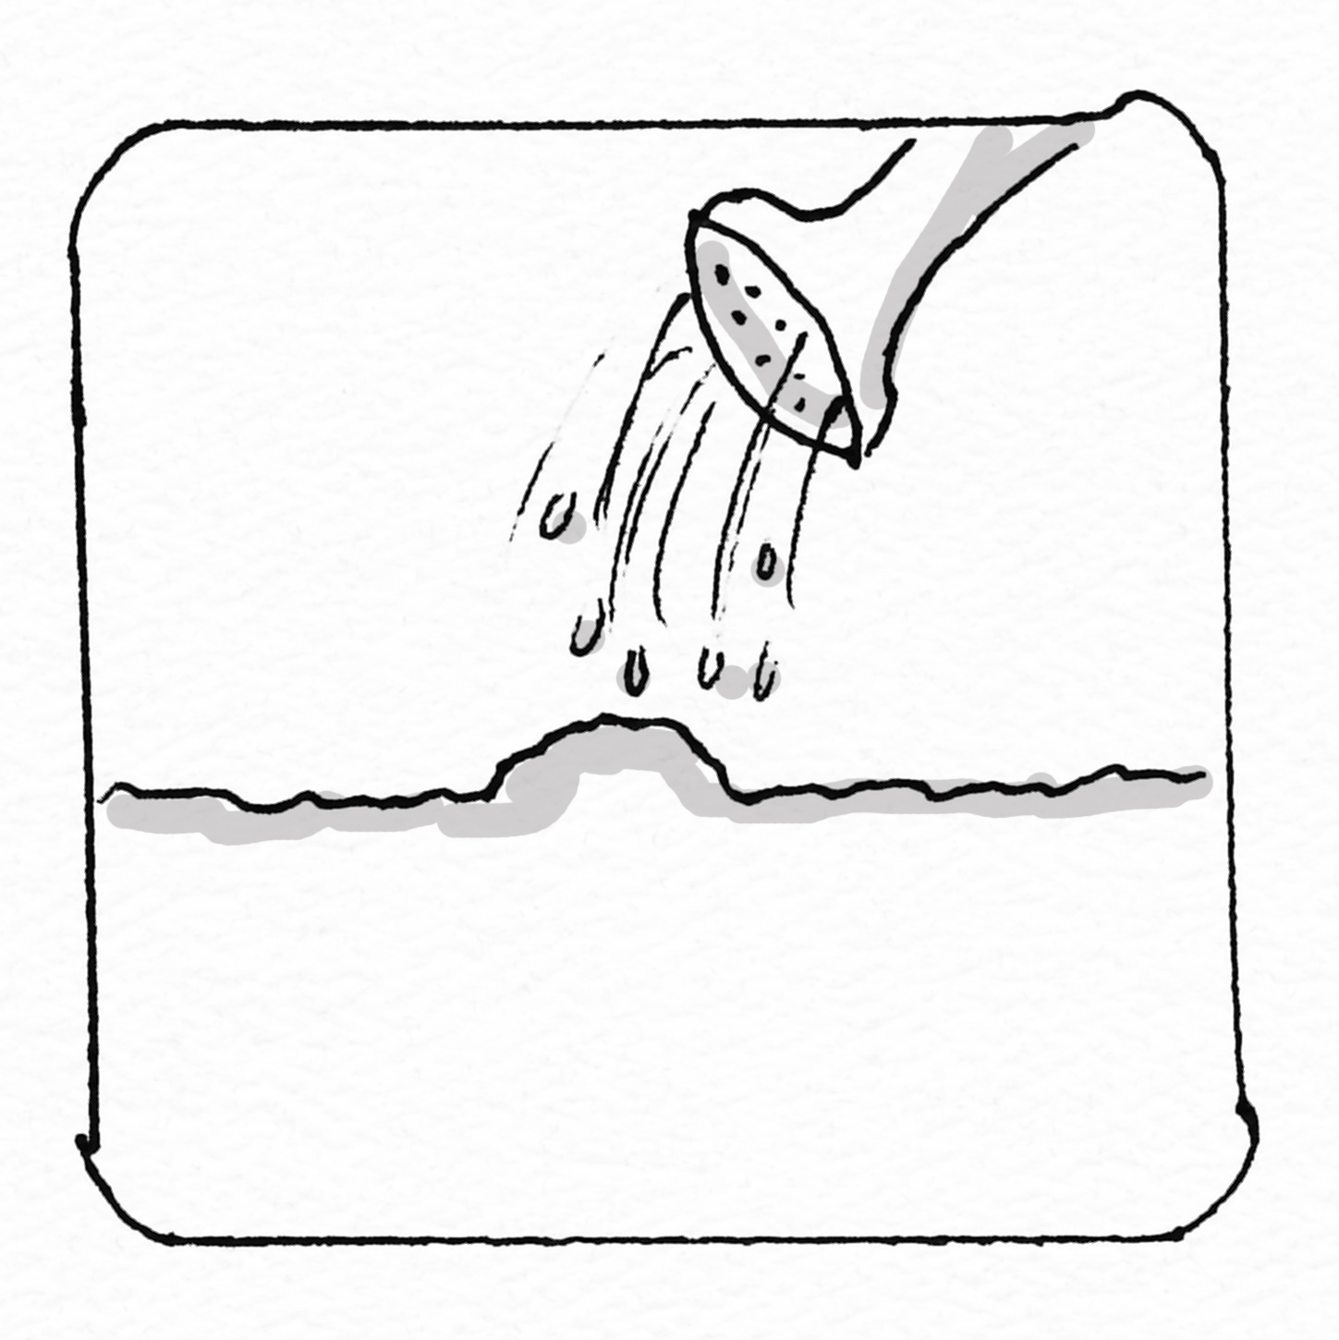

Slide 10
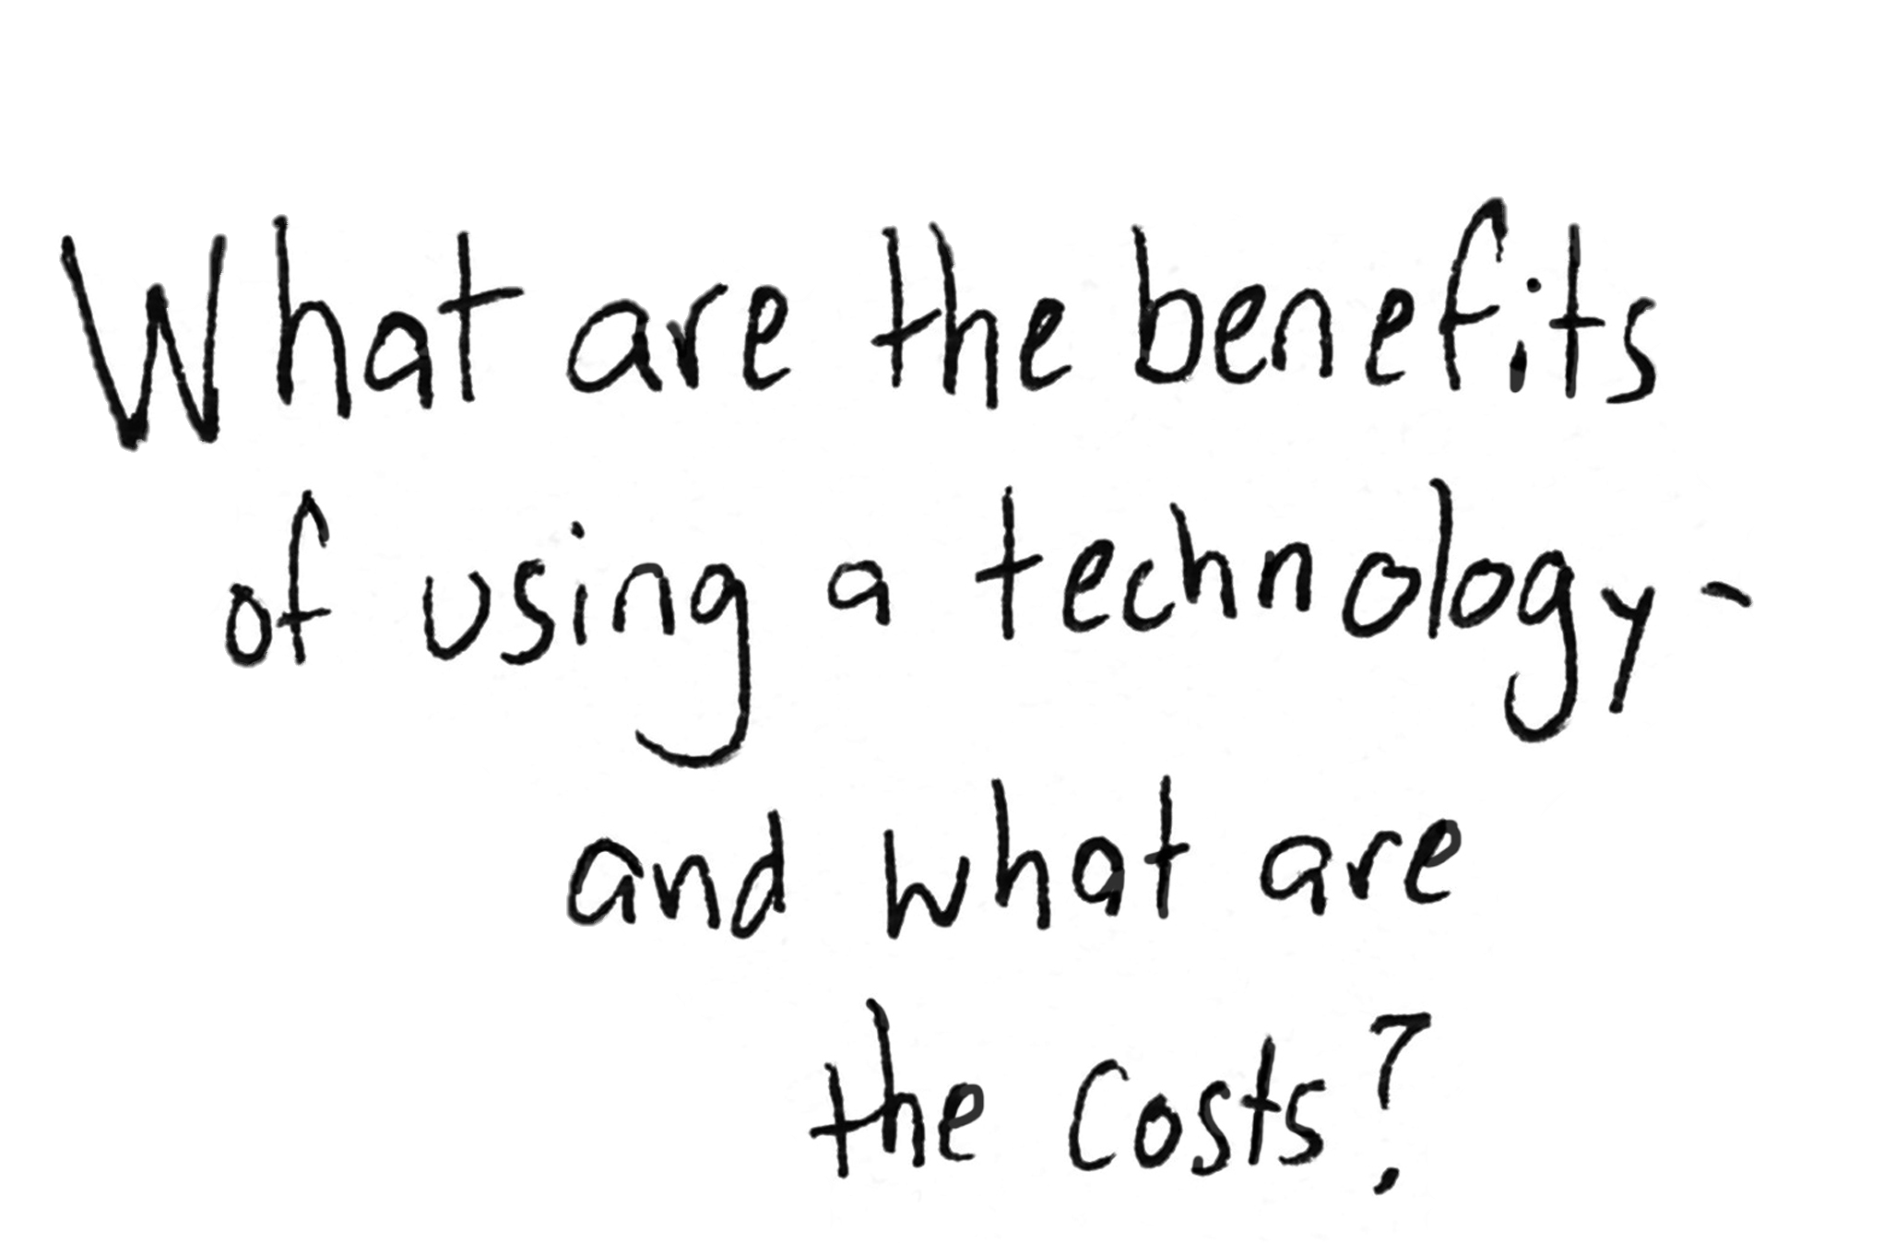
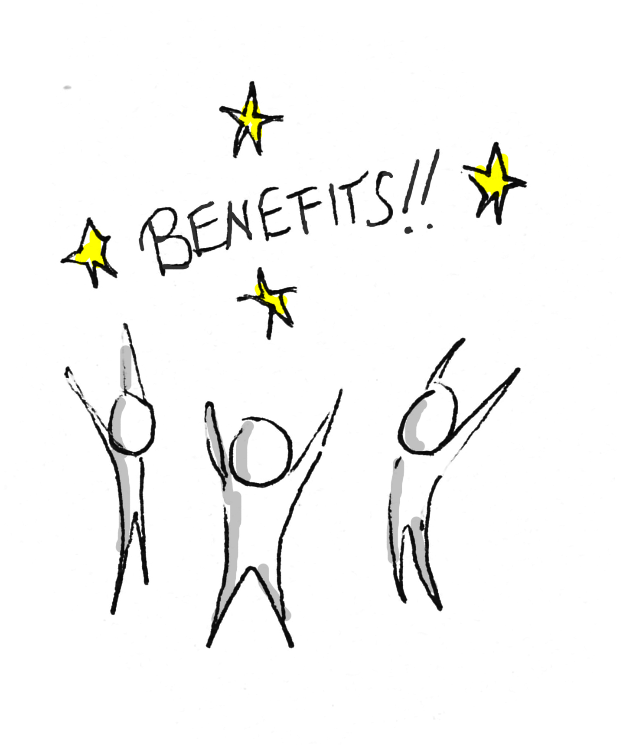
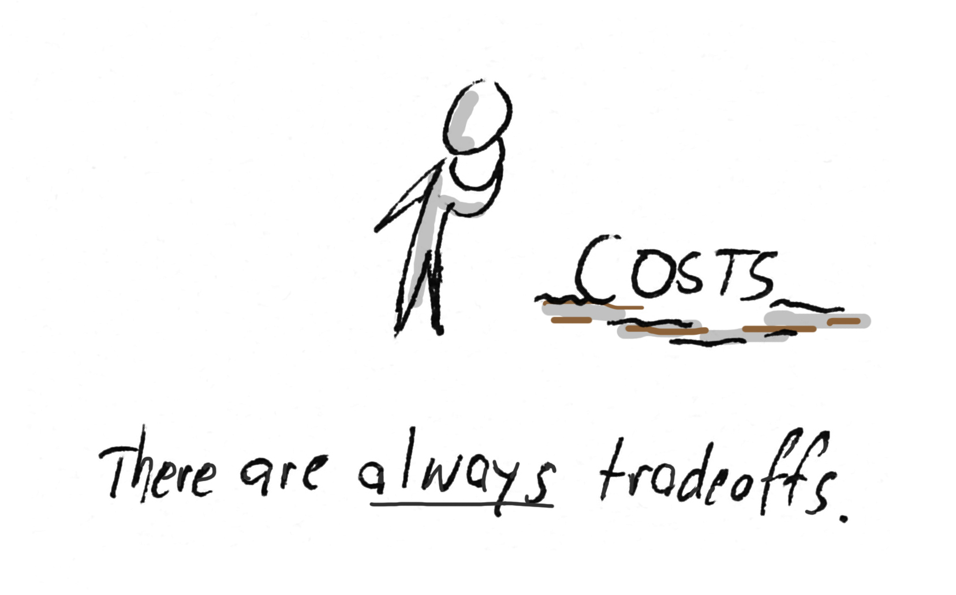

Slide 11
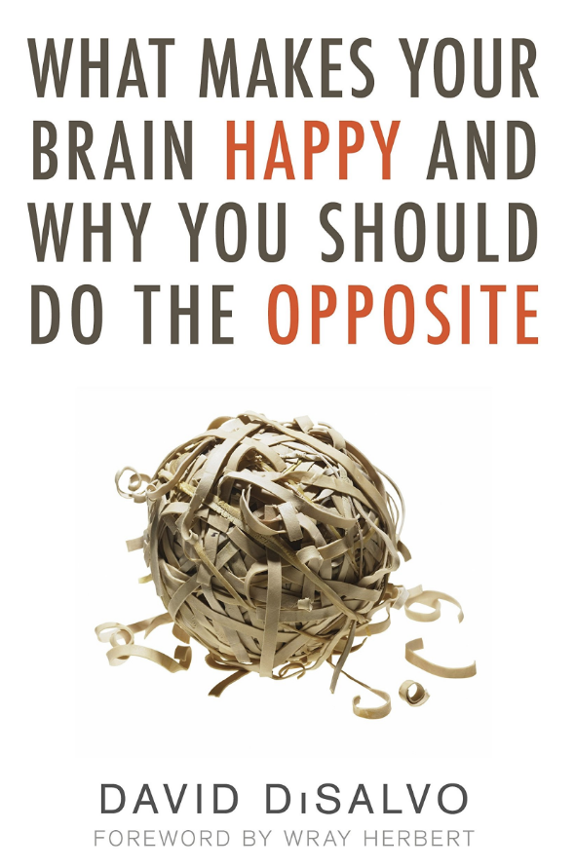

Slide 13
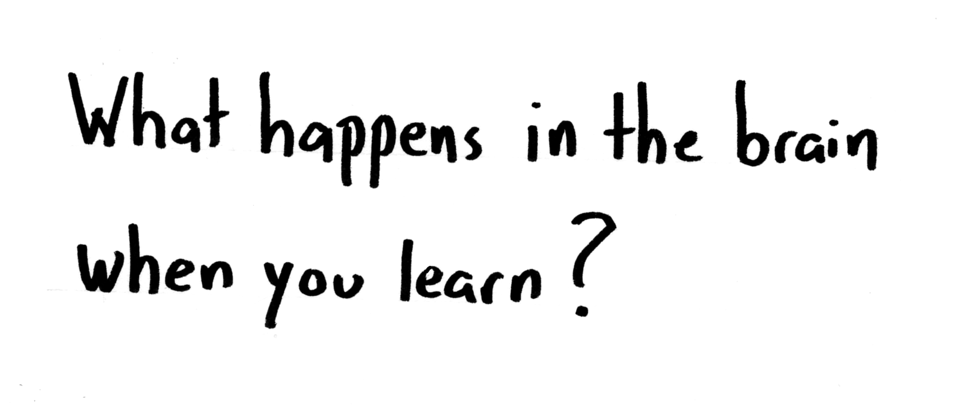
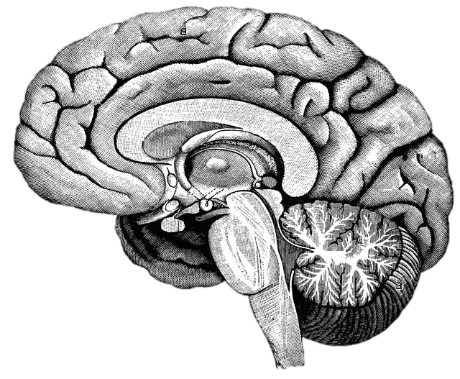
Notes:
http://upload.wikimedia.org/wikipedia/commons/f/fe/14th-century_painters_-_Diagram_of_the_brain_-_WGA15761.jpg
Without discussing with anyone, write down what you already know about what happens in the brain when you learn. You will not need to share this with anyone.
After the one minute: This is from an instructional model called the NED Learning model, designed by Dr. Kieran O’Mahony. (You can read more about it at http://k12.nedlearning.com/index.html#free_printable_kit_details) By stating this fairly open question, I’m getting you to pull up your prior knowledge on the topic, which is important because all new knowledge has to be connected to prior knowledge. It’s also an emotional hook, since I have in essence asked you to guess what I’m going to tell you next, so you are more attentive to what I’m going to say. It’s like the silly cartoon hydroplane races at the Mariners games. Why should we care if the red, green, or yellow boat actually wins? But once we’ve picked a color we get really invested in the outcome and cheer or moan at the outcome.

Slide 14
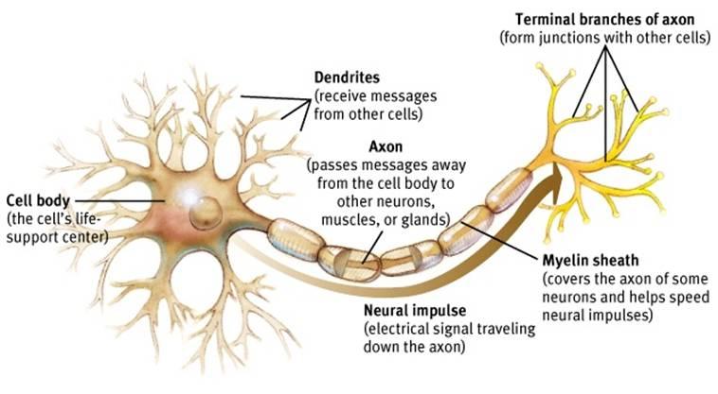
Neuron
Notes:
Dendrites receive signals from other neurons – like a baseball glove catches a ball. And axons and their axon terminals send the message to other neurons – just like a baseball player throwing a ball to another player.
http://www.appsychology.com/Book/Biological/Biologypics/clip_image002.jpg

Slide 15
Notes:
When a neuron receives a signal at the dendrite end, the chemical message is changed to an electrical pulse. At the beginning of the axon, all these electrical pulses are summed up, and if it reaches a critical threshold, it fires a signal that travels down the axon. The myelin increases the speed of this electrical signal. (It’s important to know that brains are not fully myelinated until you’re in your early 20s!) When that pulse reaches the terminal, it causes the release of neurotransmitters that diffuse across the space between the two neurons. When enough excitatory neurotransmitters dock on dendrite on the post synaptic neuron, it triggers electrical pulses that shoots down the next axon. After docking on the post synaptic neuron, neurotransmitters then float away and are recycled back into the pre-synaptic neuron’s axon terminals. Communication between neurons is an chemical process.
ASK FOR 3 VOLUNTEERS TO DRESS UP AS NEURONS! Have volunteers demo this after explanation.

Slide 16
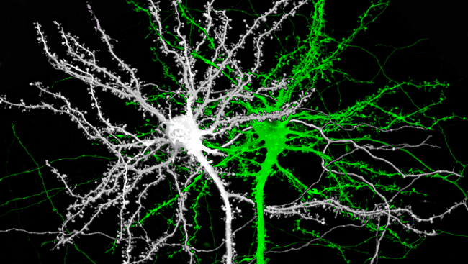
Notes:
Image source: http://www.brainfacts.org/thinking-sensing-and-behaving/learning-and-memory/2014/image-of-the-week-the-structure-of-memory
This is an image of two mouse neurons, and you can see the branches of the dendrites are covered with little knobs. They’re called spines, and they are where the dendrites grow to reach the terminals of other neurons.

Slide 17
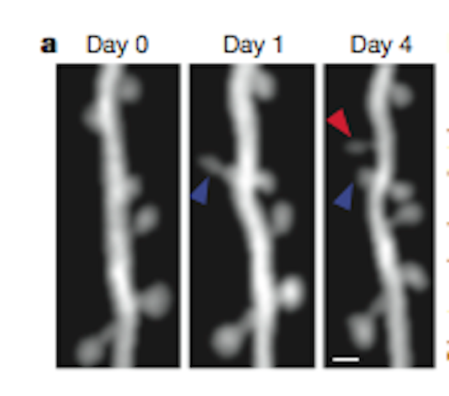
Notes:
Image source: http://blogs.scientificamerican.com/observations/files/2012/04/Screen-shot-2012-04-16-at-5.06.35-PM.png
Here is a real, live neuron growing new spines. They are growing toward neurotransmitter molecules. Notice that the spine by the blue arrow starts out long and thin, but then thickens over time. The neuron is building bridges to reach another active neuron, which is what happens in our brains when we learn. We are literally building learning connections.

Slide 18
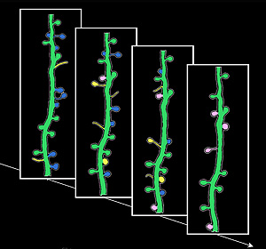
Notes:
Image source: http://news.ucsc.edu/2009/11/3413.html
Learning is not just about building new connections, though. The yellow spines are new ones growing and developing; the blue spines show the opposite, existing spines that disappear. This is called pruning, and they are going away because they aren’t being used. Neural connections are a literal “use it or lose it” proposition. One of the heaviest times of pruning is adolescence, with young teenagers starting out with twice as many connections as they will retain as adults. That’s why the patterns established as teenagers are so profound.

Slide 20
Notes:
https://commons.wikimedia.org/wiki/File:Dog.in.sleep.jpg
What can we do to improve neuron connections? Sleep is #1. Spines consolidate during sleep, and lack of sleep can seriously impact the learning from the day before.

Slide 21
Notes:
Exercise is important as well. Aerobic exercise generates Brain Derived Neurotropic Factor, which enhances neuron growth.

Slide 22
Notes:
Stress damages new neuron spines, or prevents them from forming.

Slide 23
Repetition
Repetition
Repetition
Notes:
Repetition is critical to learning facts and skills, particularly repetition with good coaching or feedback.

Slide 24
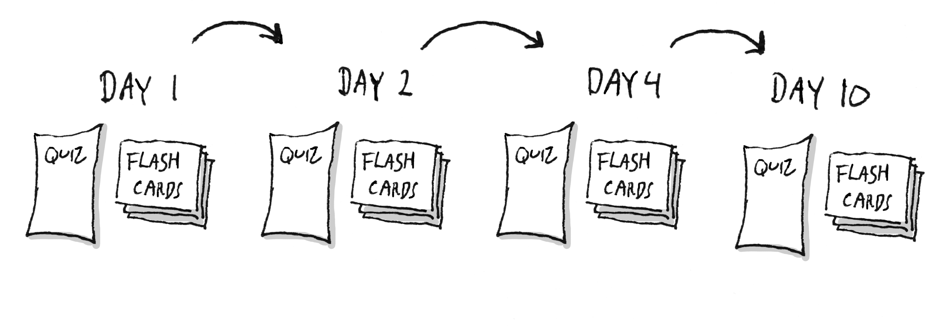

Slide 25
Notes:
https://www.flickr.com/photos/vandycft/29428436431

Slide 28
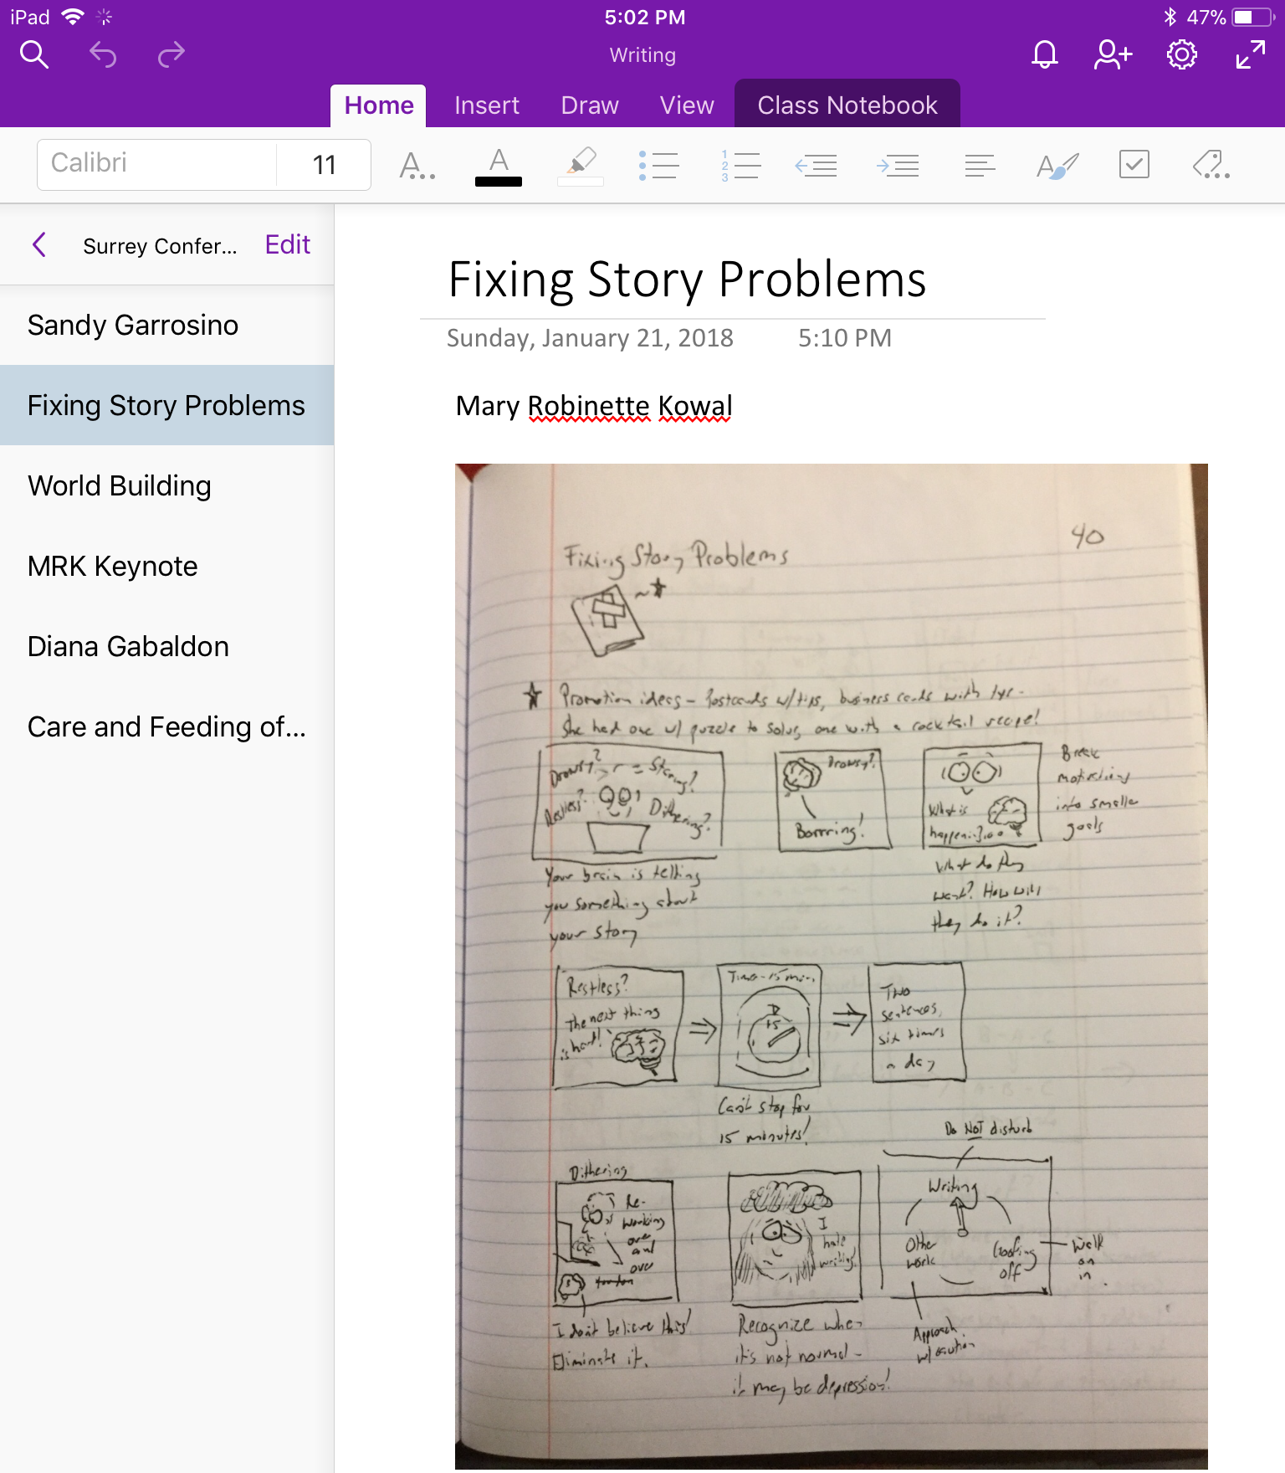

Slide 29
Reflection
What was surprising?
What did you already know, but now see in a new way?
What new questions do you have?

Slide 30
Reflection
What was surprising?
What did you already know, but now see in a new way?
What new questions do you have?

Slide 31
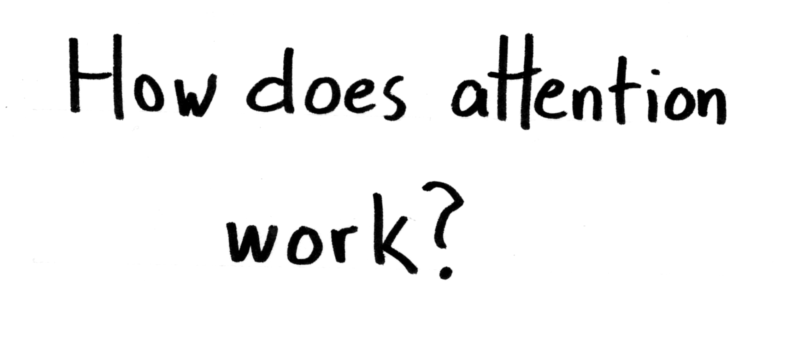
Notes:
http://upload.wikimedia.org/wikipedia/commons/f/fe/14th-century_painters_-_Diagram_of_the_brain_-_WGA15761.jpg

Slide 32
Notes:
There is a network of structures in the brain stem called the reticular activating system, or thankfully RAS for short. This system is one of the core mechanisms for filtering sensory input. We can’t attend to all of the information flooding our senses at any one moment, and the RAS helps to decide what we are consciously aware of and what we aren’t‘.

Slide 33
Notes:
The brain is designed to be easily distractible!

Slide 34
Notes:
The brain is designed to be easily distractible!

Slide 35
Notes:
The brain is designed to be easily distractible!

Slide 36
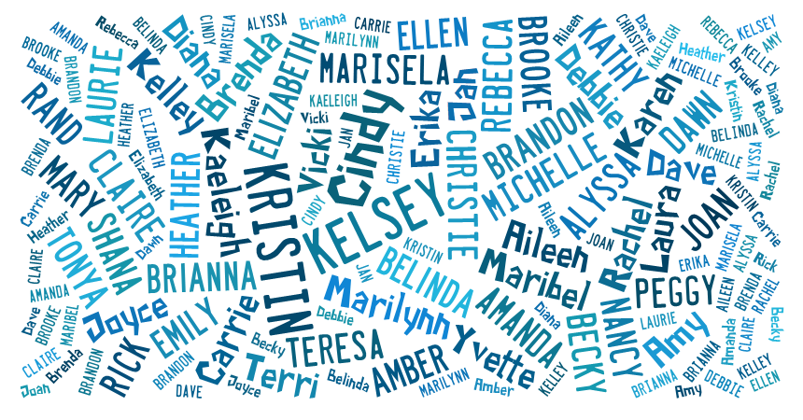

Slide 38
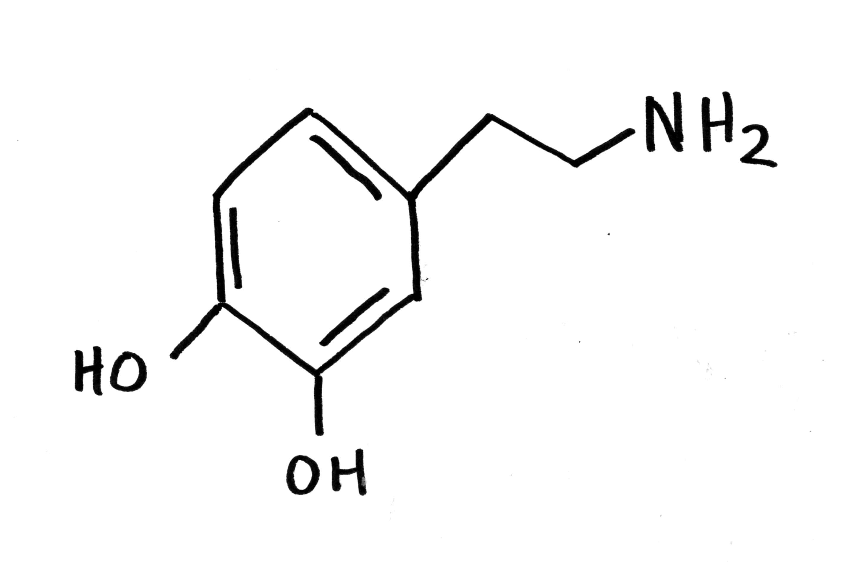
Notes:
https://commons.wikimedia.org/wiki/File:Dopamine_chemical_structure.png

Slide 39
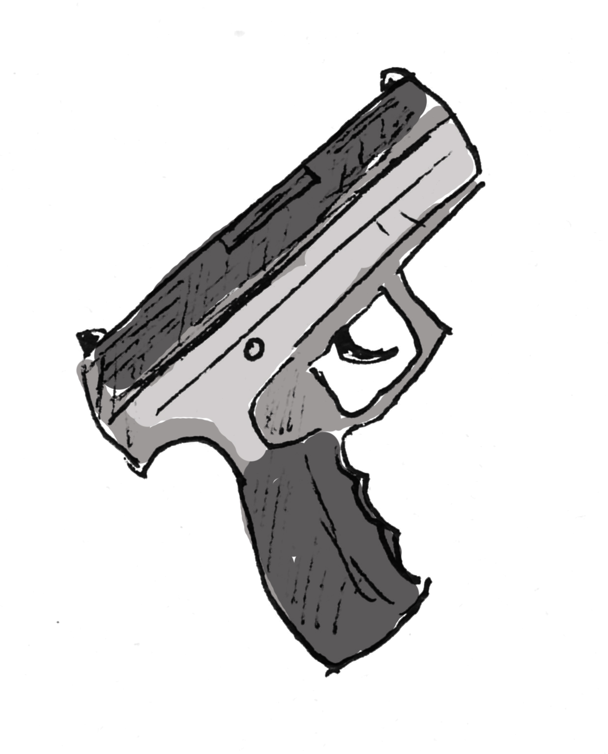
Notes:
The brain is designed to be easily distractible!

Slide 40
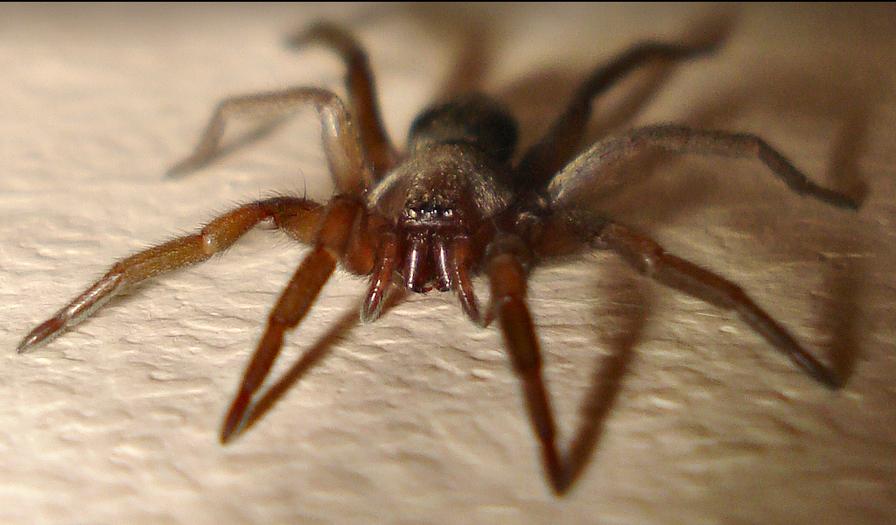
Notes:
http://www.flickr.com/photos/micks-wildlife-macros/
The other set of priorities is learned. Hearing your name spoken in a party, seeing the face of a loved one in a crowd, that certain tone of voice your mother uses when she’s upset, spotting a particular kind of critter you don’t like, or seeing an interesting car/bird/quilt/comic book/insert your favorite interest here. These are different for different people.

Slide 41
Multitasking is a lie
1 2 3 4 5 6 7 8 9 10 11 12 13 14 15 16 17 18
Notes:
This is adapted from this video by Dave Crenshaw - https://www.youtube.com/watch?v=BCeGKxz3Q8Q

Slide 42
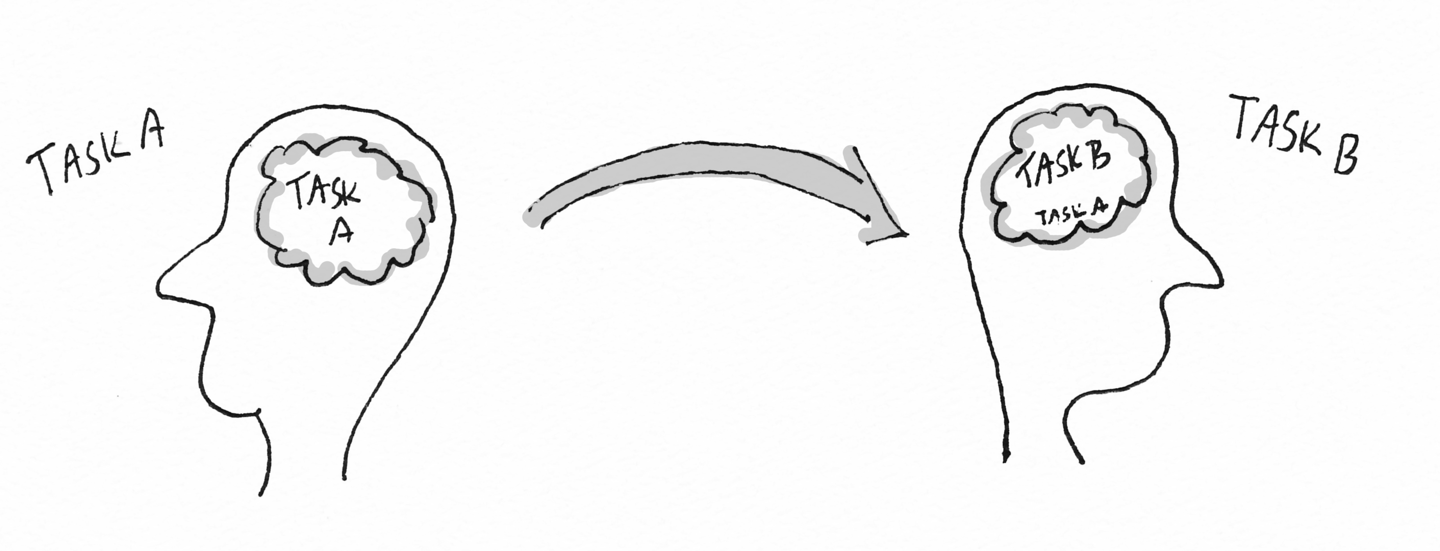

Slide 43
Notes:
https://www.fastcompany.com/53713/art-work

Slide 44
Notes:
Placeholder

Slide 46
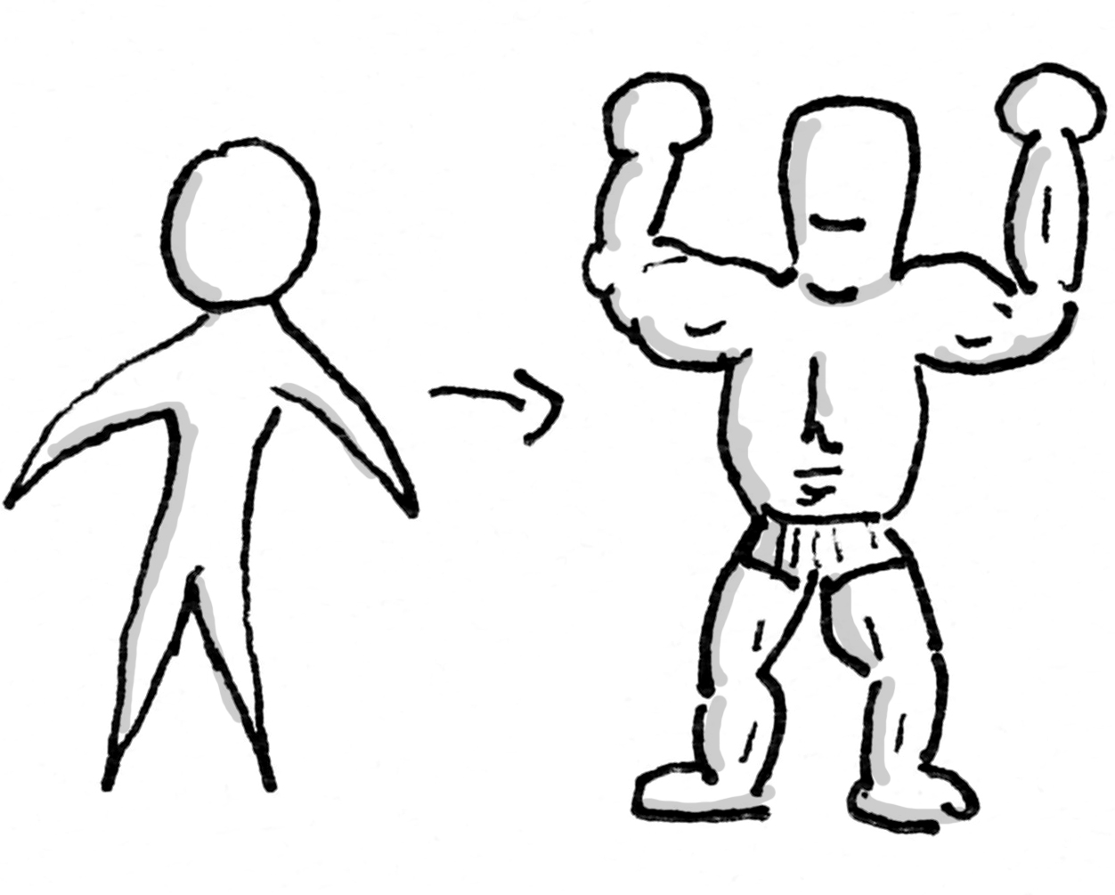
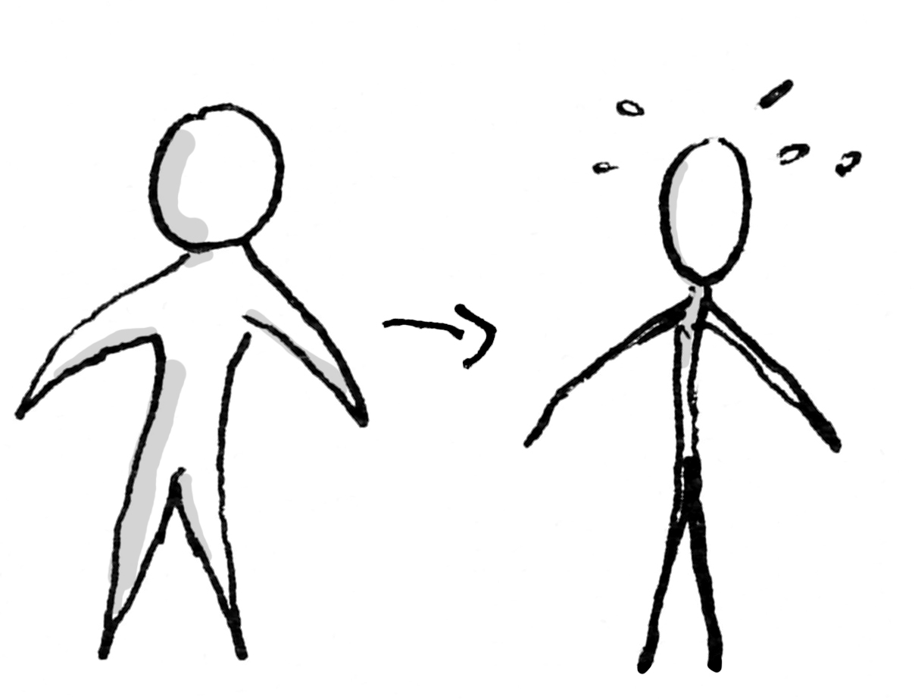

Slide 48
Reflection
What was surprising?
What did you already know, but now see in a new way?
What new questions do you have?

Slide 49
Reflection
What was surprising?
What did you already know, but now see in a new way?
What new questions do you have?

Slide 50
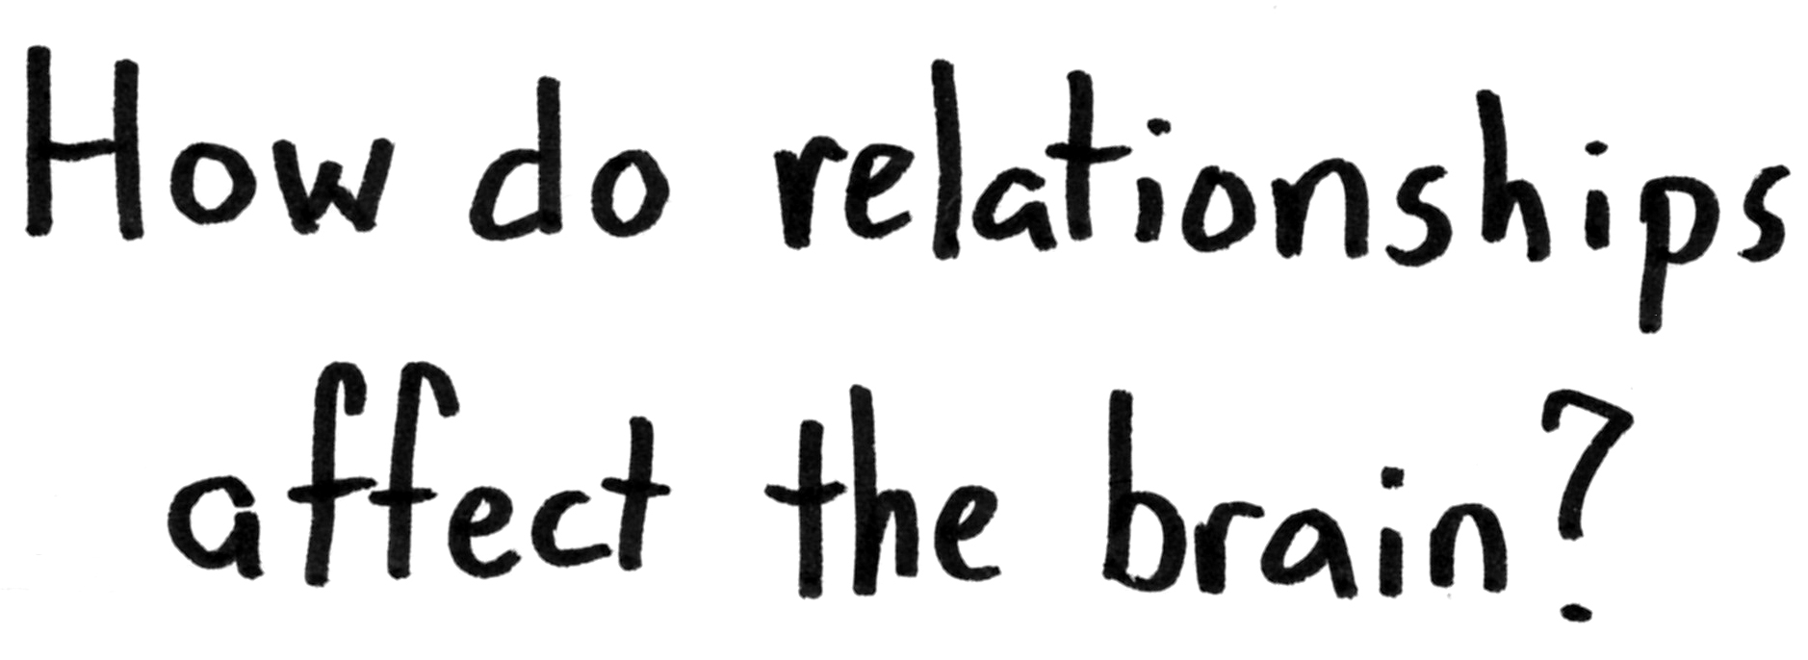
Notes:
http://upload.wikimedia.org/wikipedia/commons/f/fe/14th-century_painters_-_Diagram_of_the_brain_-_WGA15761.jpg

Slide 51
Notes:
https://upload.wikimedia.org/wikipedia/commons/9/9a/Default_mode_network-WRNMMC.jpg
On to another set of structures. It turns out that when your brain isn’t busy doing a specific task (counting, making a shopping list, doing a spelling test, etc.), there is a set of structures that becomes active. It’s very unpoetically called the Default Network. When you’re daydreaming, that’s where your brain is active.

Slide 52
Notes:
https://commons.wikimedia.org/wiki/File:Maslow%27s_Hierarchy_of_Needs.svg

Slide 53
Notes:
Image: https://pixabay.com/en/advert-advertising-banner-blank-84406/
For instance, most of us can look at this woman and feel pretty confident about how she’s feeling about us.

Slide 54
Notes:
And it’s not too hard to interpret this expression, either!

Slide 55
Notes:
Image: https://upload.wikimedia.org/wikipedia/commons/7/7b/Paul_Brook_Mind_Reader.jpg
But what is he thinking? Just exactly how is he feeling about you? Who wants to volunteer their response?

Slide 58
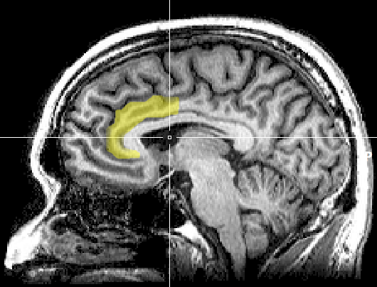
Notes:
https://upload.wikimedia.org/wikipedia/commons/1/10/MRI_anterior_cingulate.png
A note of caution right up front, however. There has been a lot of misapplication of neuroscience, or misinterpretation, to outright myths that have sprung up around this area of study. Often a minor research result gets blown up into a complex model of application that is touted as being "proven by science," when the original research might only have suggestive implications. And according to one study, just by putting an image of a brain scan into my presentation, you’ll score it more credible!
Original image caption: There is evidence suggesting that the more the anterior cingulate cortex signals conflict, the more dissonance a person experiences and the more their attitudes may change.

Slide 59
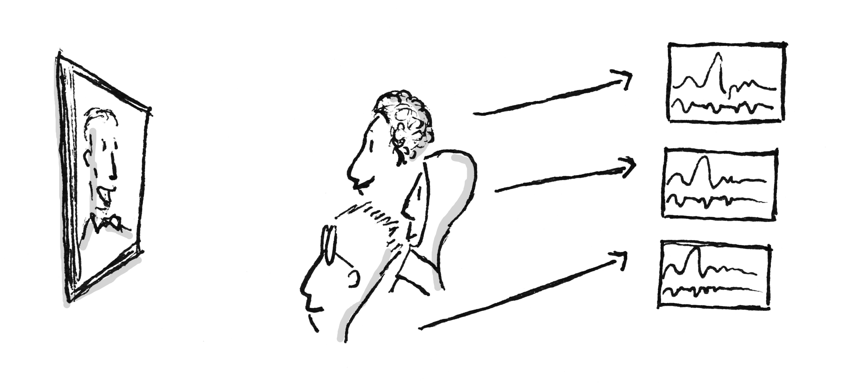

Slide 60
Notes:
Placeholder

Slide 61
Reflection
What was surprising?
What did you already know, but now see in a new way?
What new questions do you have?

Slide 62
Reflection
What was surprising?
What did you already know, but now see in a new way?
What new questions do you have?

